Slide 1
Machining Workshop 2026-2027
Week 1
Notes:
richard

Slide 2
01
Overview
Notes:
richard

Slide 3
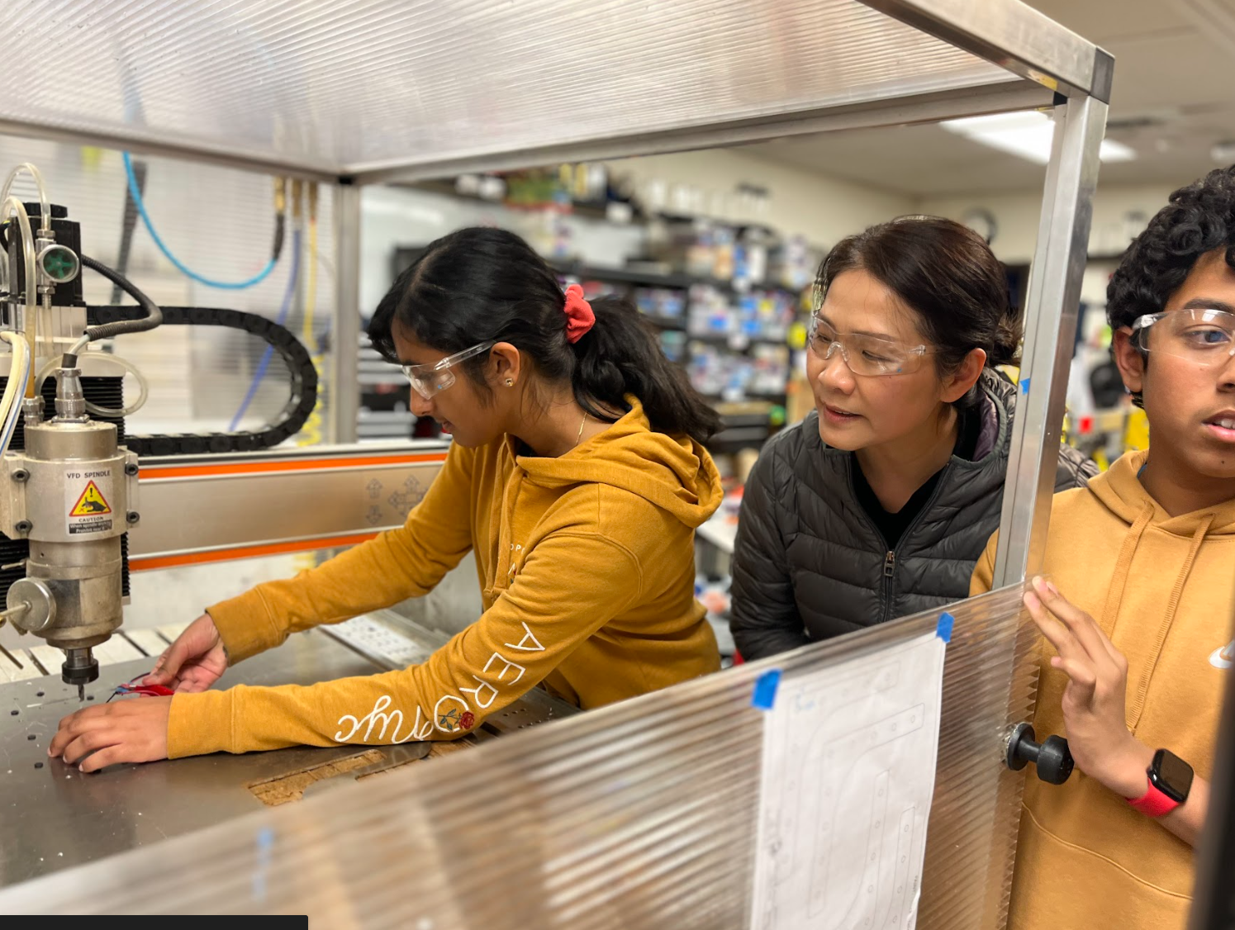
What is Machining?
Controlled process of material-removal
Cut materials to desired shape and size
Machine parts to build the robot
Notes:
Richard
At its core, machining is a controlled process of material removal where we cut raw stock down to a specific desired shape and size. In robotics, this is how we custom-fabricate the precise parts that bring our CAD models to life and build the physical robot.

Slide 4
02
Rules

Slide 5
The Ten Commandments of Machining
Thou shalt not commit stupid acts, and shalt ask if unsure.
Thou shalt listen to thy mentors.
Notes:
alice

Slide 6

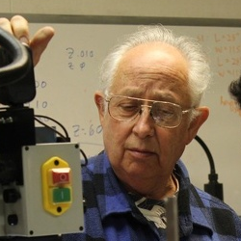
2. Thou shalt listen to thy mentors
Mr. David Giandomenico
Joined 2004
Mr. Ralph Lowd
Joined 2010
Notes:
alice

Slide 7
The Ten Commandments of Machining
Thou shalt not commit stupid acts, and shalt ask if unsure.
Thou shalt listen to thy mentors.
Thou shalt remember all the safety features of the shop.
Notes:
richard

Slide 8
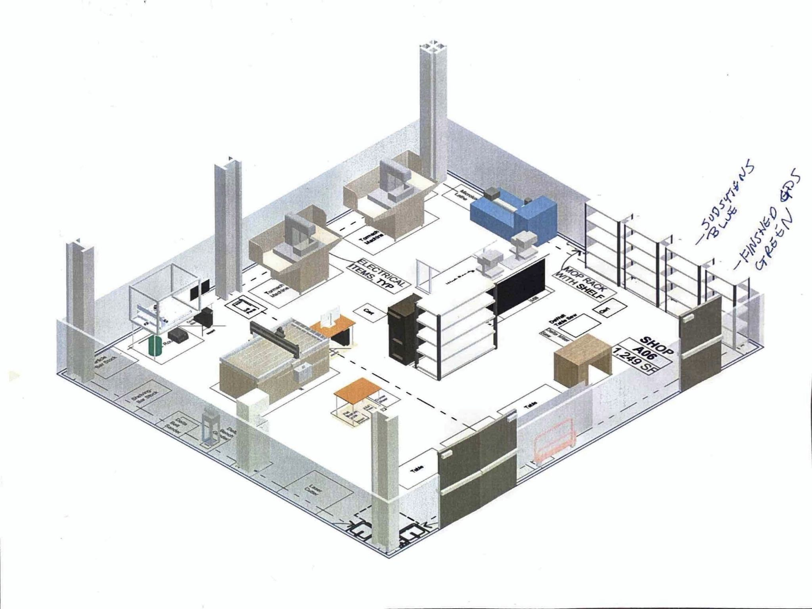
Fire Extinguisher
First Aid Kit
Safety Goggles
Notes:
Richard
We will go over where these items are located when we go to the shop later during the workshop.

Slide 9
The Ten Commandments of Machining
Thou shalt not commit stupid acts, and shalt ask if unsure.
Thou shalt listen to thy mentors.
Thou shalt remember all the safety features of the shop.
4. Thou shalt not distract others.
5. Thou shalt remember to clean up after thyself.
Notes:
alice

Slide 10

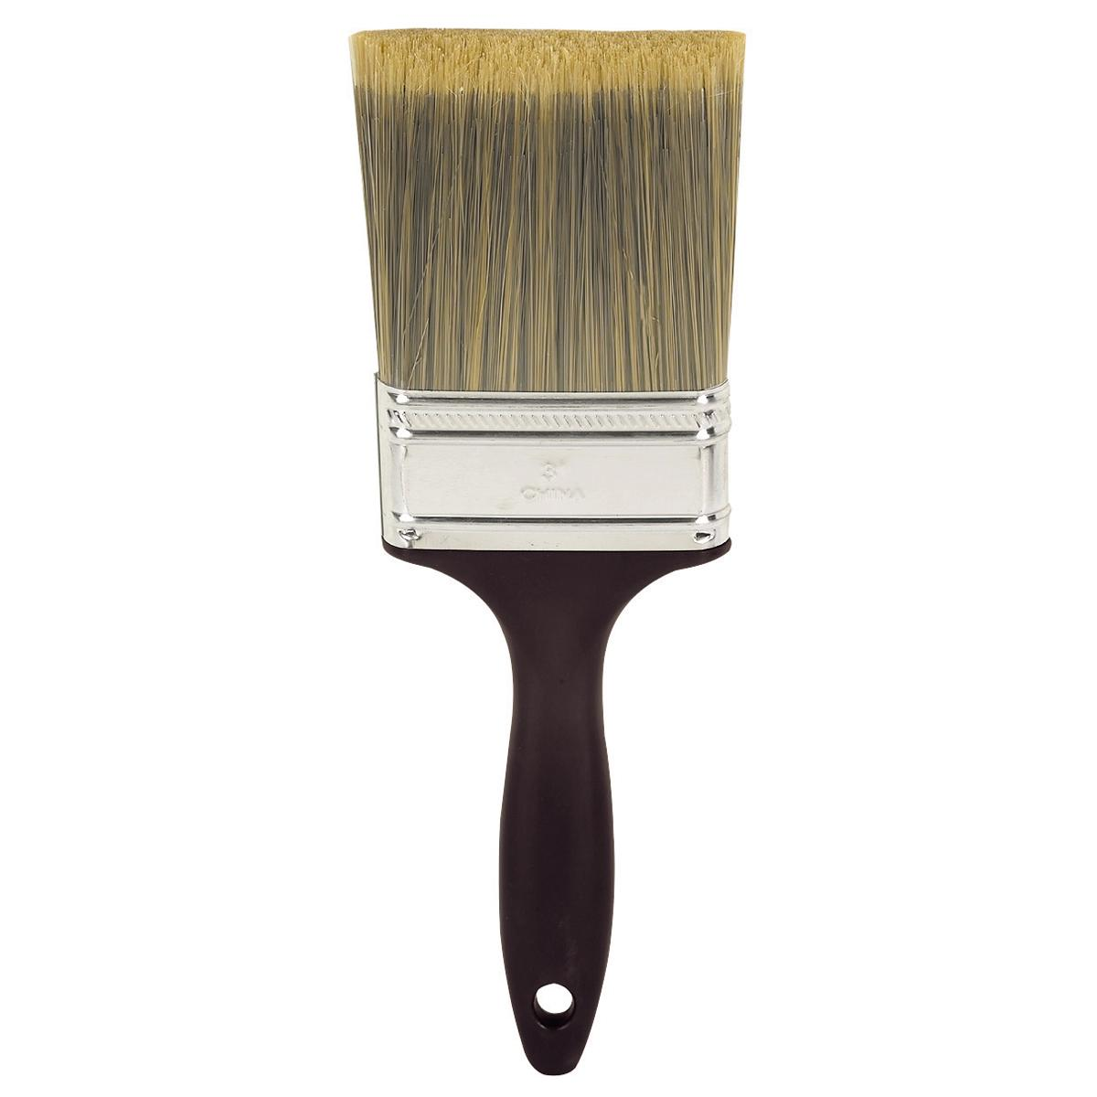
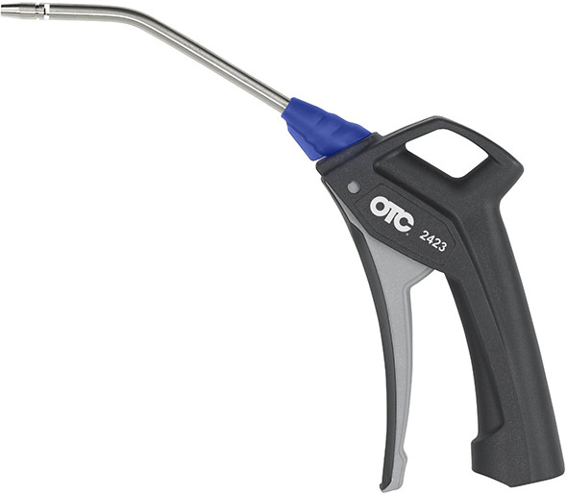
Notes:
alice
* expectations clean shop
never use bare hands
Use compressed air and brushes to clean off metal shards/wood dust
don’t blow directly into machine
as it can force the chips further into the machines
Vacuum the shop at the end
check for screws or nails on the ground
be sure to pick them up before vacuuming
Always clean up all tools you use
put them back

Slide 11

Funky Pants
https://funkyparts.vercel.app/
Password - Banana846
Notes:
alice

Slide 12
The Ten Commandments of Machining
Thou shalt not commit stupid acts, and shalt ask if unsure.
Thou shalt listen to thy mentors.
Thou shalt remember all the safety features of the shop.
Thou shalt not distract others.
Thou shalt remember to clean up after thyself.
Thou shalt wear proper attire.
Notes:
richard

Slide 13


Safety glasses
No drawstrings
Rolled-up sleeves
Closed-toed shoes
Notes:
Richard
Bring up a volunteer
Make sure long hair is tied up above your shoulders

Slide 14
The Ten Commandments of Machining
Thou shalt not commit stupid acts, and shalt ask if unsure.
Thou shalt listen to thy mentors.
Thou shalt remember all the safety features of the shop.
Thou shalt not distract others.
Thou shalt remember to clean up after thyself.
Thou shalt wear proper attire.
Thou shalt always double-check thy work.
Notes:
Alice

Slide 15
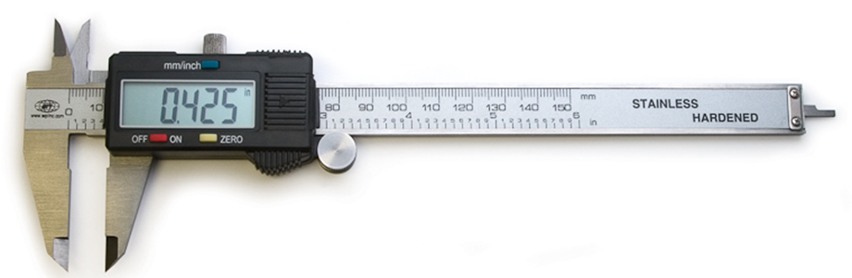
Caliper
2. Inner diameter/Width of openings
3. Depth
4. Step Height (between surfaces)
1. Outer diameter/Width of objects
Notes:
alice

Slide 16
The Ten Commandments of Machining
Thou shalt not commit stupid acts, and shalt ask if unsure.
Thou shalt listen to thy mentors.
Thou shalt remember all the safety features of the shop.
Thou shalt not distract others.
Thou shalt remember to clean up after thyself.
Thou shalt wear proper attire.
Thou shalt always double-check thy work.
Thou shalt correctly distinguish tools.
Notes:
richard

Slide 17
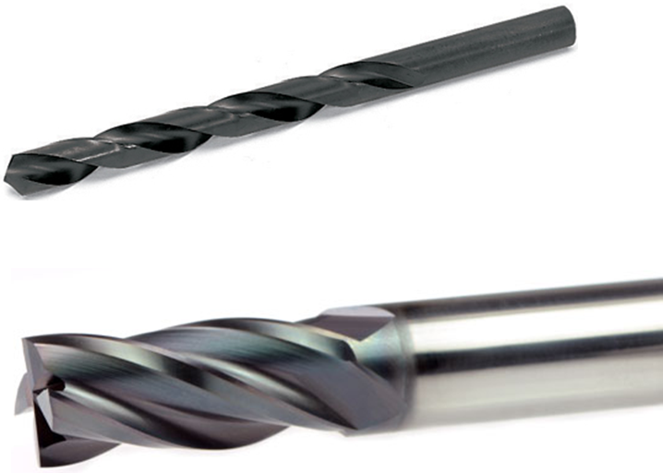
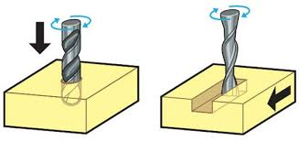
Drill v.s. Endmill
Notes:
Richard
Ask for the difference from audience
A drill bit is designed for making round holes by cutting only at its tip, while an end mill is designed for cutting sideways and downwards to shape slots, profiles, and flat surfaces
Cutting Direction: Drill bits move straight down. End mills move both vertically and sideways
Cutting Edges: Drill bits have cutting edges restricted to the conical tip. End mills have sharp cutting flutes along their sides and often across the bottom (end-cutting).
Flute Design: Drill flutes are engineered mainly to clear out stock as the tool plunges deep. End mill flutes are made to handle strong sideways forces and cut material horizontally.
Hole Quality & Bottom Shape: Drills leave a conical (pointed) bottom in a blind hole. Center-cutting end mills can leave a flat-bottomed hole.

Slide 18
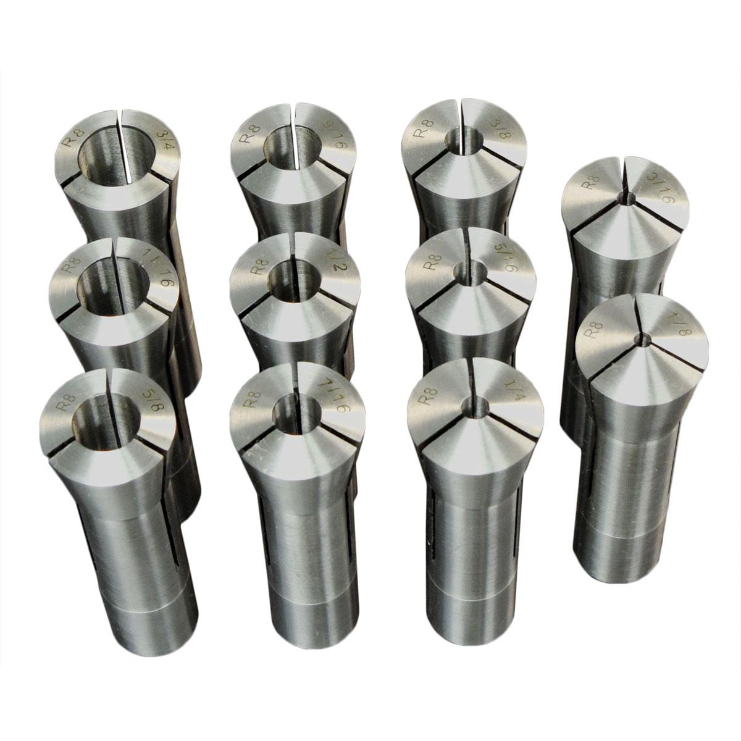
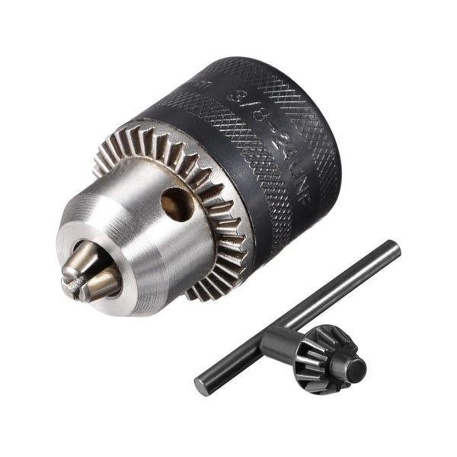
Chuck vs. Collet
Notes:
richard
Chuck – drilling
Multiple sizes in one collet, adjustable
3 jaws, less grip on drill
Collet – end mill
One size end mill for each collet
Holds tighter for better resistance against sideways pressure
Holding Method: Drills are typically secured in a drill chuck. End mills are held in rigid collets to resist sideways pressure.

Slide 19
The Ten Commandments of Machining
Thou shalt not commit stupid acts, and shalt ask if unsure.
Thou shalt listen to thy mentors.
Thou shalt remember all the safety features of the shop.
Thou shalt not distract others.
Thou shalt remember to clean up after thyself.
Thou shalt wear proper attire.
Thou shalt always double-check thy work.
Thou shalt correctly distinguish tools.
Thou shalt operate machines at a safe speed.
Notes:
richard

Slide 20
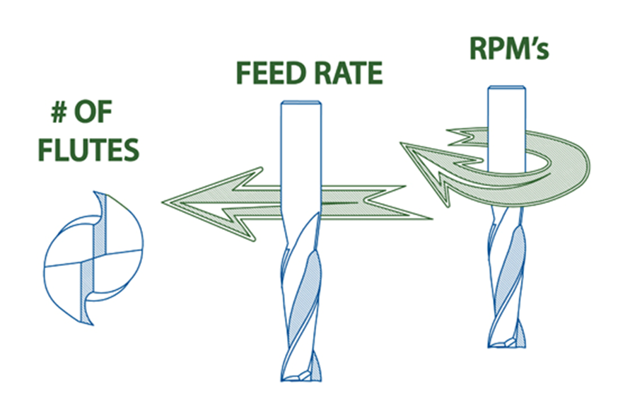
Notes:
Richard
# Flutes: flutes are the individual cutting edges carved into the tool. A tool with more flutes makes more cuts per single revolution, which affects chip clearing space and surface finish.
Feed Rate: this is the linear velocity at which the tool moves sideways through the workpiece we use surface feet per minute. Feeding too fast risks breaking the bit, while feeding too slowly can cause heat buildup and tool rubbing.
RPM: Ask for what rpm stands for (Revolutions per minute) then,,,,, this is the rotational speed of the spindle and tool. It dictates how fast the cutting edge turns through the material.

Slide 21
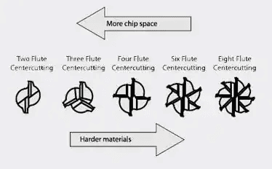
Notes:
Richard
Image of an endmill, ask audience to identify whether is drill bit or endmill
a center-cutting endmill can plunge directly down into solid material much like a drill bit before moving sideways to mill slots or pockets.

Slide 22
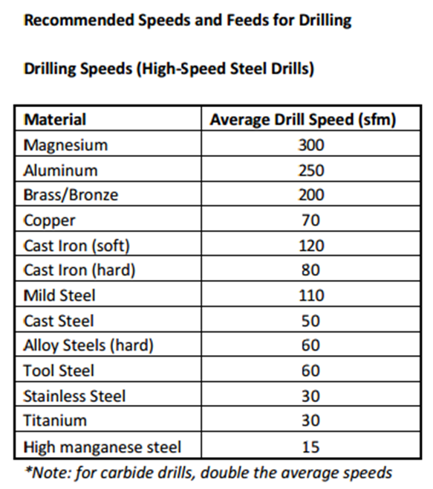
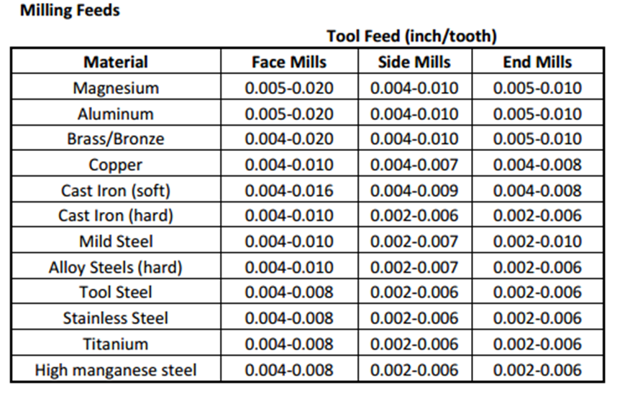
Notes:
Richard
Drilling Speeds:
Measured in Surface Feet per Minute (SFM) Softer materials like Aluminum tolerate high surface speeds around 250 SFM, whereas tough materials like Stainless Steel require much lower speeds around 30 SFM to avoid burning out the tool
Milling Feeds:
Measured in Inches Per Tooth. This dictates how thick of a chip each cutting edge shaves off per rotation.. For example, when end milling aluminum, a recommended chip load is between 0.005' and 0.010’ per tooth.
nrpm = (sfm × 12) ÷ (diameter × π)
Feed rate = (TF x Teeth x RPM)

Slide 23
rpm = (sfm × 12) ÷ (diameter * π)
Feed rate = (FPT x Teeth/Flutes x RPM)
circumference = π*diameter
distance per min(in/min) = π*diameter*RPM
sfm(ft/min) = π*diameter*RPM -> rpm = sfm × 12
12 diameter*π
SFM - surface feet per minute
FPT - inches per tooth, how much material removed in one pass
RPM - rotations per min (using degrees)
Notes:
alice

Slide 24
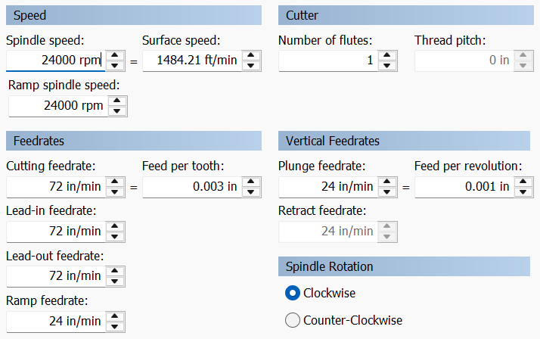
6mm (~0.2362 in), one flute, endmill
= rpm
feet per minute
search on internet
Hint:
cutting feedrate = lead-in feedrate = lead-out feedrate
Notes:
Richard
We have a single-flute 6 mm endmill running at 24,000 RPM with a feed per tooth of 0.003 inches
Ask audience to calculate the surface speed, cutting feedrate, lead-in feedrate, lead-out feedrate
1. Surface Speed
Step 1: Convert tool diameter from millimeters to inches.
6 mm / 25.4 mm per inch = 0.2362 inches
Step 2: Use the formula shown on the slide: Surface Speed = (pi * tool diameter * RPM) / 12 Surface Speed = (3.14159 * 0.2362 in * 24000 RPM) / 12 Surface Speed = 1,484 ft/min (SFM)
2. Cutting Feedrate
Step 1: Use the feedrate formula: Cutting Feedrate = Feed per tooth * Number of flutes * RPM Cutting Feedrate = 0.003 in/tooth * 1 flute * 24000 RPM Cutting Feedrate = 72 in/min
3. Lead-in Feedrate
Matches the cutting feedrate: 72 in/min
4. Lead-out Feedrate
Matches the cutting feedrate: 72 in/min

Slide 25
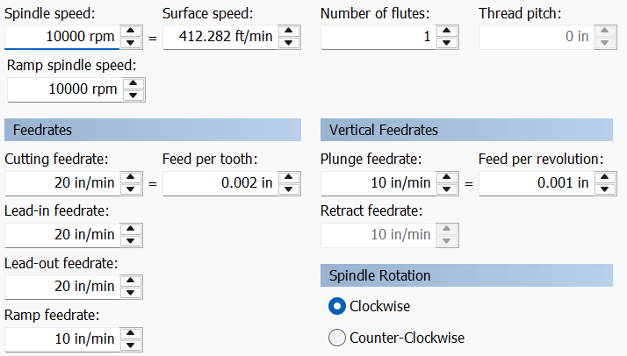
4mm, one flute, endmill
= rpm
=π*(tool diameter in inches)*RPM
12
search on internet
Feed rate = (FPT x Teeth/Flutes x RPM)
Hint:
cutting feedrate = lead-in feedrate = lead-out feedrate
Notes:
Alice
Surface Speed
Step 1: Convert tool diameter from millimeters to inches. 4 mm / 25.4 mm per inch = 0.1575 inches
Step 2: Use the formula shown on the slide: Surface Speed = (pi * tool diameter * RPM) / 12 Surface Speed = (3.14159 * 0.1575 in * 10000 RPM) / 12 Surface Speed = 412 ft/min (SFM)
Cutting Feedrate
Step 1: Use the feedrate formula: Cutting Feedrate = Feed per tooth * Number of flutes * RPM Cutting Feedrate = 0.002 in/tooth * 1 flute * 10000 RPM Cutting Feedrate = 20 in/min
Lead-in Feedrate Matches the cutting feedrate: 20 in/min
Lead-out Feedrate Matches the cutting feedrate: 20 in/min

Slide 26
The Ten Commandments of Machining
Thou shalt not commit stupid acts, and shalt ask if unsure.
Thou shalt listen to thy mentors.
Thou shalt remember all the safety features of the shop.
Thou shalt not distract others.
Thou shalt remember to clean up after thyself.
Thou shalt wear proper attire.
Thou shalt always double-check thy work.
Thou shalt correctly distinguish tools.
Thou shalt operate machines at a safe speed.
Thou shalt read machinist drawings properly.
Notes:
richard

Slide 27
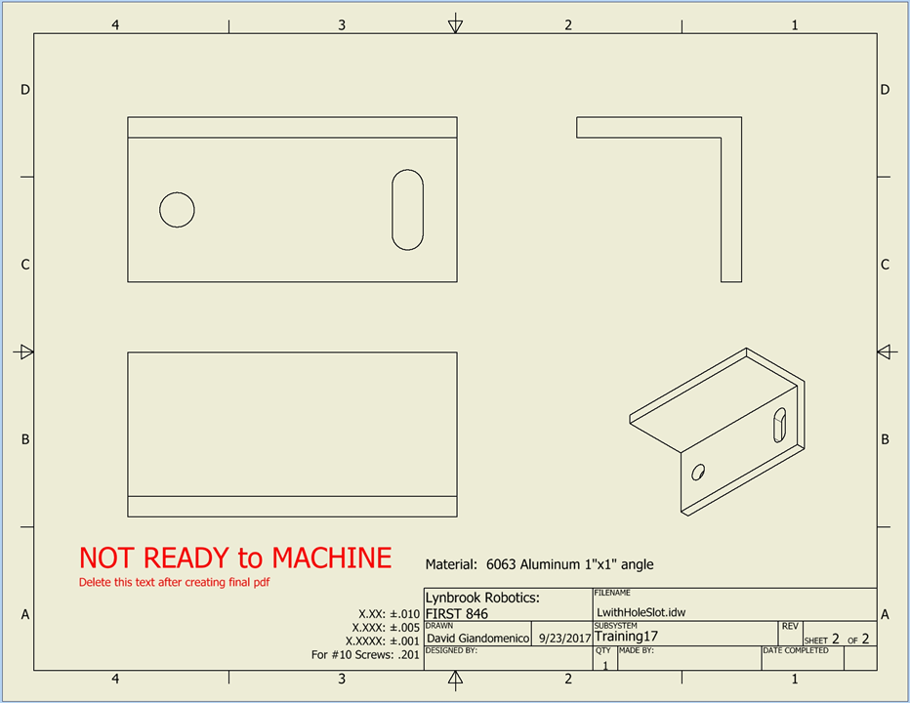
Notes:
alice

Slide 28
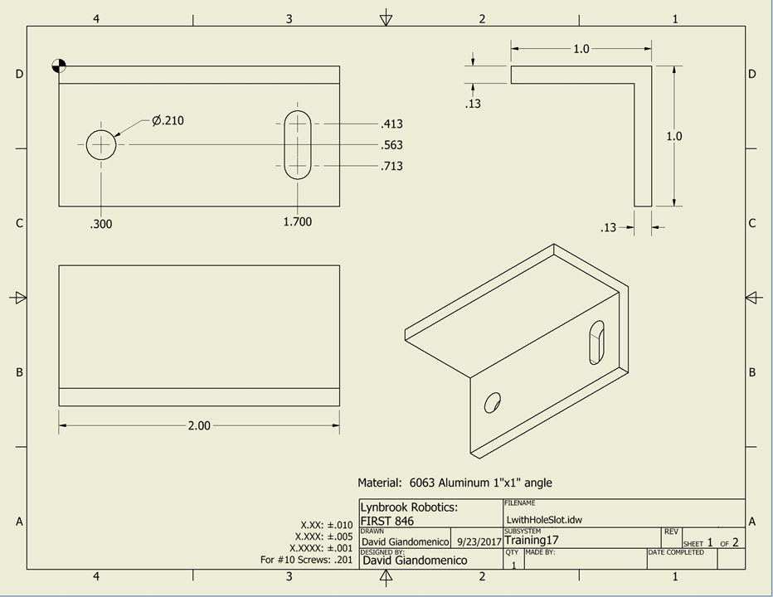
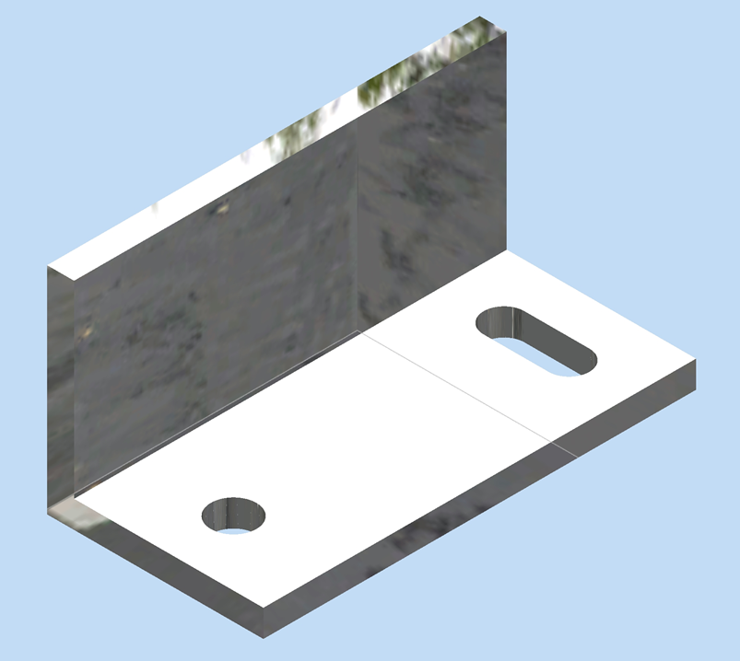
Notes:
alice
Top left - base view (top down view)
Others - projections (different angles)
Note precision table on the bottom
Shows how much over or under your cut can be
Sometimes the bounds can differ. For example, -0 and +0.010, indicating your cut should be at most 0.010 inch greater but not smaller than the indicated value
If you are unsure, ask the designer for clarification
If you are the designer, make it clear!

Slide 29
HOMEWORK
Please make sure to fill out the release form by next week!
https://lynbrookrobotics.com/forms/firstname-lastname-releaseform.pdf

Slide 30
Attendance
https://tinyurl.com/846fallWorkshops26

Slide 31
05
Shop Tour
Notes:
You will be using all the machines later on. Don’t worry if you missed it! :)

