Slide 1
Machining Workshop 2026-2027
Week 2
Notes:
richard

Slide 2
01
Machinist Drawings
Notes:
richard

Slide 3
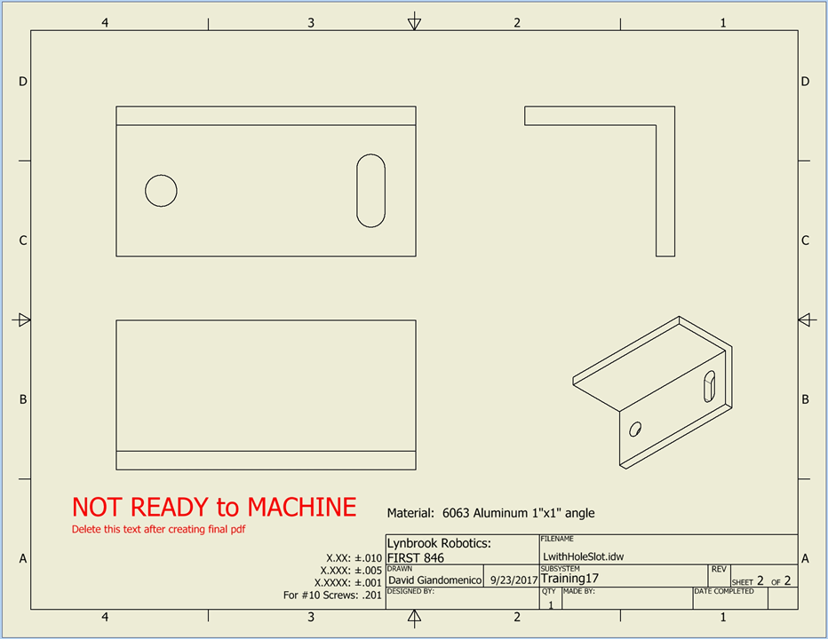
Notes:
alice

Slide 4
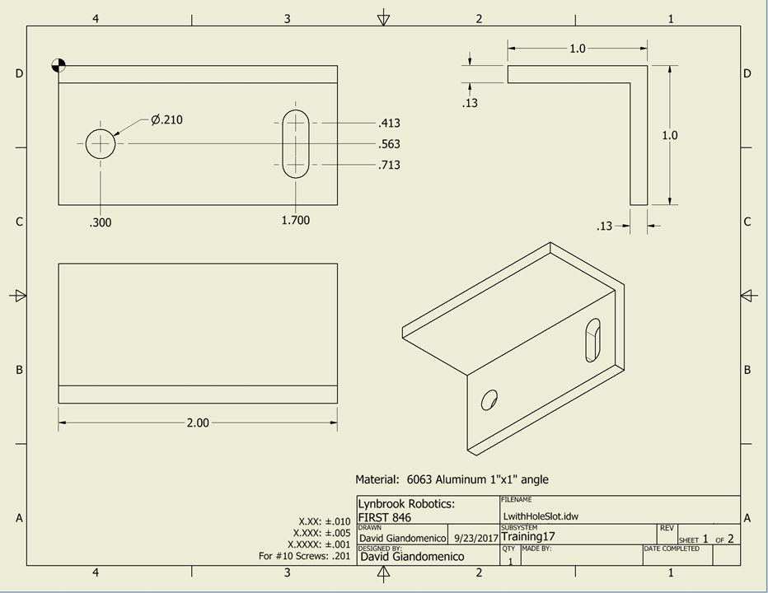
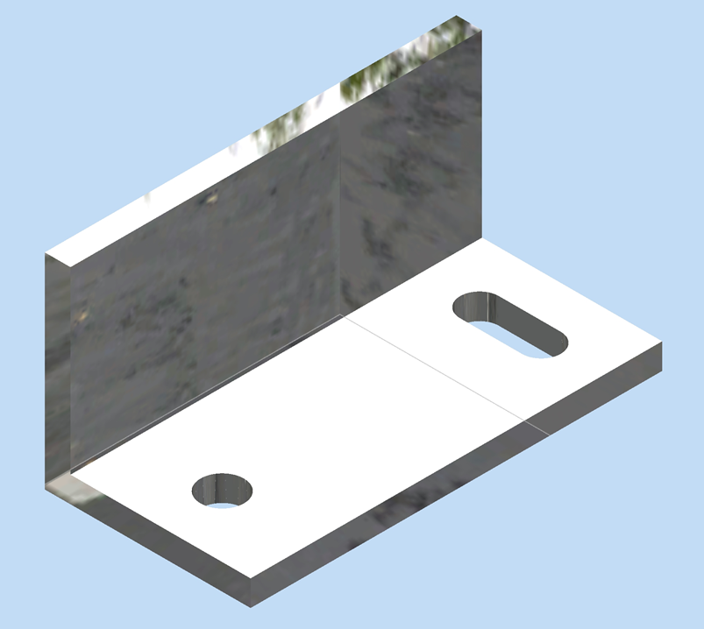
Notes:
alice
Top left - base view (top down view)
Others - projections (different angles)
Note precision table on the bottom
Shows how much over or under your cut can be
Sometimes the bounds can differ. For example, -0 and +0.010, indicating your cut should be at most 0.010 inch greater but not smaller than the indicated value
If you are unsure, ask the designer for clarification
If you are the designer, make it clear!

Slide 5
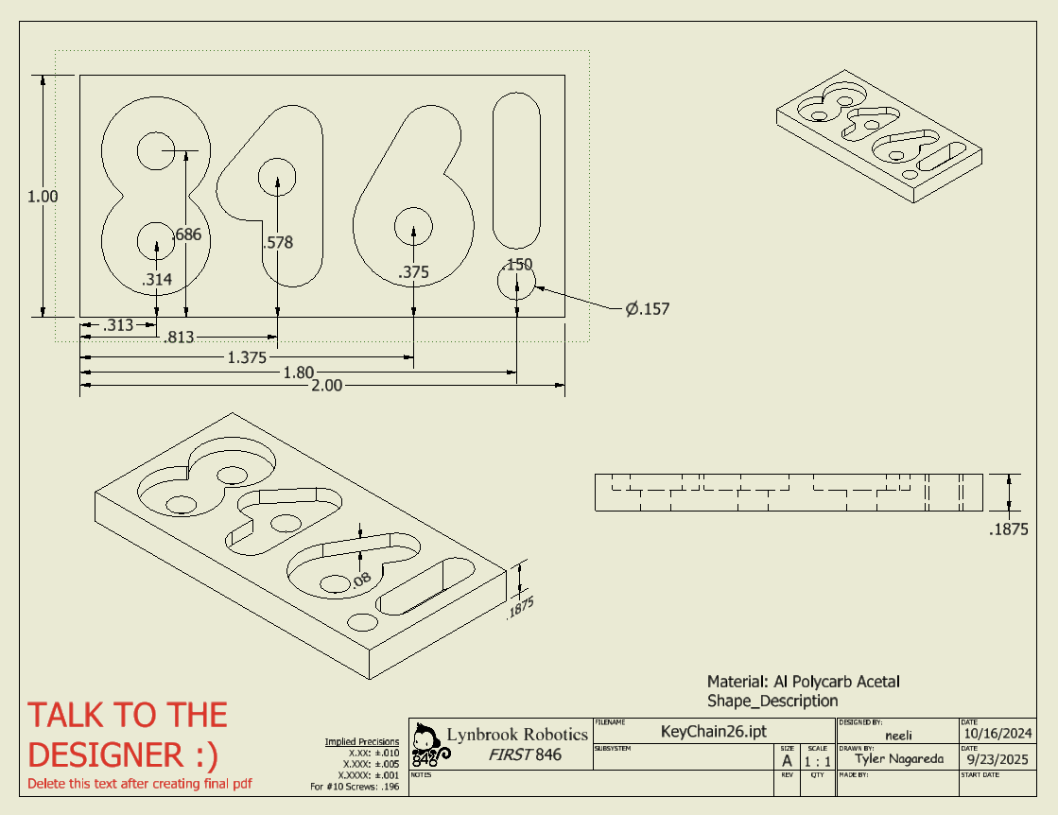
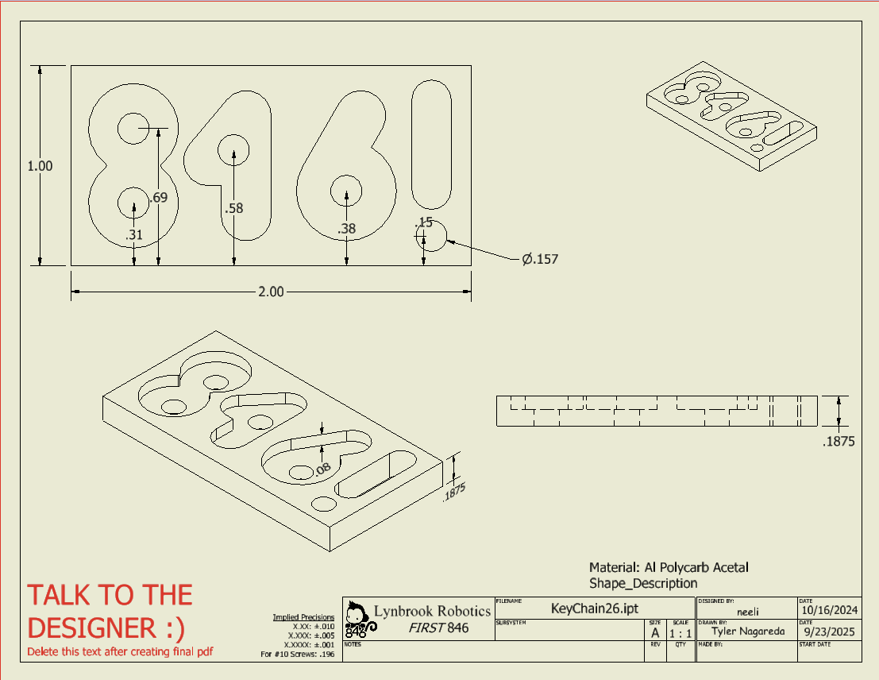
Notes:
richard

Slide 6
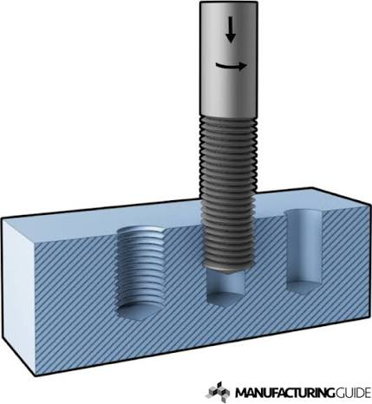
Tapping
the process of cutting threads inside a pre-drilled hole so that screws, bolts, and other threaded fasteners can fit securely
Notes:
alice
drill tap hole first( smaller than the screw outer diameter to leaver material for threading)
then tap cuts the internal threads
what could go wrong?
wrong tap drill size
too small - difficult to thread
too large - shallow threads
not aligned/clearing chips
back the tap out after a turns to make sure its aligned and to clear chips
forcing taps
taps r brittle and snap

Slide 7
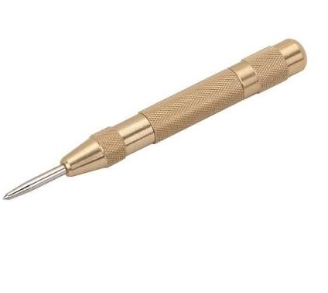
Center Punch
Tool to create a small dimple or indentation in materials like metal or wood to guide and prevent drill bits from "walking" or slipping off the targeted spot
Notes:
richard

Slide 8
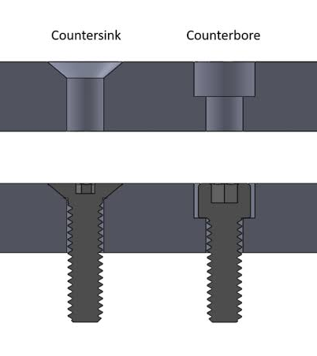
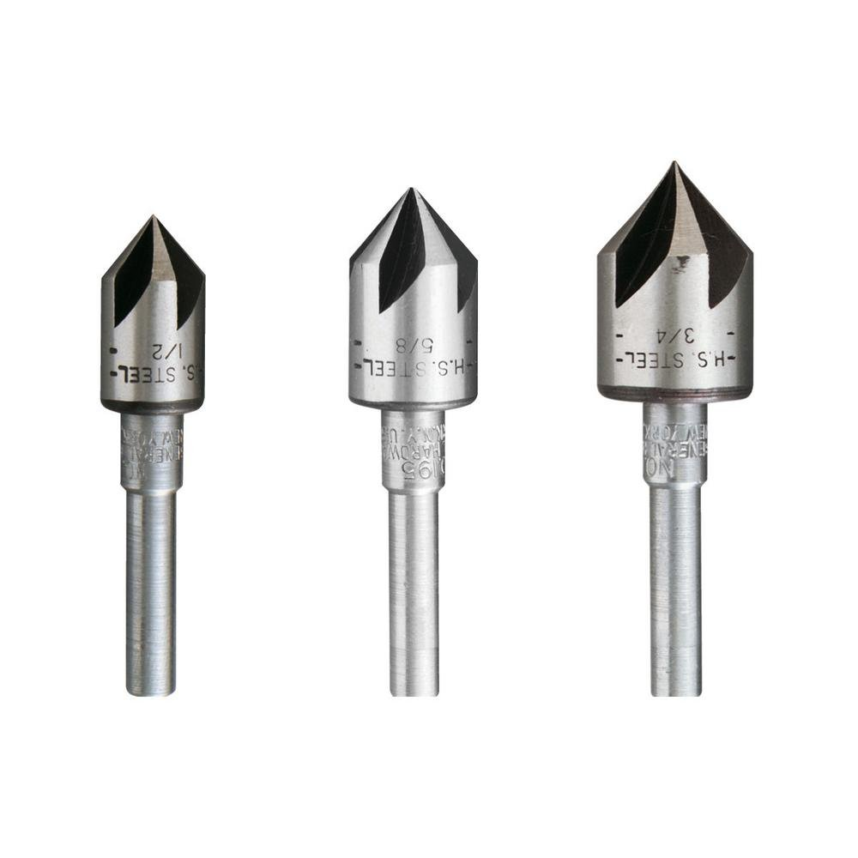
Countersink vs Counterbore
Countersink : a cone-shaped recess for flat-head screws to sit flush
Counterbores : a cylindrical-shaped recess for socket-heads and hex bolts to fit.
Notes:
alice
diff between counter sink and counter bore?
counter sink : angled
usually for screws to sit flushed
use countersinks to create recess
counterbore : flat at the bottom of the hole
for screws to sit flushed or below flush

Slide 9
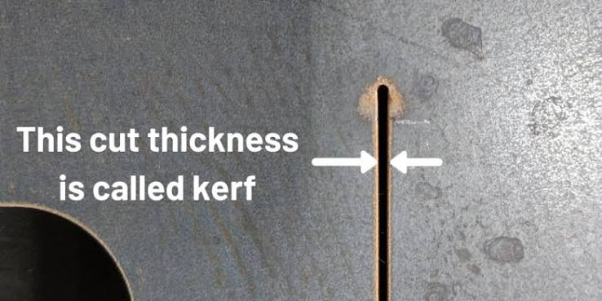
Kerf
the width of the slot or material removed by a cutting tool
Notes:
richard

Slide 10
Attendance
https://tinyurl.com/846fallWorkshops26

