Slide 1
Software Workshops
Week 1
Funky Monkeys

Slide 2
Important links
If you haven’t filled out the sign-up form:
https://tinyurl.com/softwarews26
Setup instructions:
https://github.com/Team846/2026-training

Slide 3
What’s FRC?
International competition
Design, build, wire, code a robot in 6 weeks
Each year is a different game
Compete in 3v3 based competitions

Slide 4
This year’s (2026) challenge
https://www.youtube.com/watch?v=_fybREErgyM
Some questions to consider:
What are the most important actions needed to be completed?
Potential Software complexities/challenges?

Slide 5
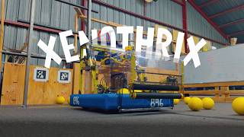
Robot Reveal Video
Our robot from this competition season
Competed at Oregon, San Francisco, and Aerospace District Events
Won Excellence in Engineering award at District Championships
Competed at Chezy Champs offseason competition last weekend !

Slide 6
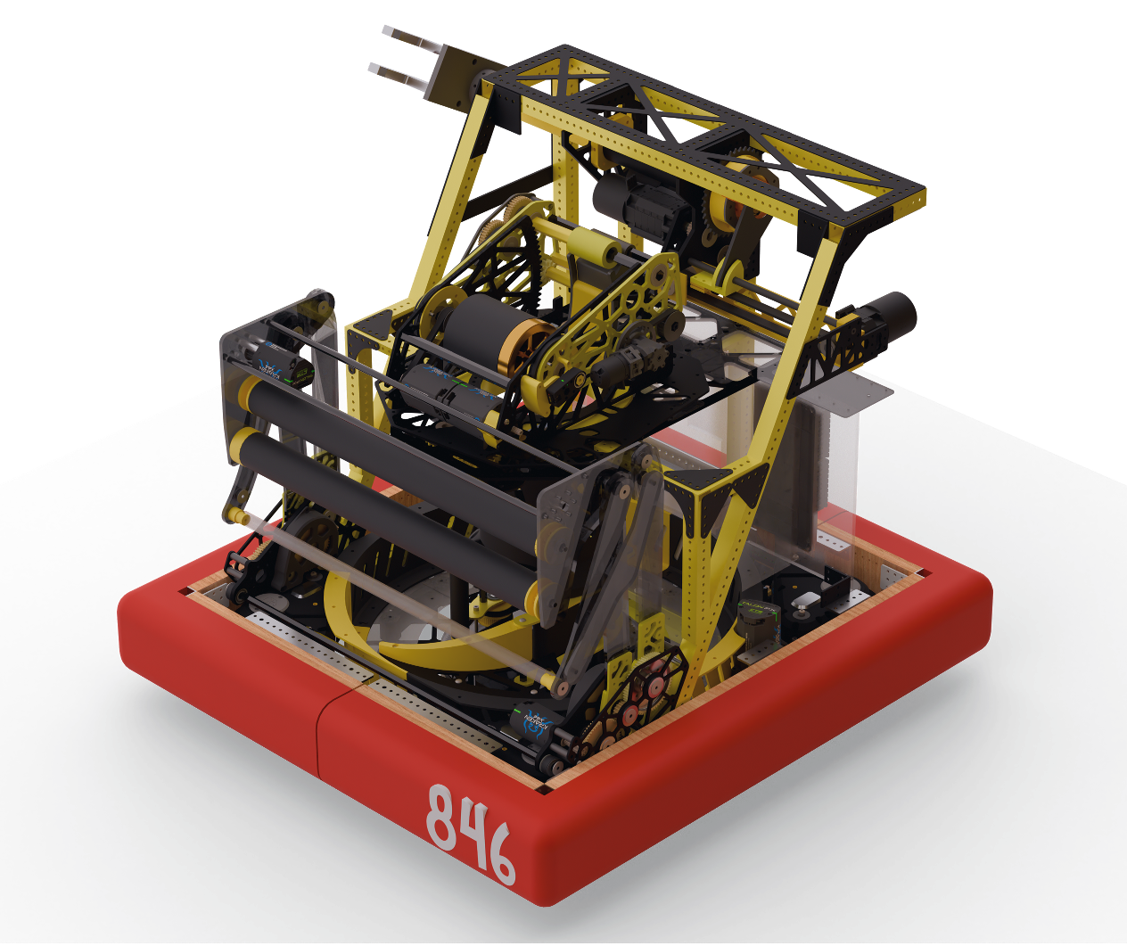
Our Robot
Hood
Shooter
Intake
Hopper
Drivetrain
Dye Rotor

Slide 7
Electrical Components
Overview
Notes:
Prakhar

Slide 8
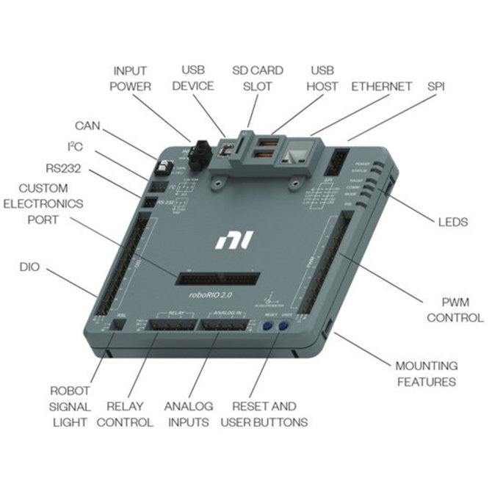
RoboRIO
Main robot controller
512 MB DDR3 (RAM)
Processor speed: 866 MHz
  8.66e+8 cycles per second!

Slide 9
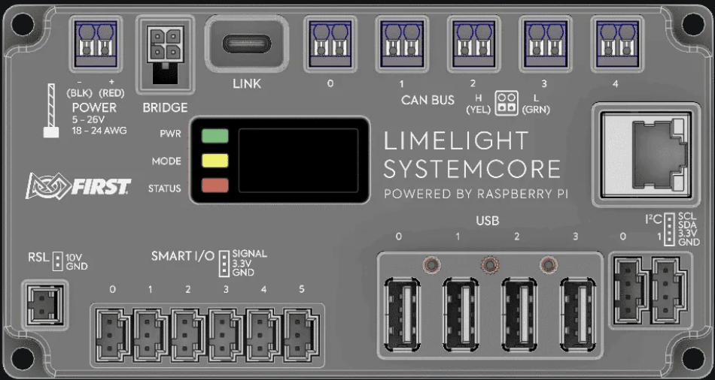
Systemcore (replacing roboRIO)
Powered by a Raspberry Pi (CM5)
Quad-core processor, 4GB RAM
Comes with CAN/Ethernet ports

Slide 10
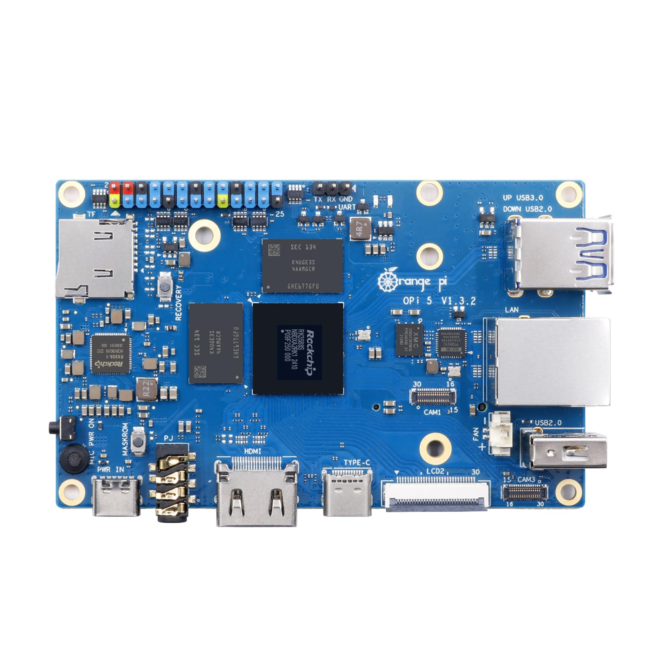
Orange Pi
4 GB (RAM)
Co-Processor to run other code
  April Tag vision
  Game Piece Detection

Slide 11
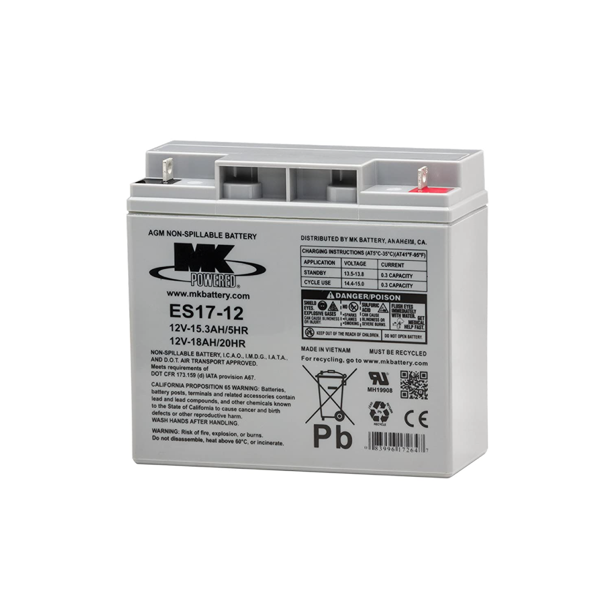
Battery
12 V battery
Has a + and - side
Safety: Make sure the wires are not cut
Watch on how to put battery in!

Slide 12
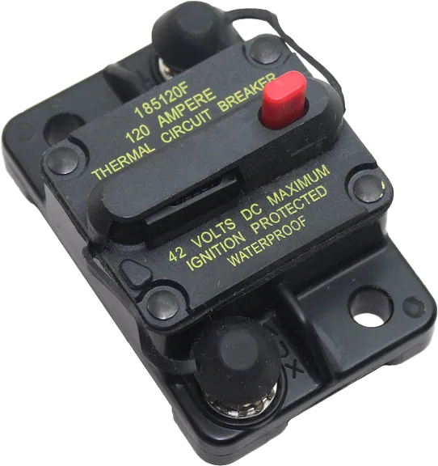
Circuit Breaker
Connects to Battery and serves as an on/off switch
Prevents robot from drawing too much current → safety mechanism

Slide 13
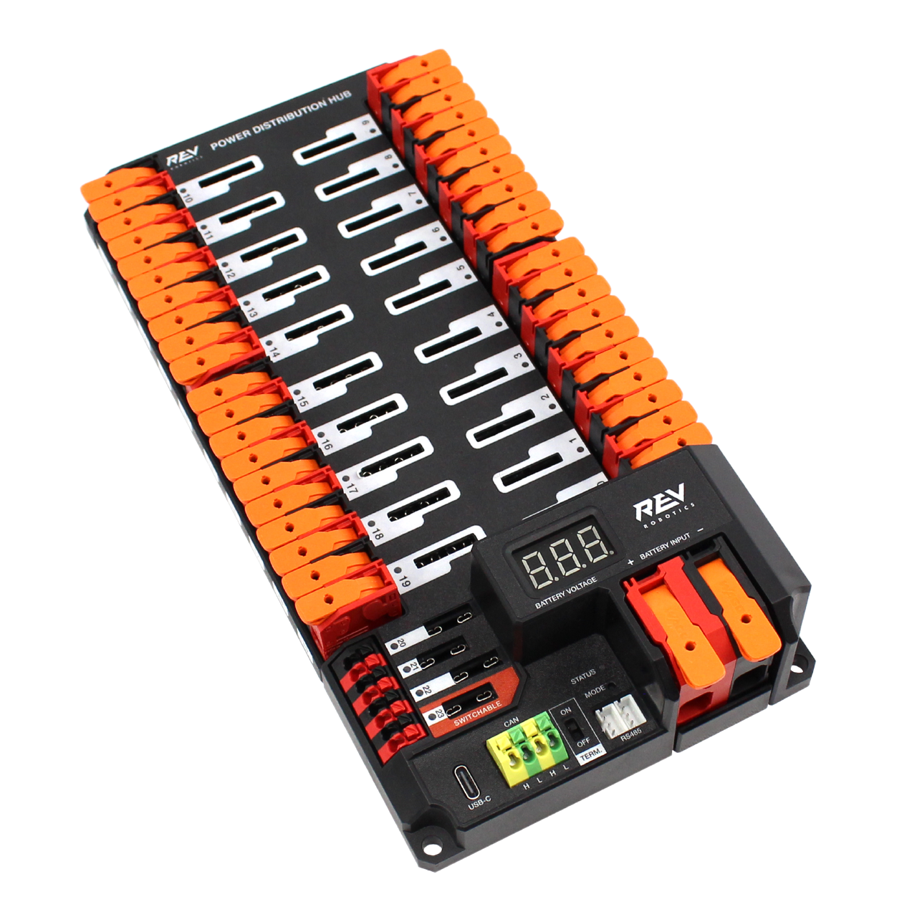
Power Distribution Hub
Power goes from circuit breaker to PDH
PDH distributes power amongst all other motors/devices

Slide 14
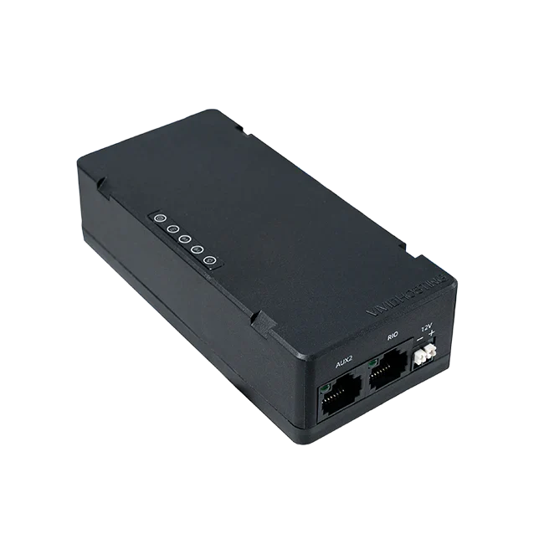
Radio
Allows us to connect to robot via WiFi or ethernet
Networks between roboRIO, Orange Pi, Driver Station

Slide 15
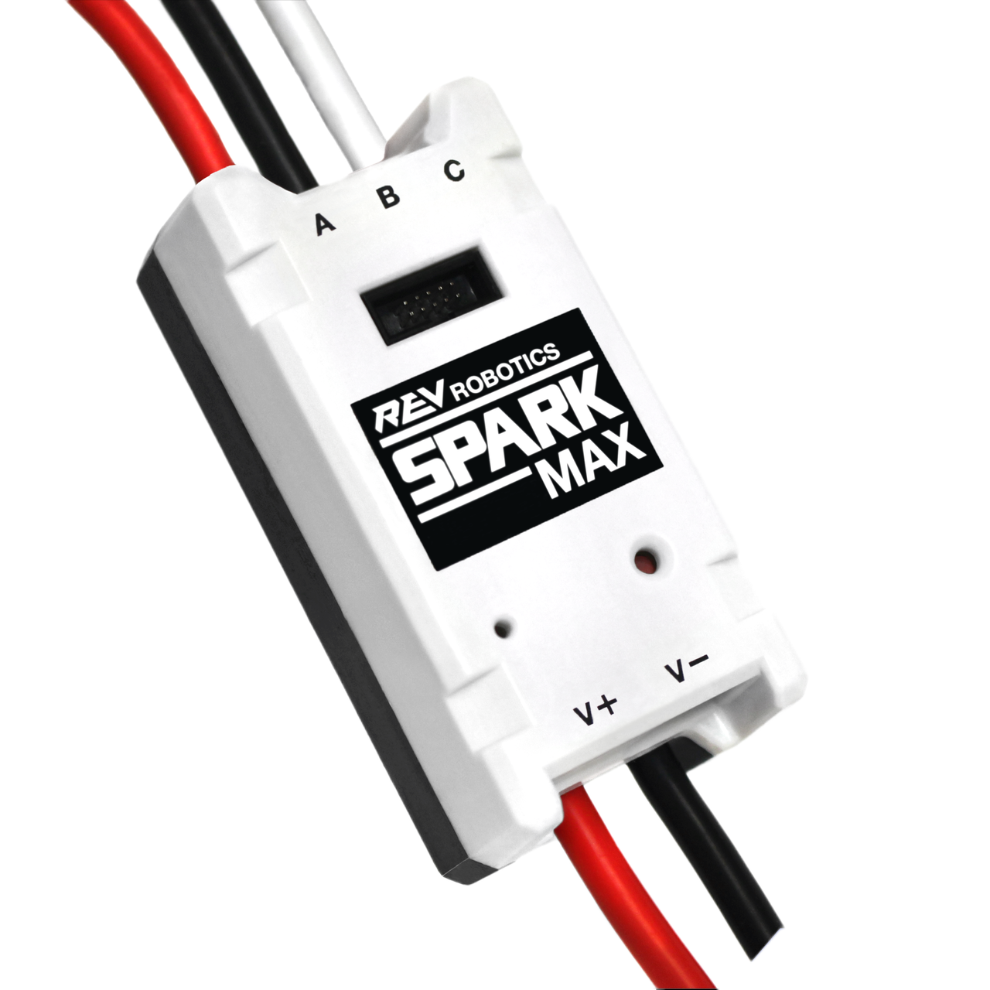
Motor Controllers
Takes input from roborio
Gives output to motors
Accessed through code instead of writing directly to motor

Slide 16
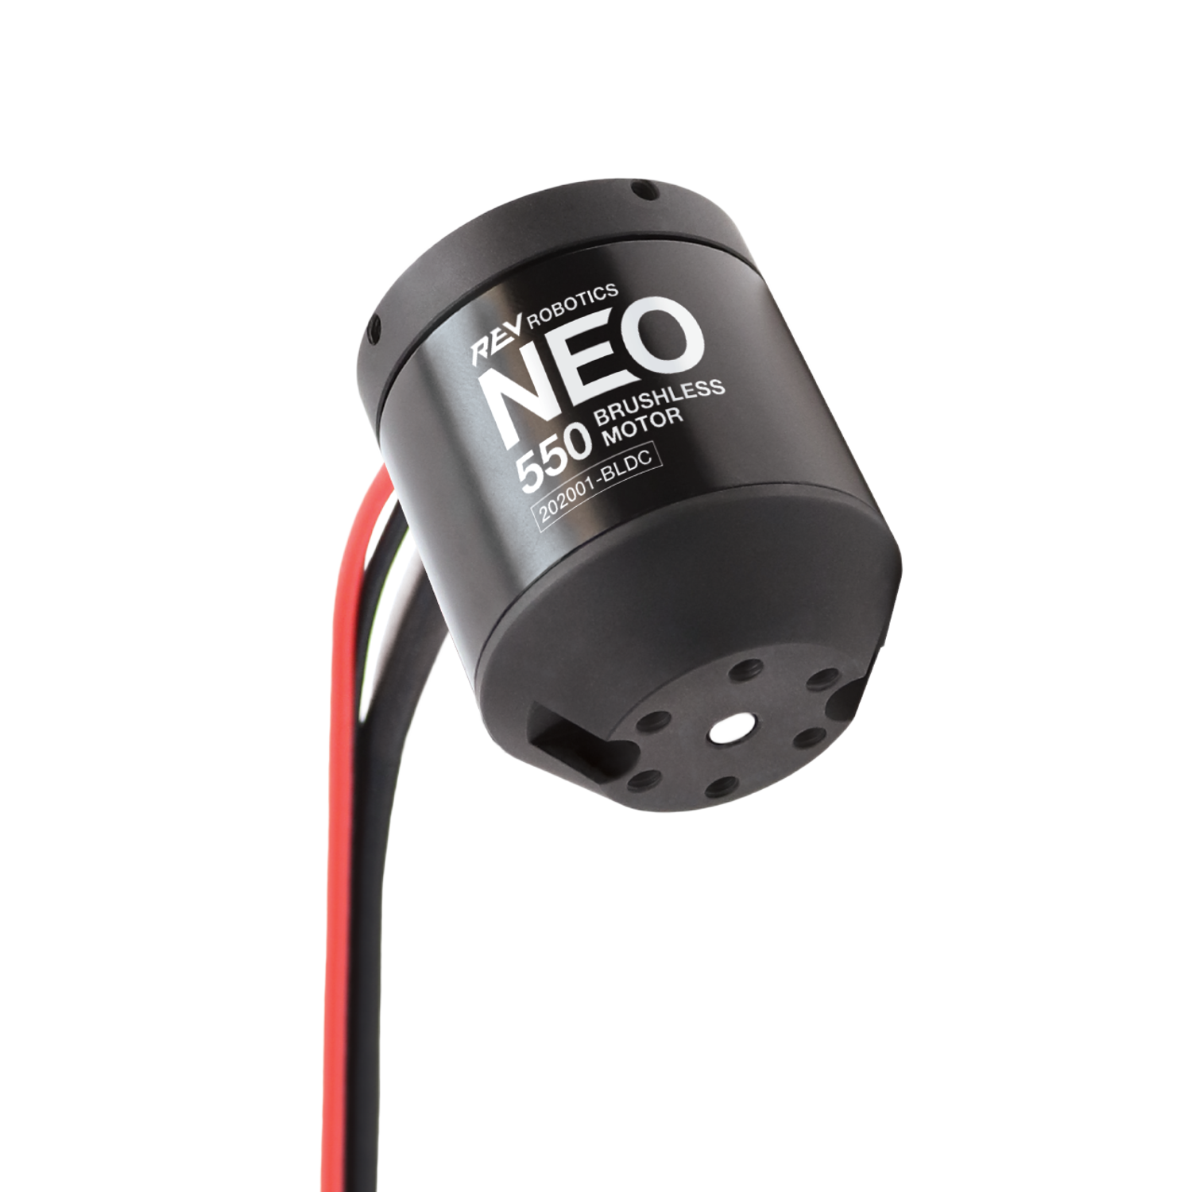
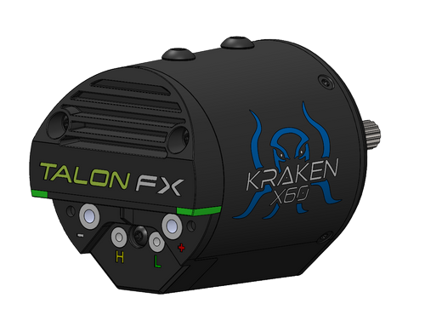
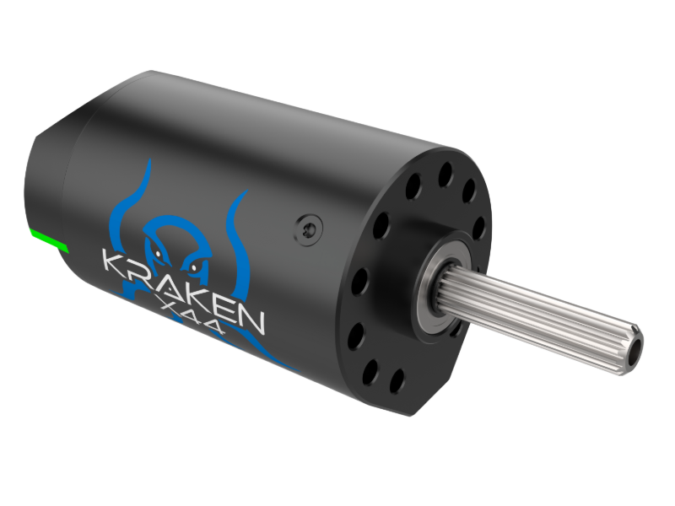
Motors
Kraken X60
Kraken X44
Neo 550s

Slide 17
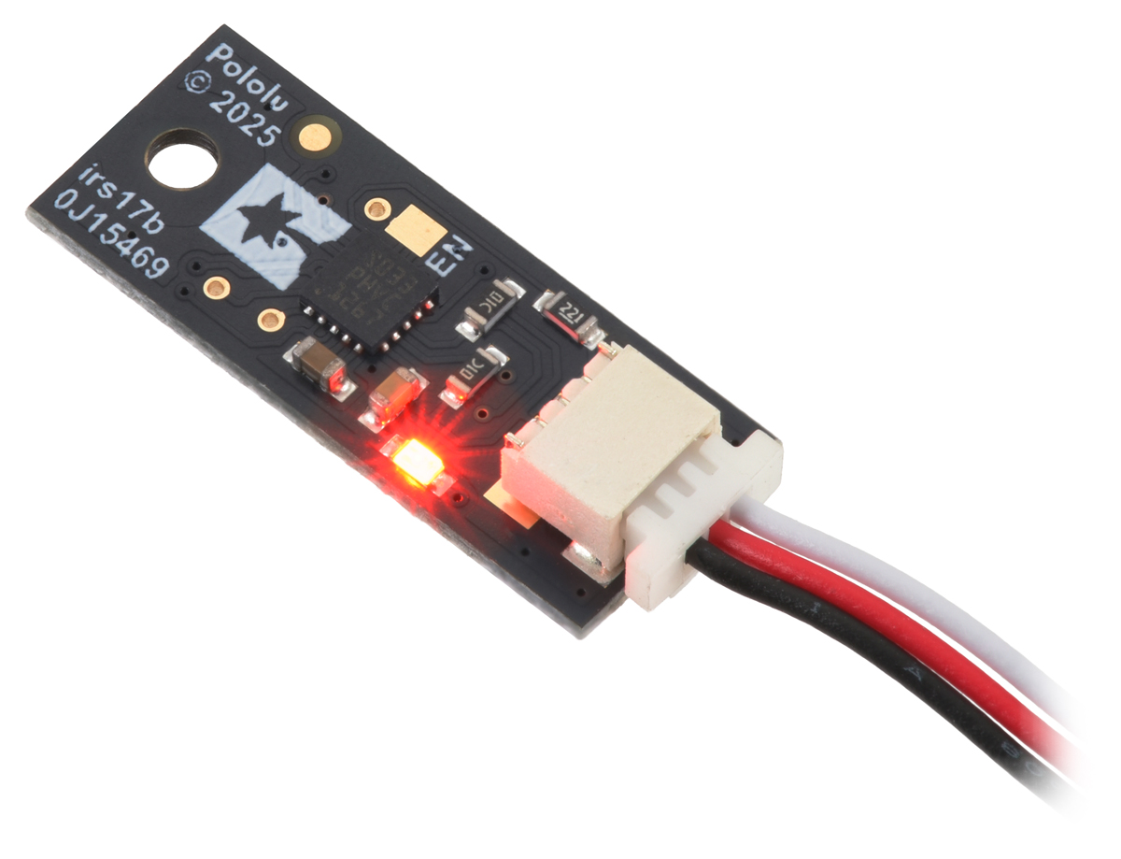
Digital Distance Sensor
Tells you if an object is within some distance
  Detecting game pieces

Slide 18
Introduction
to
Code

Slide 19

Git

Slide 20
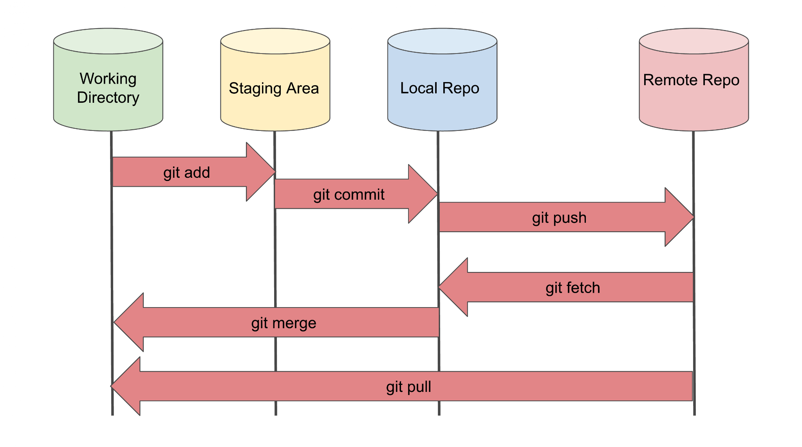
Git

Slide 21
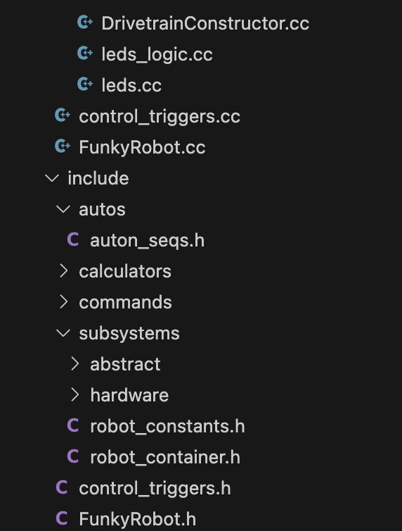
Header Files (.hpp, .h) and Code Class Files (.cc, .cpp)
Header
  Describe function types
  Define classes and structs
Code Class files
  build on top of header files, contain actual logic/implementation
  reference corresponding header files with #include
  Example: #include “example.h”
#include also used to access functions from libraries
  Example: #include <iostream>
    Allows you to call standard functions

Slide 22
C++ Challenge 1
Mr. J has an incomplete struct that represents a 2D vector. Complete it so it has the following functionalities:
Dot product
Subtract
Add
Angle from +x (in positive degrees)
Magnitude
Once done, submit your code here: https://frc-846-lms.vercel.app/

Slide 23
C++ Challenge 2
Write code that converts a double representing meters to either ft, in, lightyears, cm, or mm depending on the target state. Feel free to search up the conversions!
Once done, submit your code here: https://frc-846-lms.vercel.app/

Slide 24
C++ Challenge 3
Code that returns all a std::vector of permutations of words that can be made using some string, provided that it is 5 letters long (Include duplicates, ex. There should be two “robot” words).
Once done, send your completed code to us.
The first working code wins!!
One of the test words could be the wordle answer…
Notes:
Remove kinda unnecessary

Slide 25
Attendance
tinyurl.com/monkeyworkshops26

Slide 26
Review
kahoot!

