Slide 1
Software
Week 2
26 Software Leads

Slide 2
Agenda
Units in code
What are subsystems in code?
FRC Testing Software
Writing LED code
Review Kahoot

Slide 3
Units

Slide 4
Units (non-frc)
We represent quantities such as distance, velocity, etc. with units
Important to label units
  To remove confusion as to whether a quantity is in inches, feet, meters, etc.
Our conventions
  Length: Imperial
  Angles: Degrees
  Velocity: Feet per second
Notes:
The Mismatch: Spacecraft builder Lockheed Martin provided thruster performance data in imperial units (pound-force seconds).
The Assumption: NASA's Jet Propulsion Laboratory expected the numbers to be in metric units (newton-seconds).
The Result: The navigation software miscalculated the spacecraft's trajectory, causing it to fly way too close to Mars.

Slide 5
WPILib Units
WPILib (general frc framework) provides classes to represent units
Avoids confusion on the units of different numbers (is this in meters or inches?)
Referenced as:
  instances: units::meters_per_second_t speed{5.0}
  literals: 5_mps

Slide 6
PDCSU Units
Team 846-specific units framework
Works similarly to WPILIB units, but compiles faster and contains additional safety
Referenced as:
  instances: pdcsu::units::meters_per_second_t speed{5.0} (same)
  literals: 5_mps_ (trailing underscore)

Slide 7
Unit operations
Operations work intuitively
Ex.
  1_ft / 1_s = 1_fps
  1_ft + 1_s = Compilation error
Units will automatically cast to a different type if compatible (same kind of measurement)
Ex.
  units::foot_t x = 12_in; // this will work
  units::second_t x = 12_in; // this will not compile

Slide 8
Subsystems

Slide 9
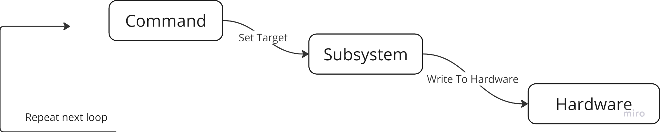
Subsystems and Commands
Subsystems represent collections of robot hardware - complete one function
Commands represent actions the robot can take, sets a target for subsystem
Commands control subsystems, subsystems control hardware.

Slide 10
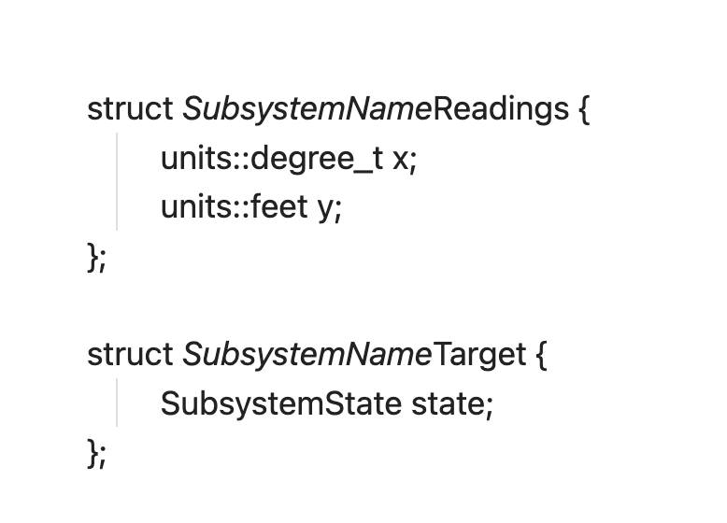
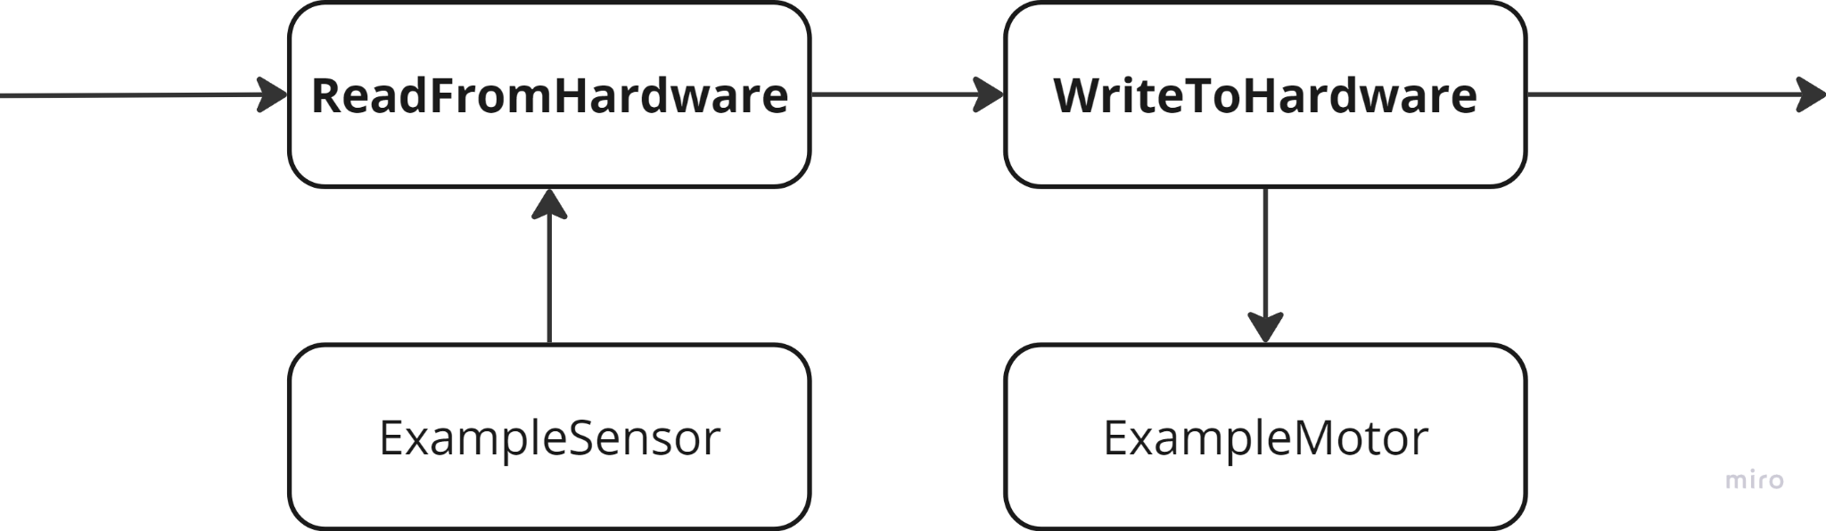
What is a subsystem?
Each subsystem is represented by a class
Interacts with hardware by writing and reading from it
Holds a target and a readings struct
Notes:
Writes to subsystem hardware with the latest target output
Fetches and return new readings

Slide 11
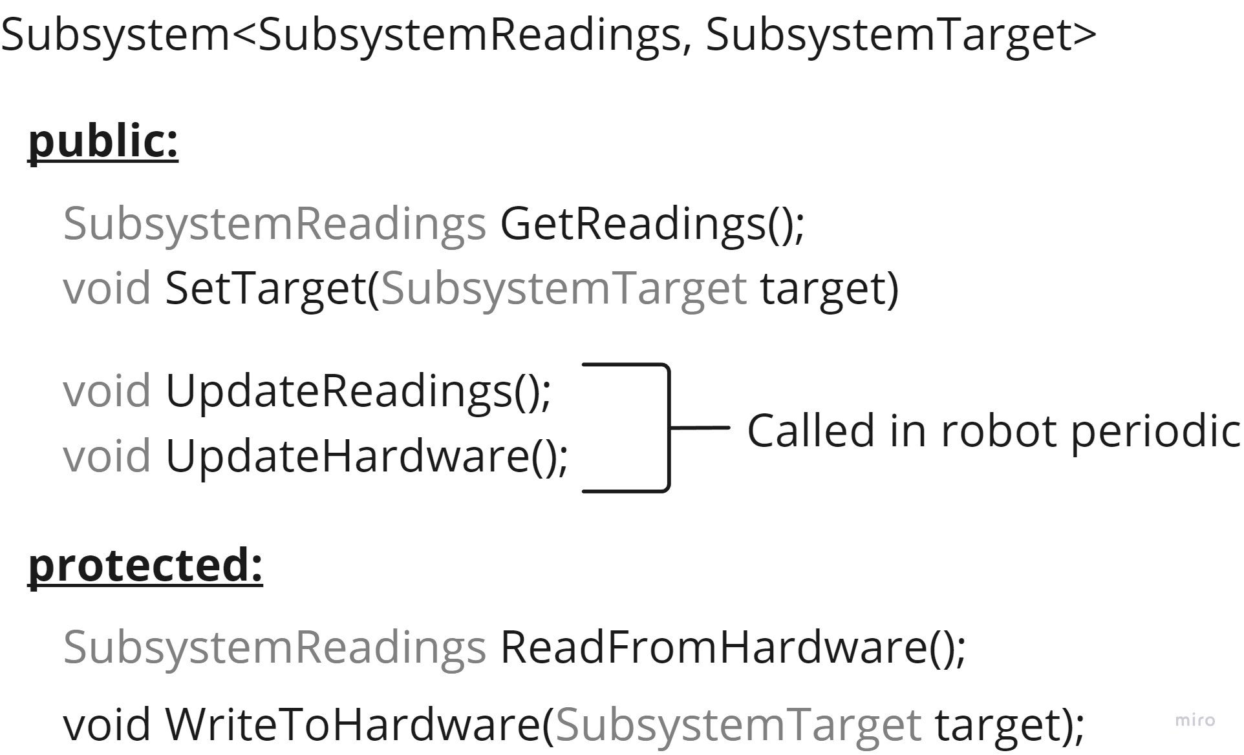

Slide 12
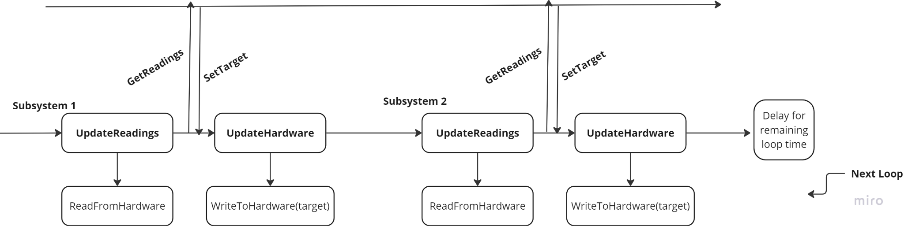
Periodic – When are Read/Write called?
Robot code loops every 20 ms

Slide 13
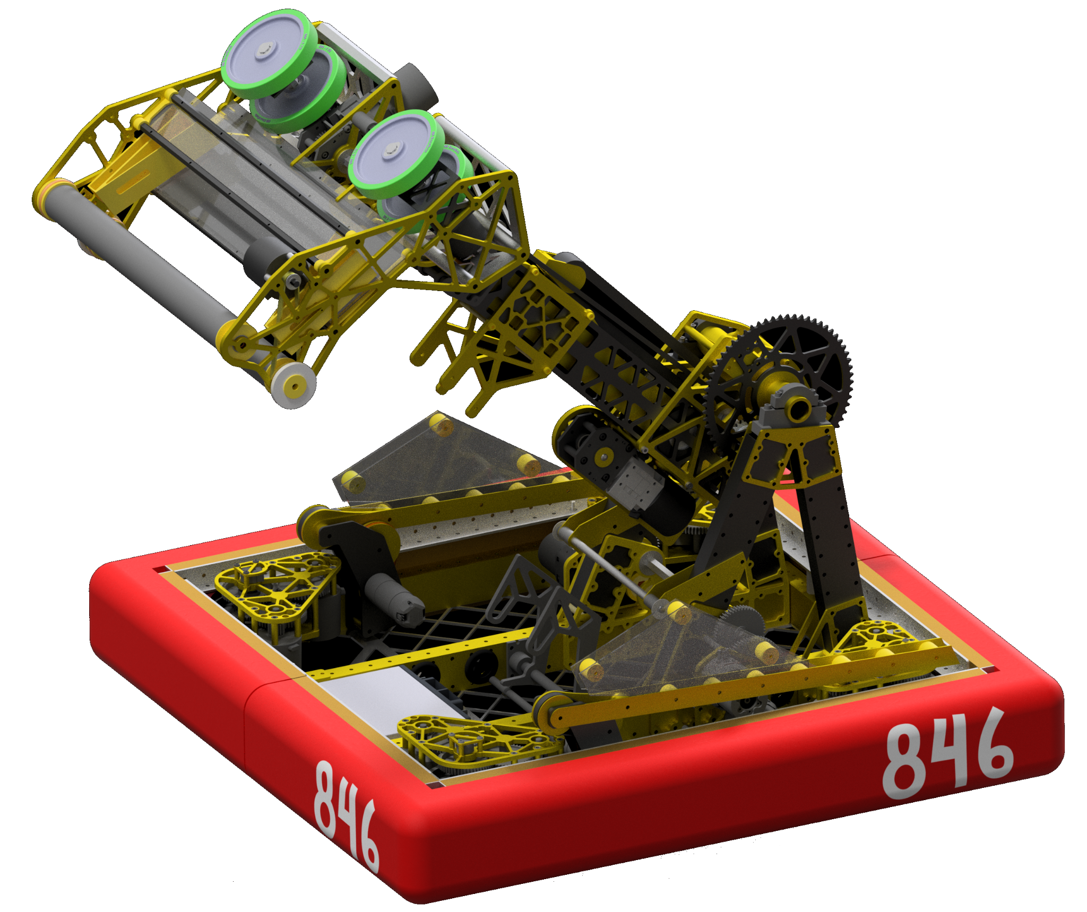
Let’s take an example – Pivot
What do we need to control it?
  We need to know its position
  We need to know its velocity
What do we want to tell the hardware?
  What position to go to

Slide 14
So how can we code the pivot?
struct PivotReadings {
units::degree_t position;
units::degrees_per_second_t velocity;
}
struct PivotTarget {
units::degree_t position;
}

Slide 15
So how can we code the pivot?
PivotReadings ReadFromHardware() {
PivotReadings readings{};
readings.position = current pivot position;
readings.velocity = current pivot velocity;
return readings;
}

Slide 16
So how can we code the pivot?
void WriteToHardware(PivotTarget target) {
Tell motor to move to position (target.position);
}

Slide 17
Testing your code

Slide 18
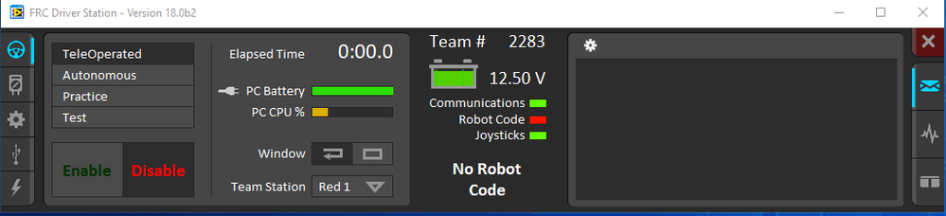
Driver Station
https://docs.wpilib.org/en/stable/docs/software/driverstation/driver-station.html
We use this to interface with our robot both when testing and in competition
Tool that allows you to enable/disable the robot, connect joysticks
Provides some access to logs

Slide 19
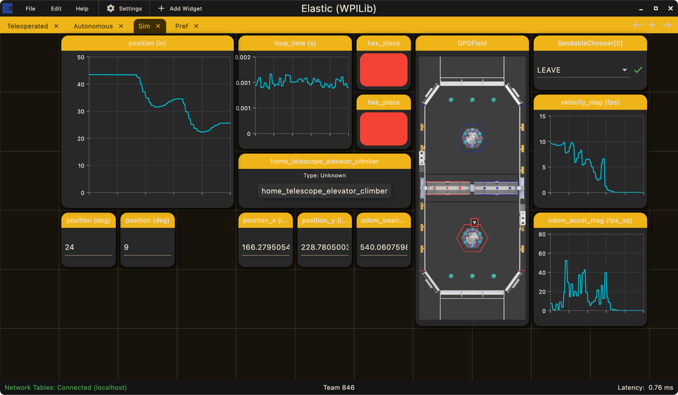
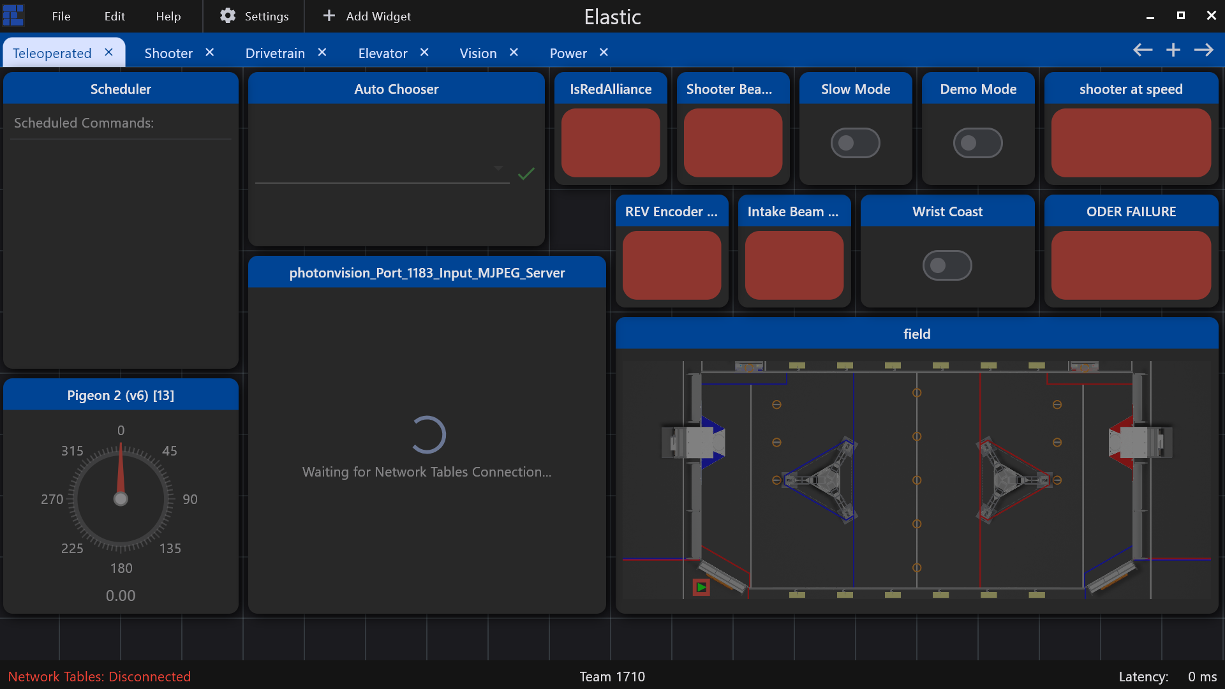
Elastic
You should already have this installed – comes with the WPILib installation in WPILIB folder
Used to change settings/preferences quickly
Used to view graphs

Slide 20
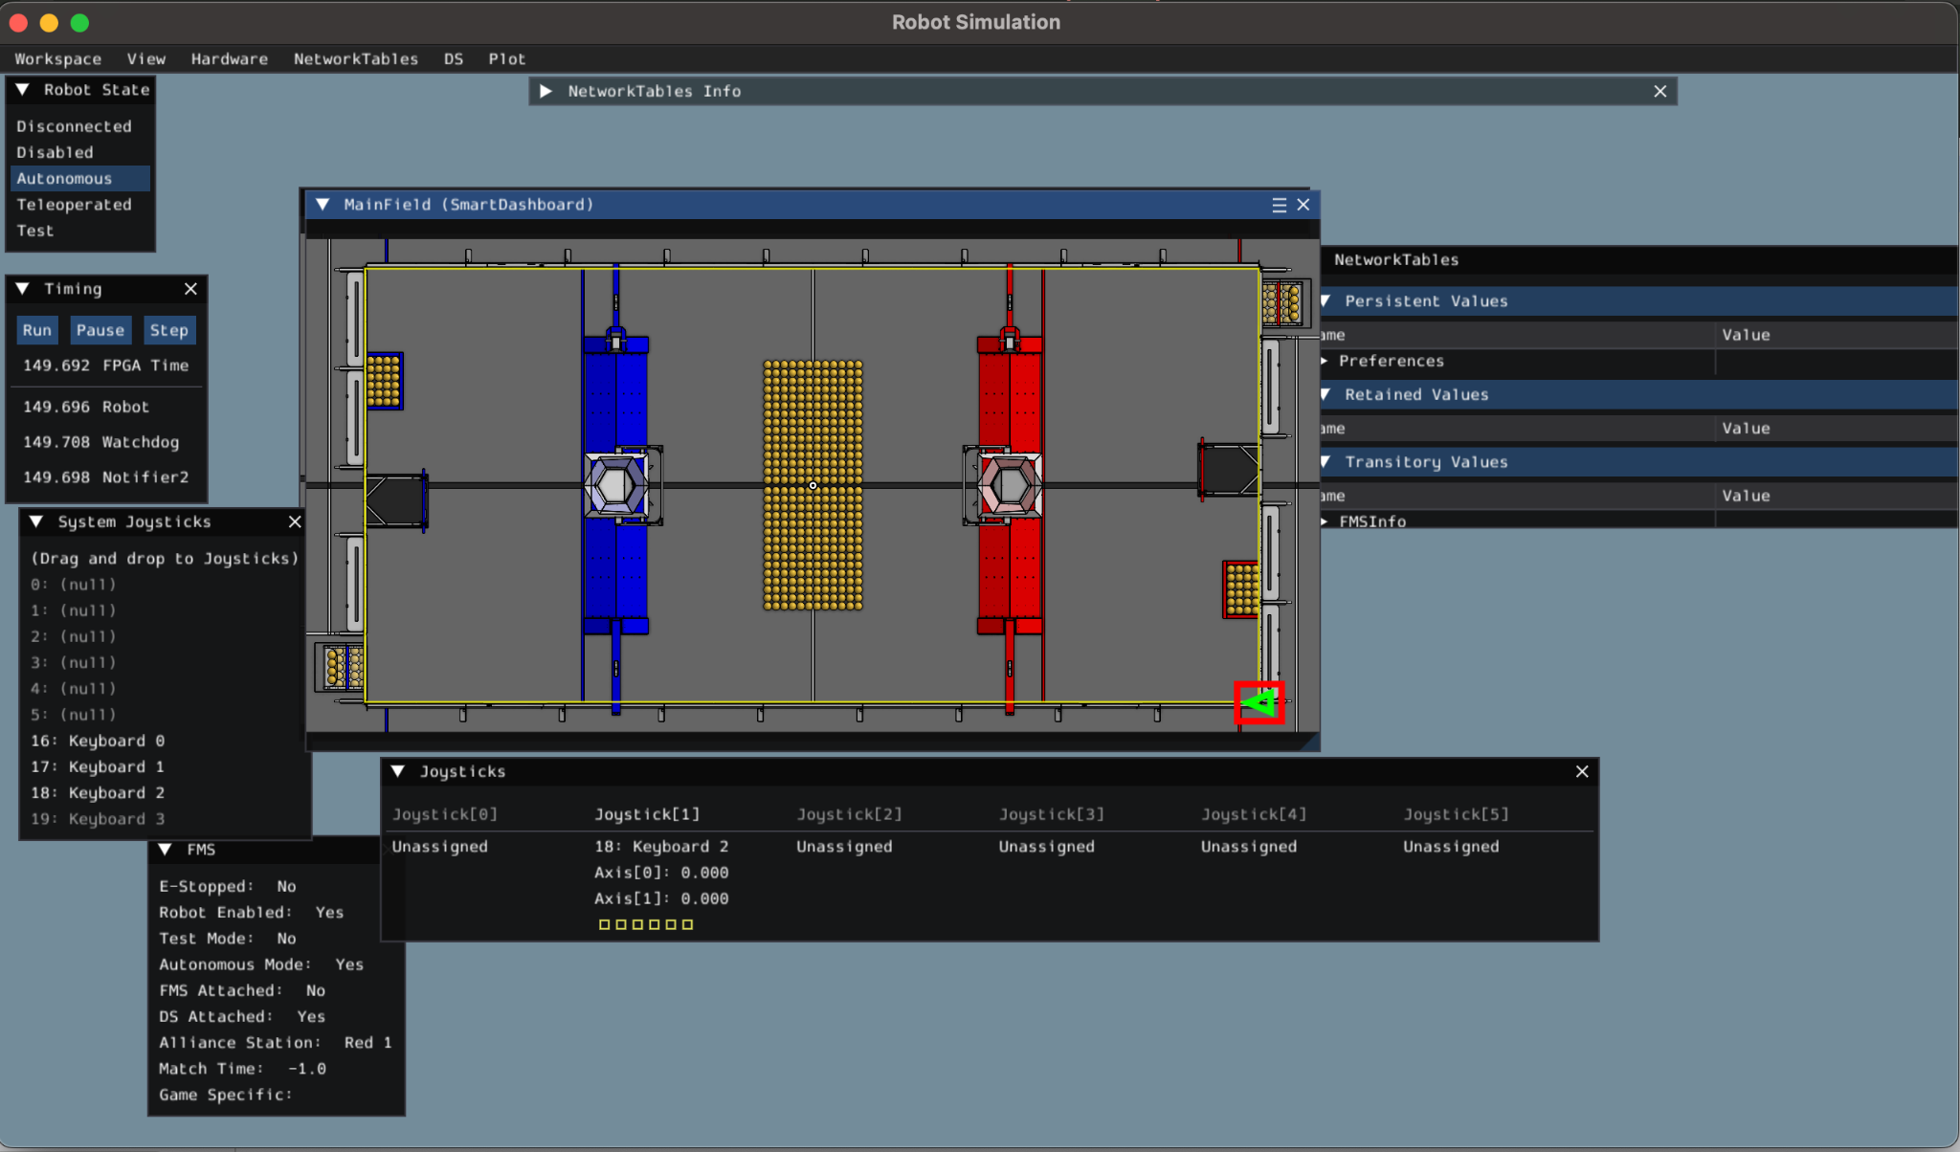
Robot Simulation
Installed with WPILIB VSCode - run Simulate Robot Code command and select GUI interface to open
Simulates autos/movement
Can pair with Elastic
  Select autos/change prefs

Slide 21
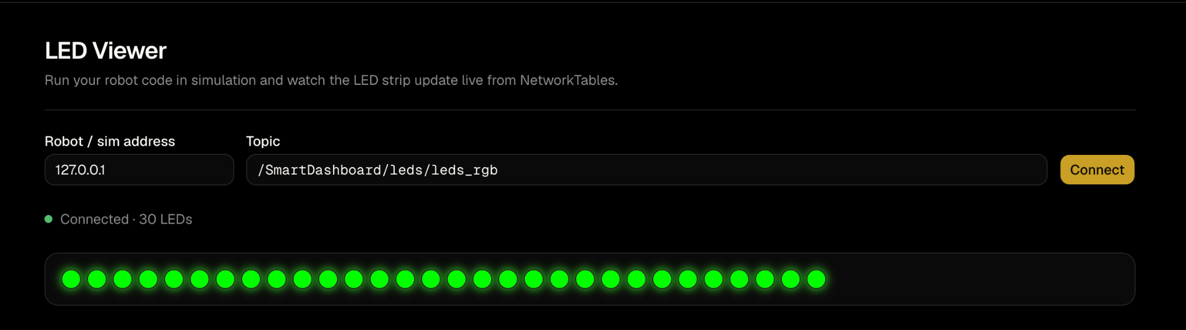
Software LMS
frc-846-lms.vercel.app - navigate to LEDS section
Student-built software test website
Can read data from Robot Simulation via NetworkTables
Use to display LED behaviors after running Robot Simulation
  Address and Topic should be automatically filled correctly

Slide 22
Write LED code
Clone: 26-training (git clone [26-training github repository link])
Get latest code (git pull)
Switch branch to led_subsystem (git checkout led_subsystem)
Work on the leds.cc, leds.h, and FunkyRobot.cc files
Think about
  What do I need to know from LEDs (readings)
  What do I want to tell LEDs (target)

Slide 23
Write LED code
Change the LED Color from your choosing every 1 sec
Remember that each loop of the code running is 20ms
Use a loop counter to decide when to set a new color

Slide 24
Review
Kahoot Link

