Slide 1

Design Workshops:
Week 1
Welcome; Take a seat!

Slide 2
About the Workshops
Instructors: Alexander Nicholson, Allison Chew, Harish Gottimukkula
~8 weeks (Monday)
  2 hours each (4 pm to 6 pm)
  Room 305
  There is homework - It’s good practice!
Please have a mouse every week!
  It will be very difficult to navigate Inventor without one

Slide 3
Agenda
Inventor + SVN setup
Intro to Design
User Folders
Inventor
Homework

Slide 4
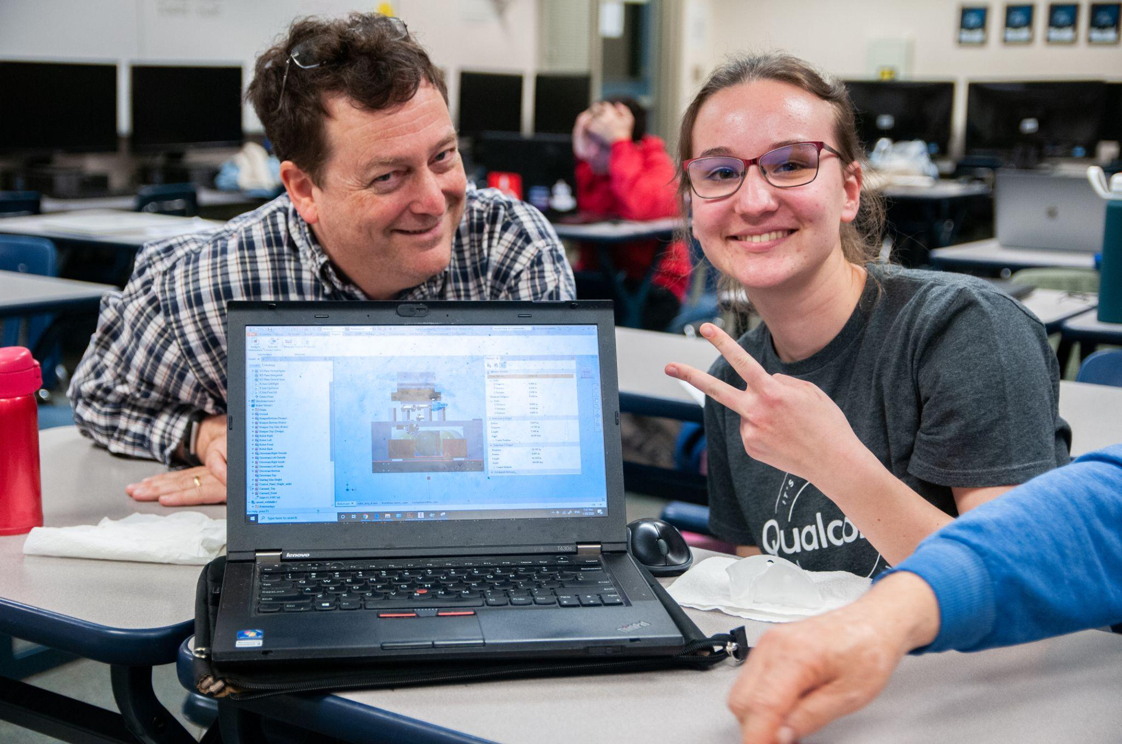
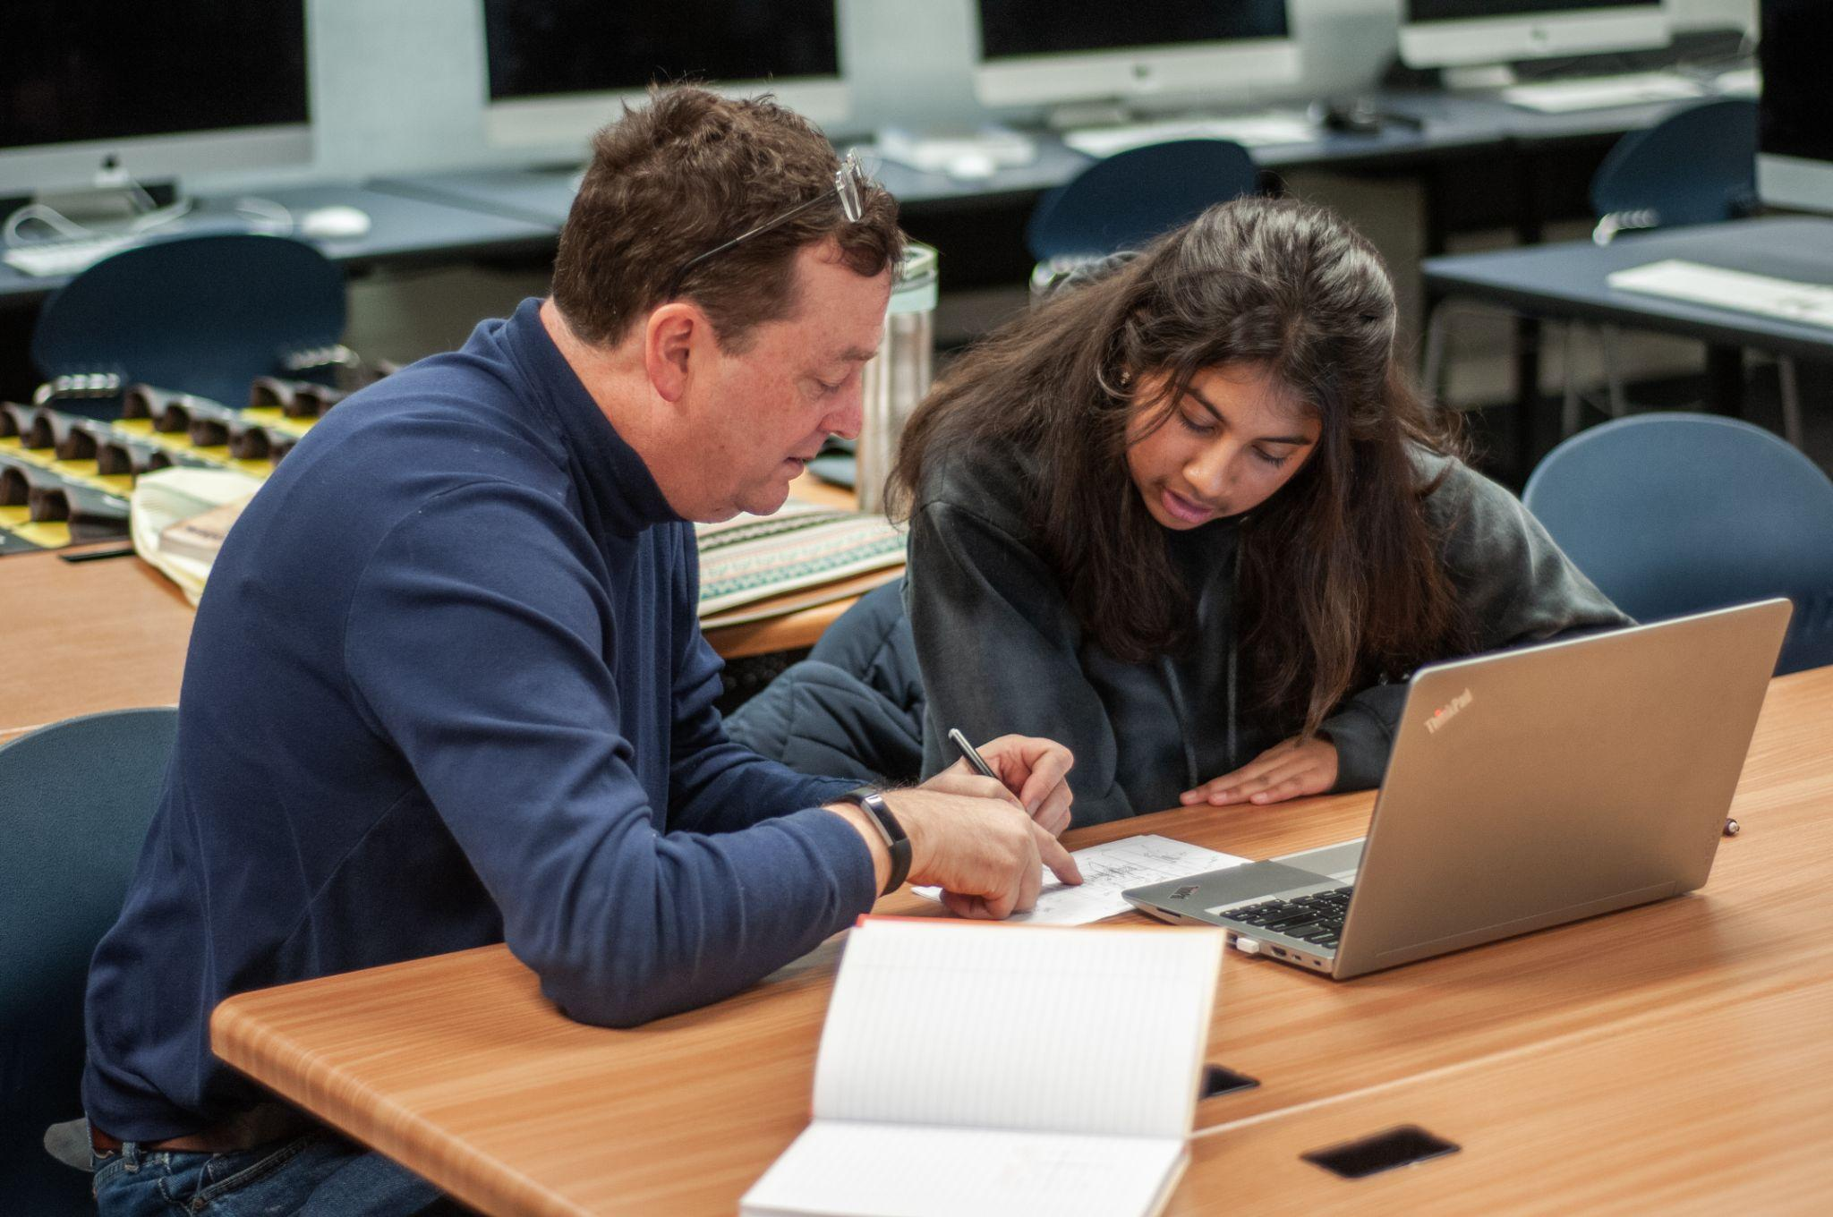
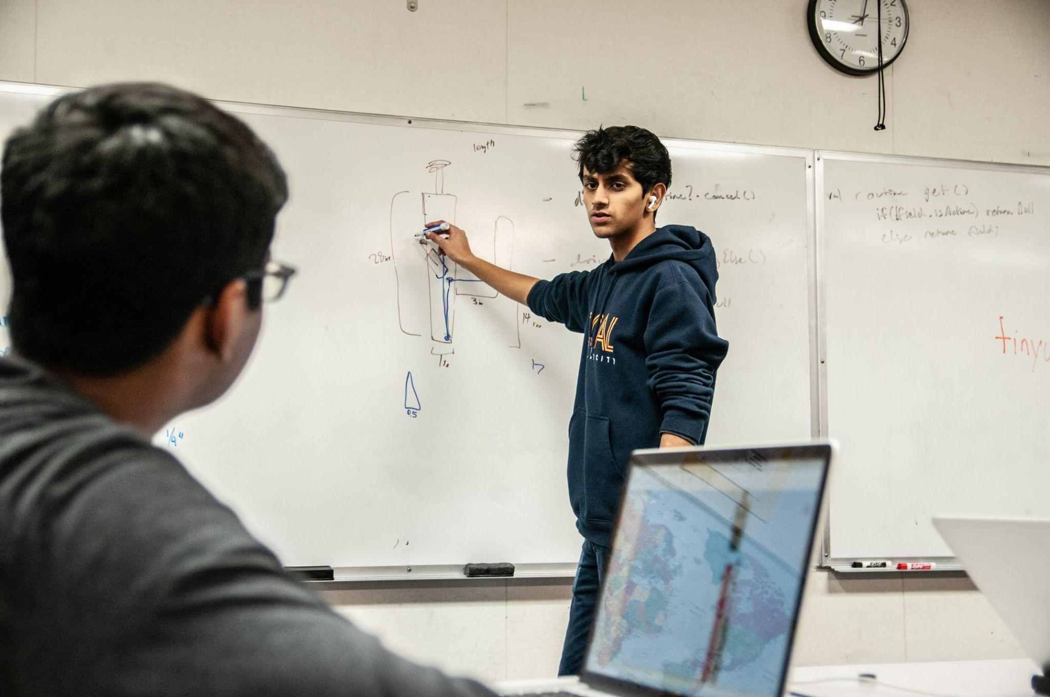

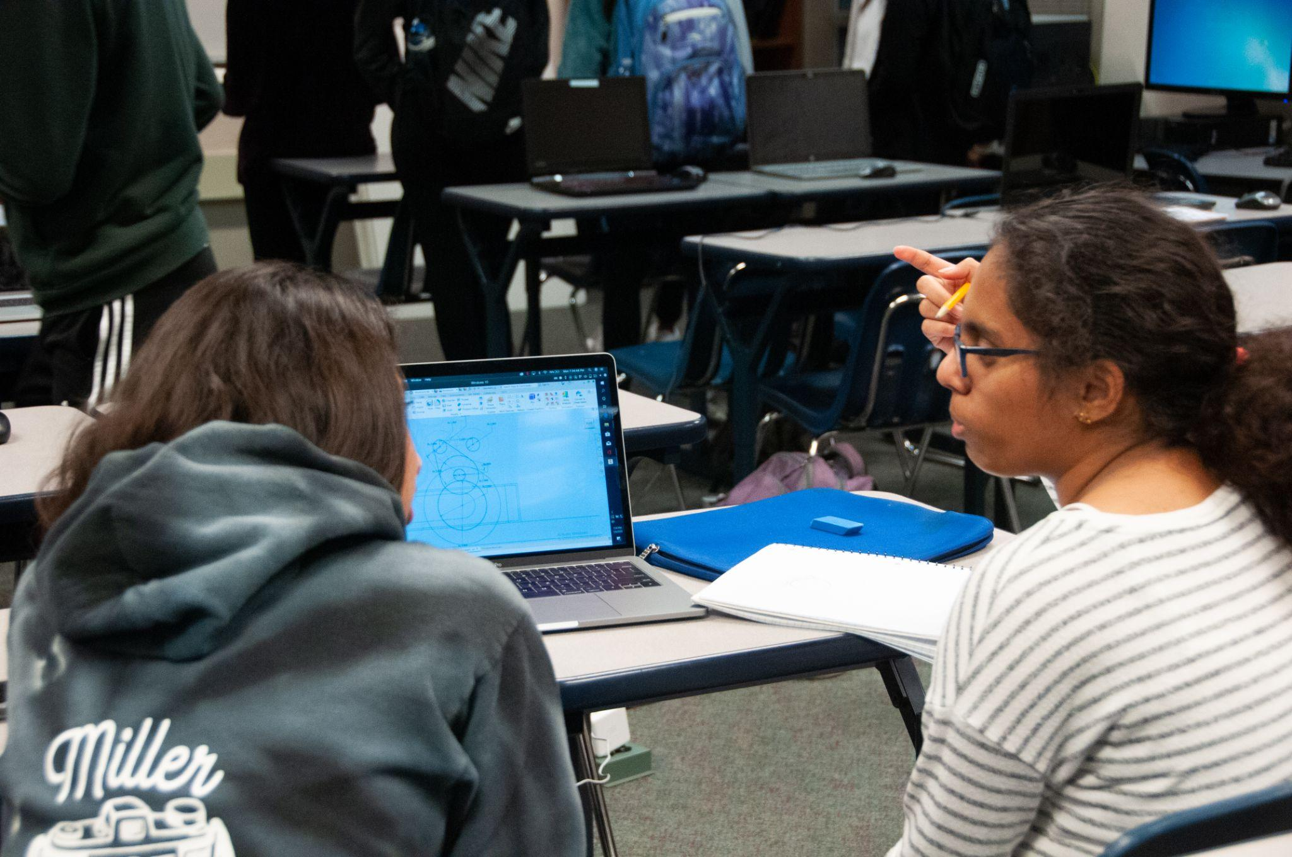
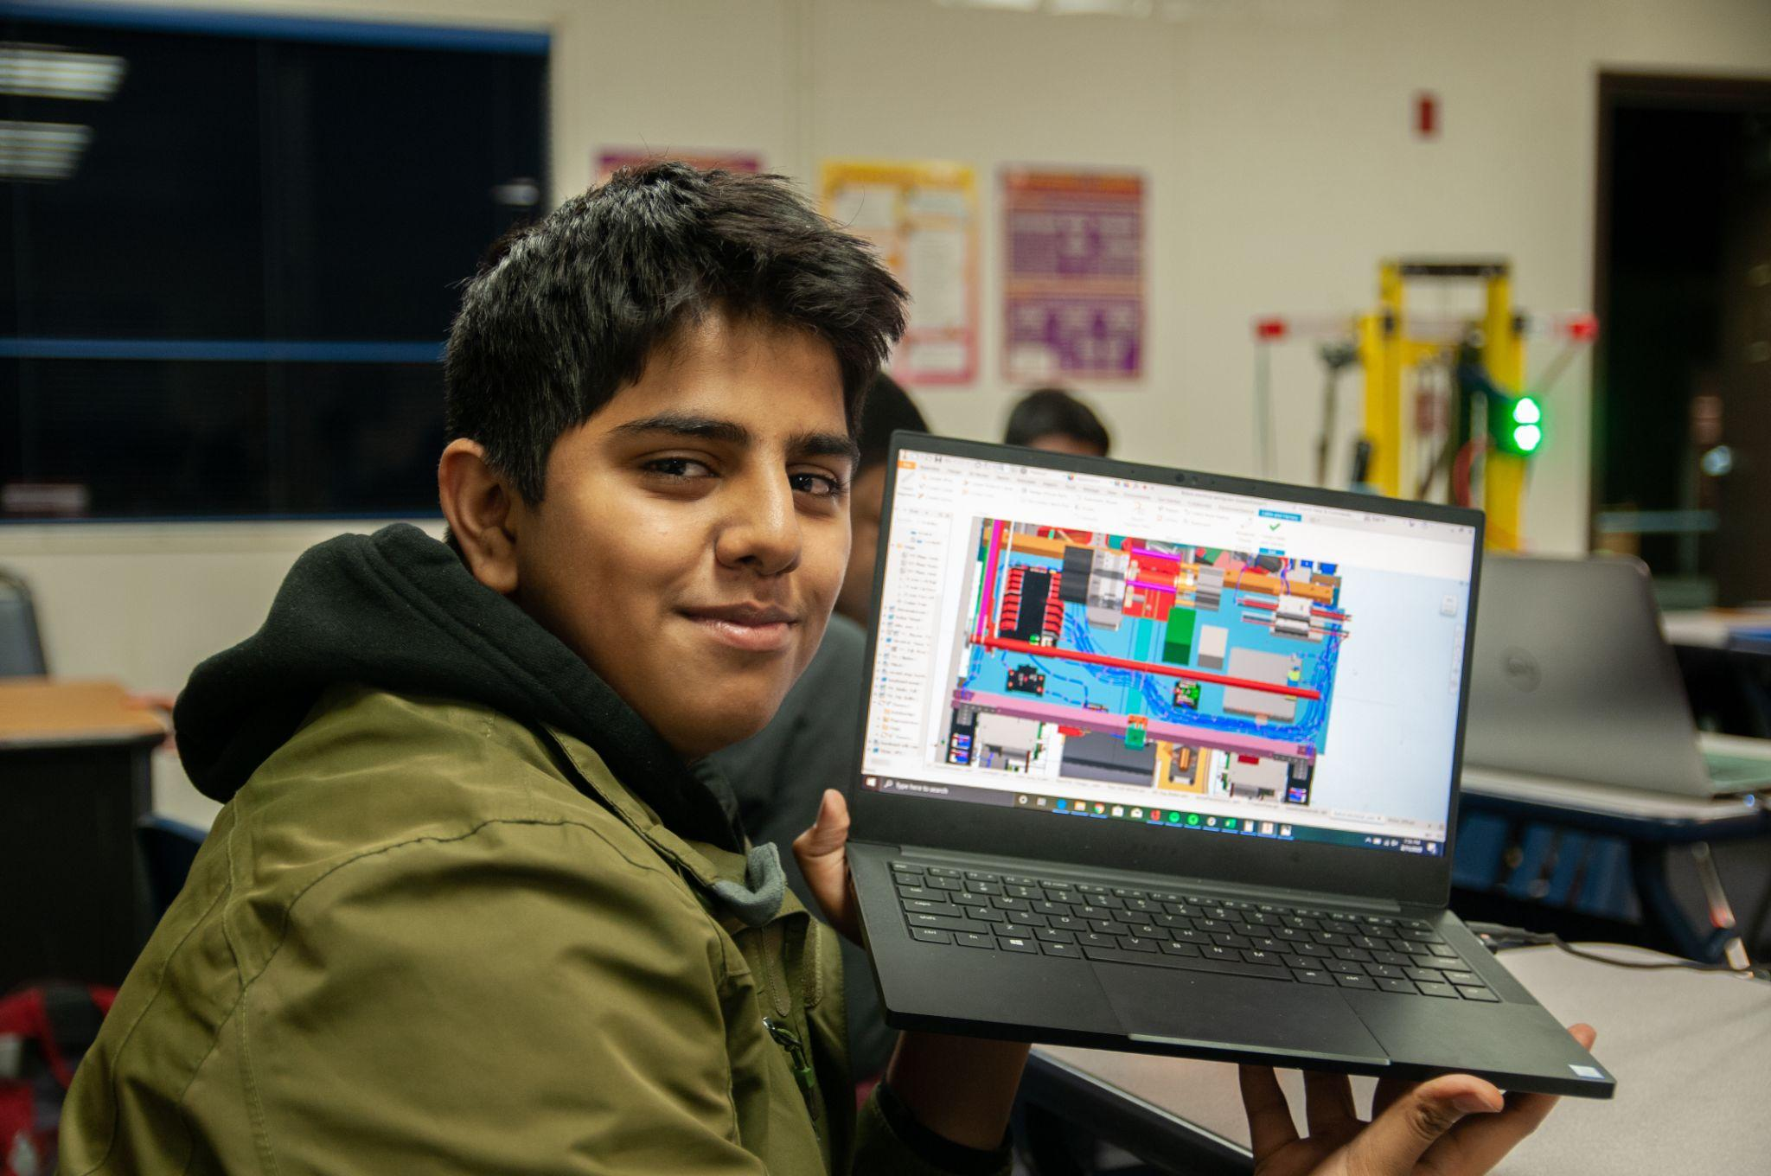
What do Designers do during Build Season?
6 weeks to design, machine, assemble, test, code, wire

Slide 5

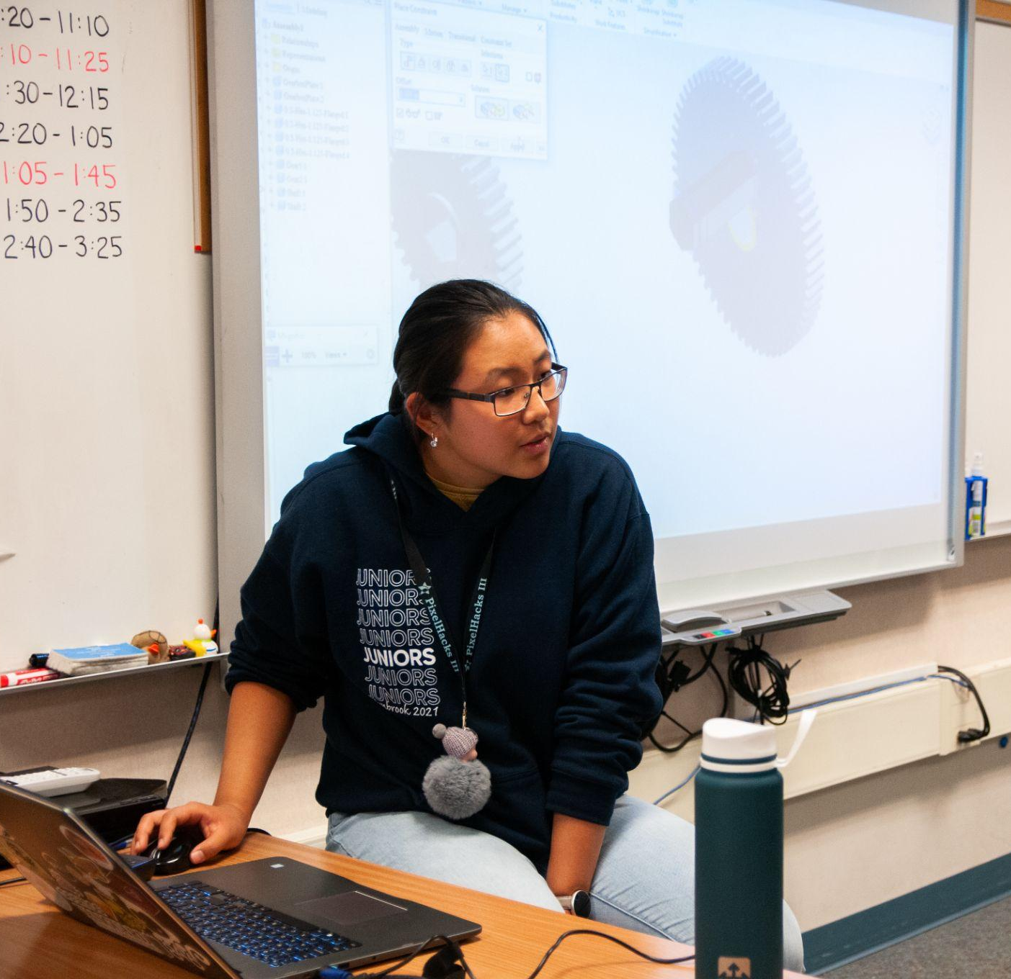

What will you learn during the 8 weeks of design workshops?
Autodesk Inventor Functionalities
  Sketches
  Parts
  Assemblies
Gearbox

Slide 6
How Does SVN Work?
Repository
Tips:
Close inventor when you update
Look through what you’re committing and leave comments (what was changed)
Communicate with others about which files will be edited
Save and Commit OFTEN
SVN Server
Update
Update
Commit
Commit
Designer 1
Designer 2

Slide 7
Set Up
Is everyone set up? Raise your hand if you do not have Inventor 2027 or SVN installed or set up completely
Notes:
download inventor and svn
svn setup

Slide 8
Let’s Explore Inventor!

Slide 9
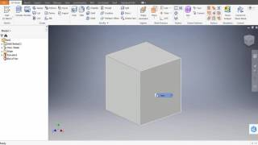
Basics
Create a sketch
Shapes (Square)
Constraints and dimensions
Extrude
Try to play around by yourself!
If you really are stuck, feel free to follow the video as a guide.
The Puzzle Cube Project - Part 1 (Autodesk Inventor 2017) [Mr. Z]. From 2:10

Slide 10

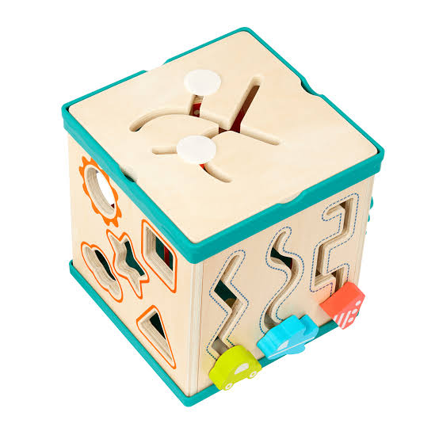

Challenge
Done?
Try adding something on it. Below are some inspiration, but feel free to use your creativity!

Slide 11
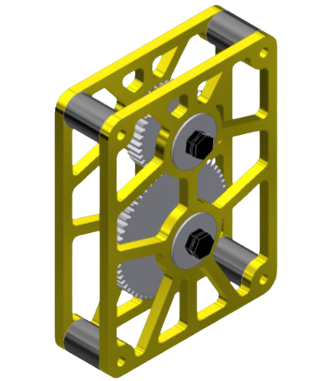
Gearbox

Slide 12
Gearbox
Gears
Bearings
Shafts
Spacers
Plates

Slide 13
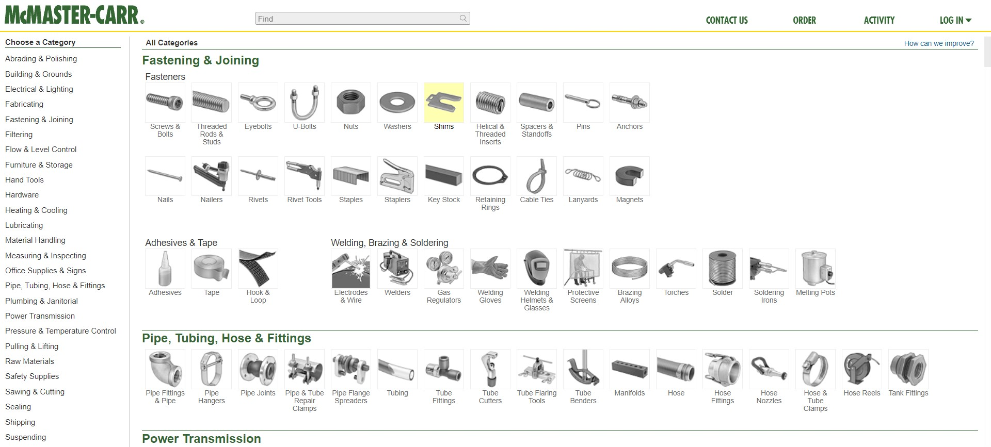
McMaster-Carr
most frequently used vendor

Slide 14
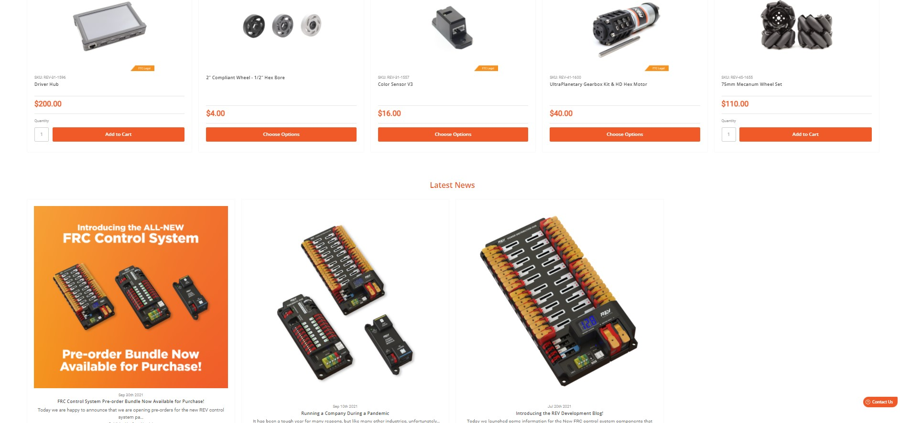
REV Robotics
Control System / Electrical Components
Sensors
Motors
Cables

Slide 15
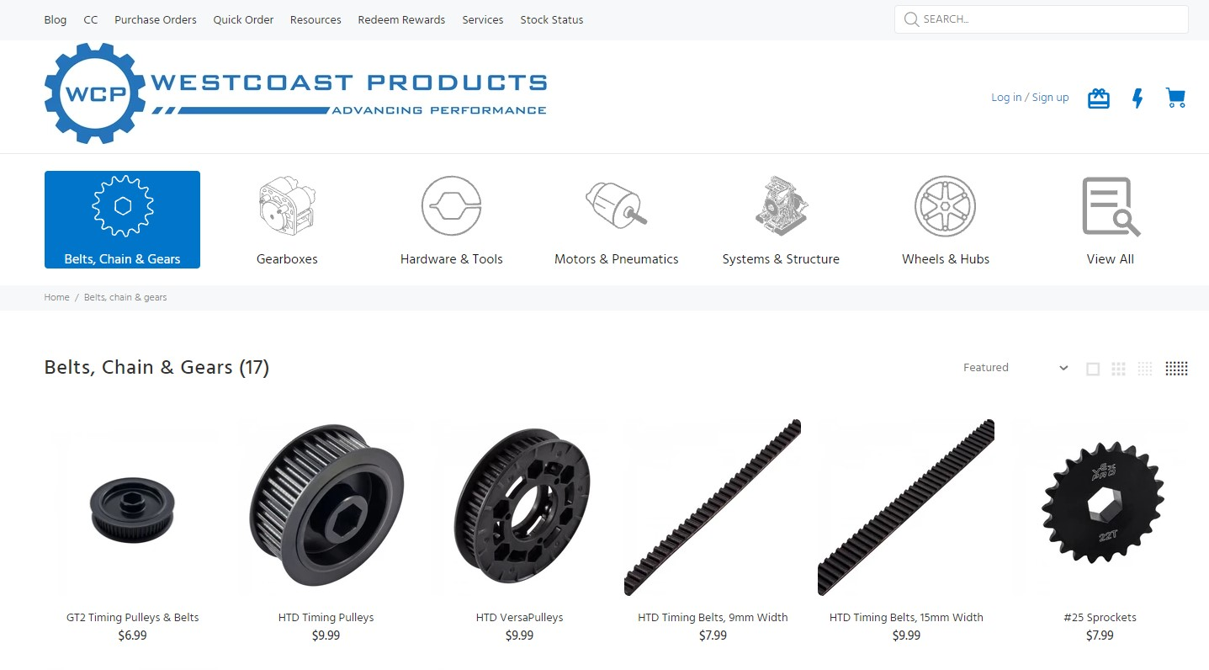
WestCoast Products
Gears
Wheels
Chains
Spacers
Motors

Slide 16
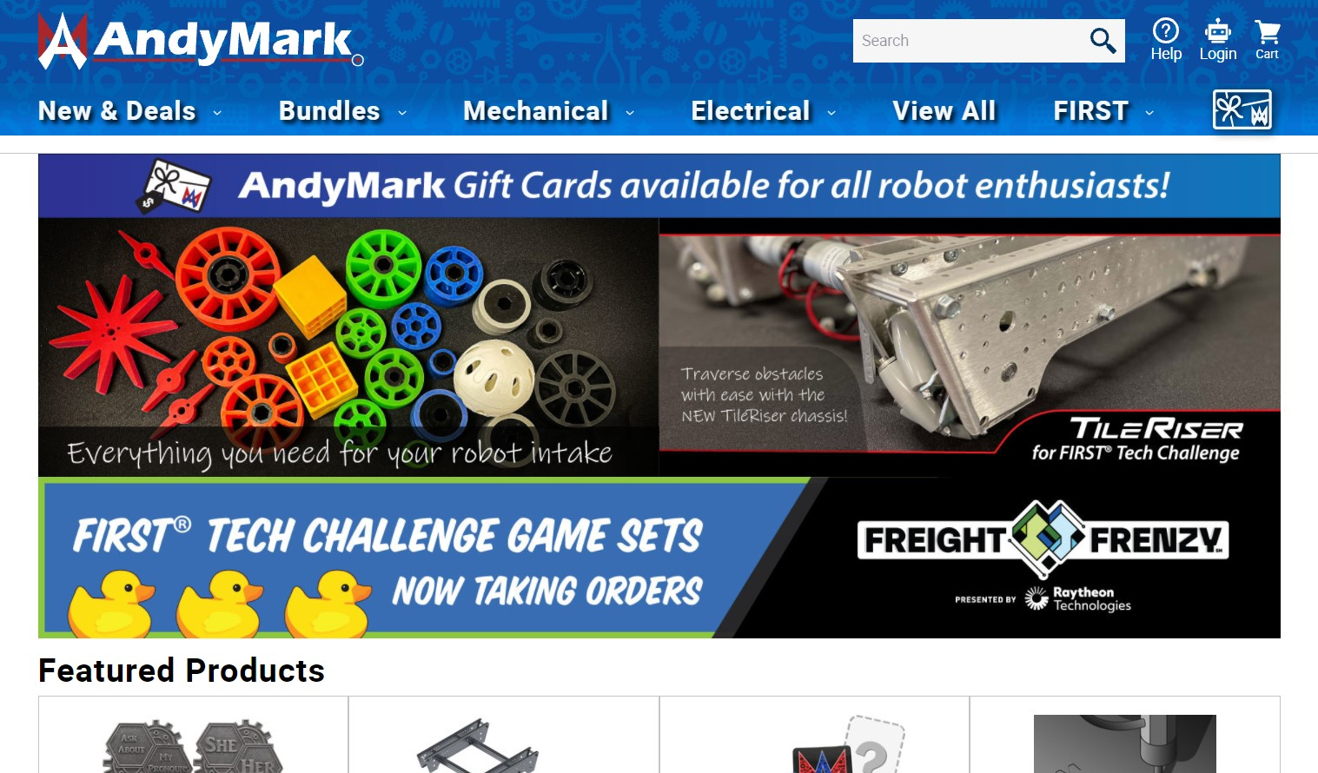
Andymark
Wheels

Slide 17
Gearbox
Gears?
Bearings?
Shafts?
Spacers?
Plates?

Slide 18
Gearbox - What Do We Make?
Gears?
Bearings?
Shafts?
Spacers?
Plates?
Bought
Bought
Bought/Machined
Bought/Machined
Designed/Machined

Slide 19

attendance:
https://tinyurl.com/846fallWorkshops26
https://forms.gle/YQXYzKseUSZpchvh7

Slide 20
Thank you for coming!
See you next week at 4 pm!

