Slide 1

Design Workshops:
Week 2
Welcome! Take a seat :)

Slide 2
Design Process
Notes:
This week, we are going to explore the full design process that occurs when build season comes around. We will also begin the first part of our gearbox project.

Slide 3
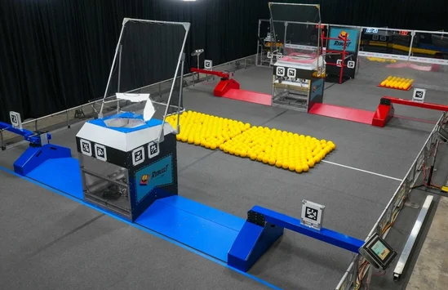
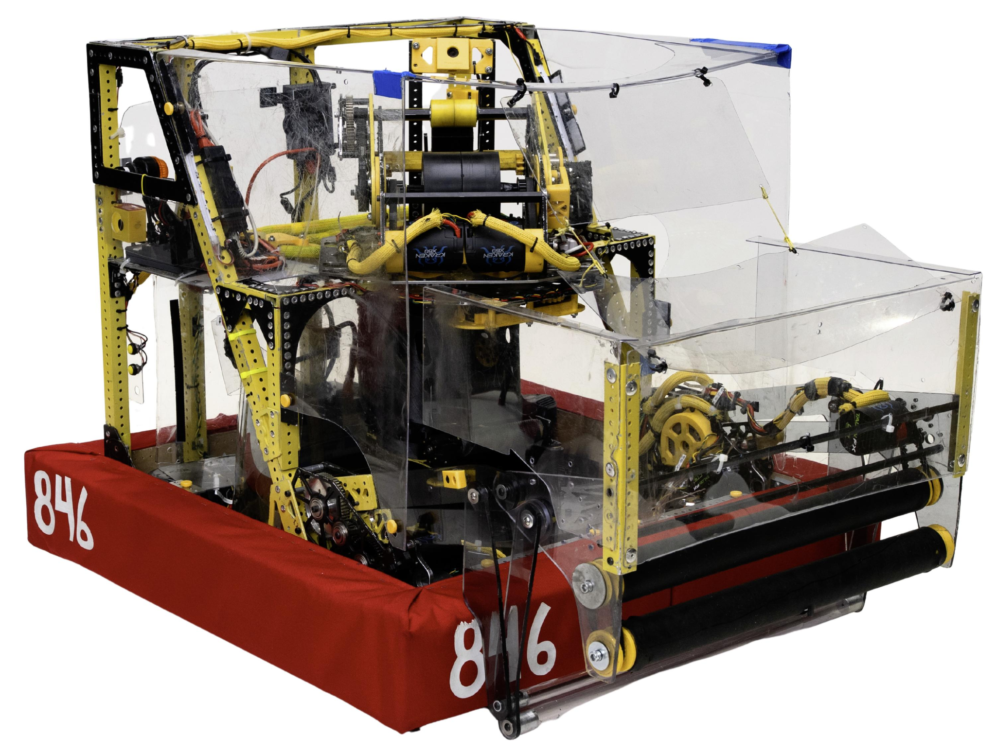
How do we go from game release → robot?
Notes:
What are things that we might consider? Can you see any correspondence from the playing field to our robot?
More questions to consider:
How do we interact with the yellow balls (fuel)?
How do we score them into the large box (hub)?
What are some other constraints or strategies?
Bump, trench, tower, starting positions

Slide 4
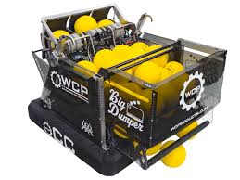
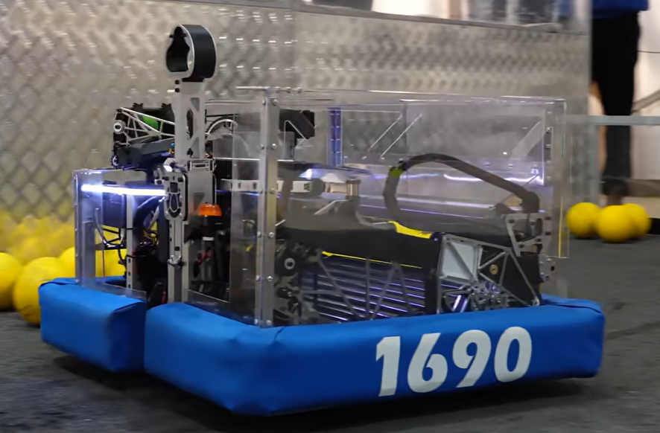
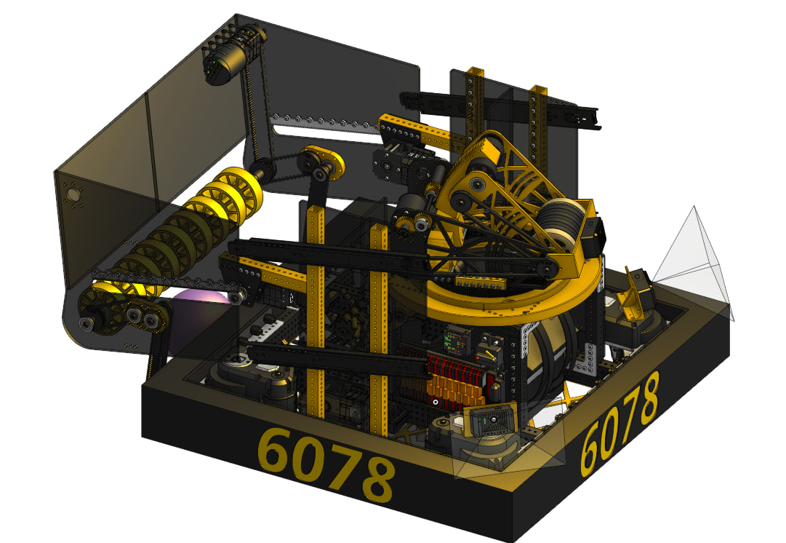
Functional differences between robots
Notes:
Observations:
Top left has a large, enclosed storage area
Middle has a gap in the bumper
Bottom has unique middle/shooter

Slide 5
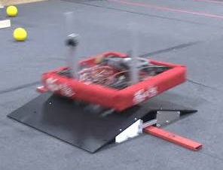
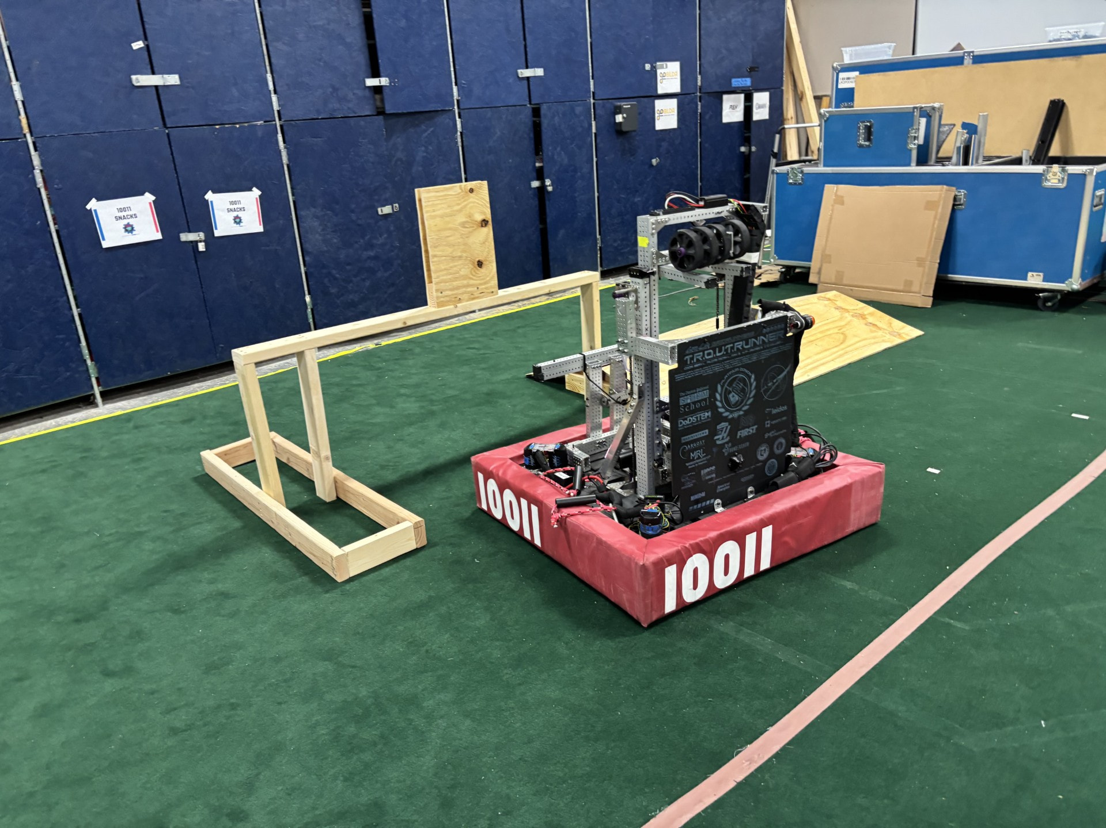
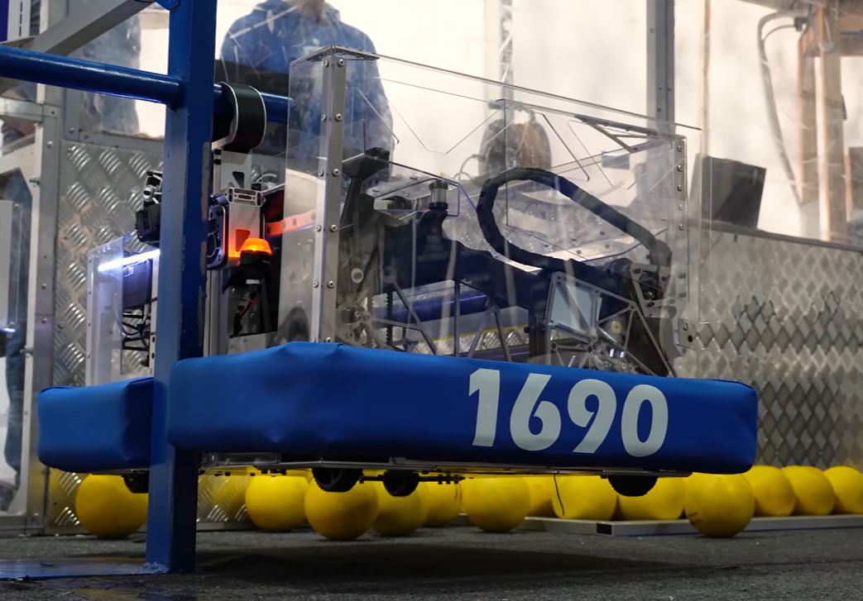

Slide 6
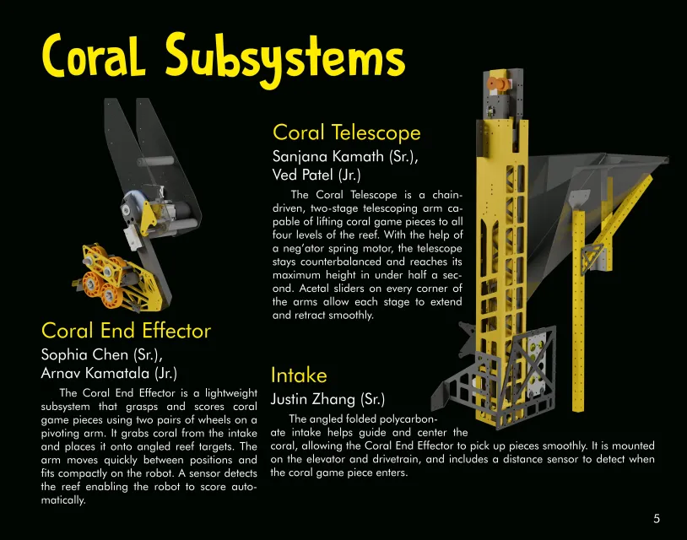
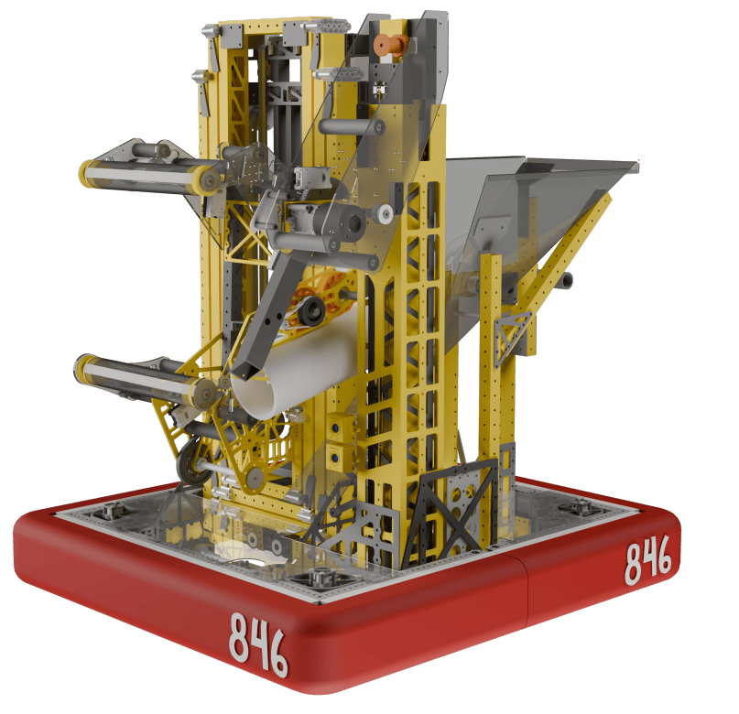
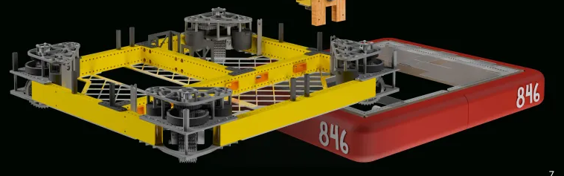
The Process
Robot Design
  Functionalities: What we want our robot to do
  Concepts: Basic robot sketches
Subsystem Design
  Functionalities
  Concept
  Detailed Geometries
  Solid modelling
  Machining
Assembly

Slide 7
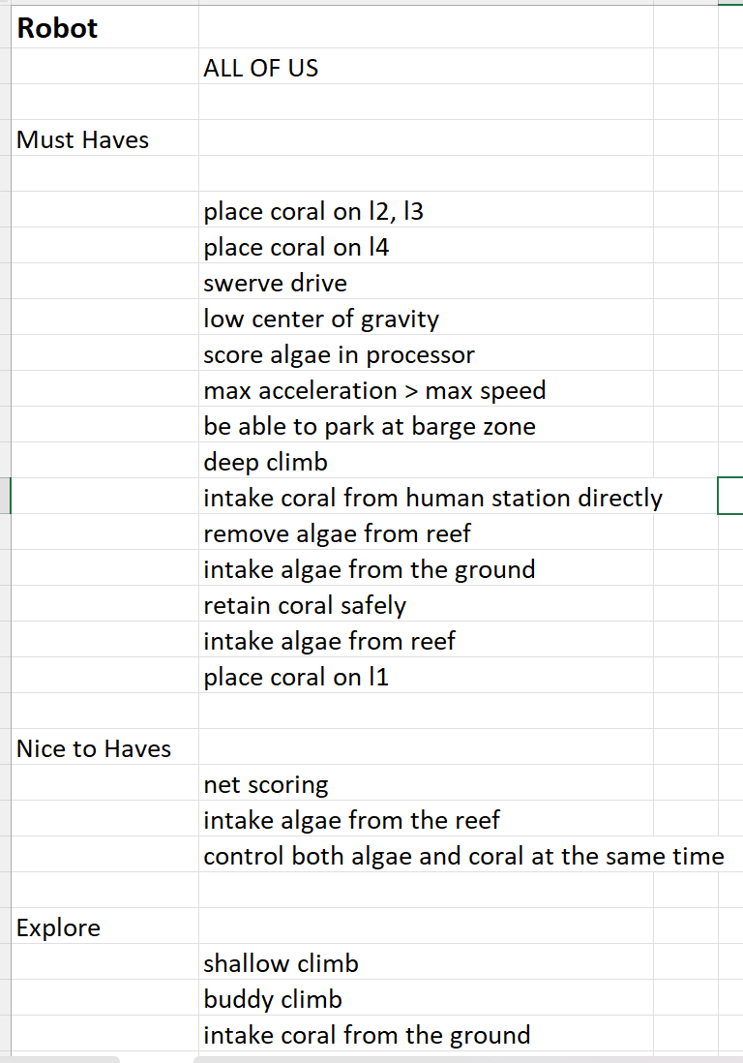
Robot Functionalities
List of things we need our robot to do
  Must haves
  Nice to haves
  Explore
Not related to any specific mechanisms

Slide 8
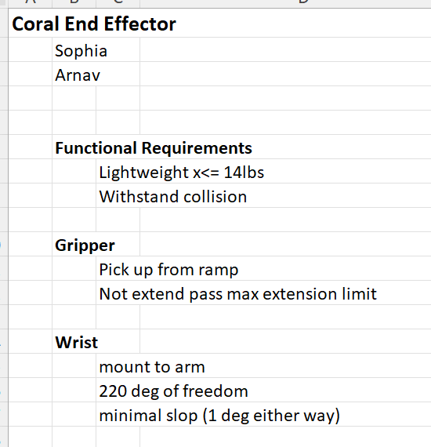
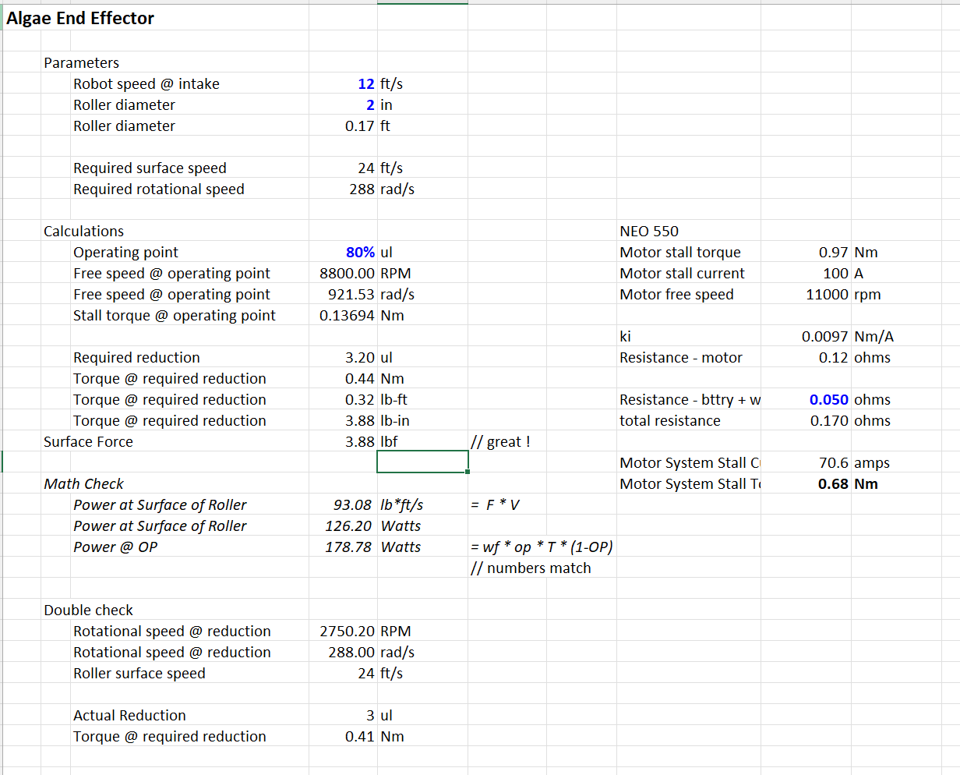
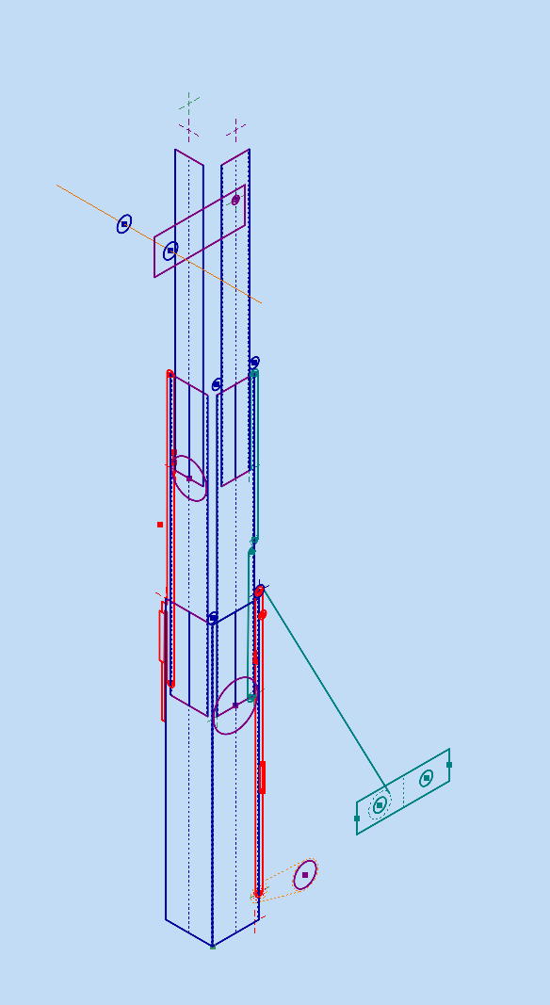
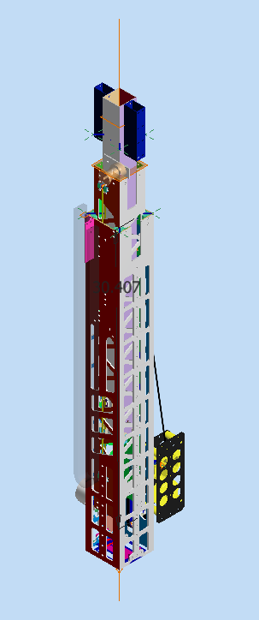
Subsystem Design:
Functionalities
Calculations
Solid Modeling
Geometries

Slide 9
Conceptual Geometry

Slide 10
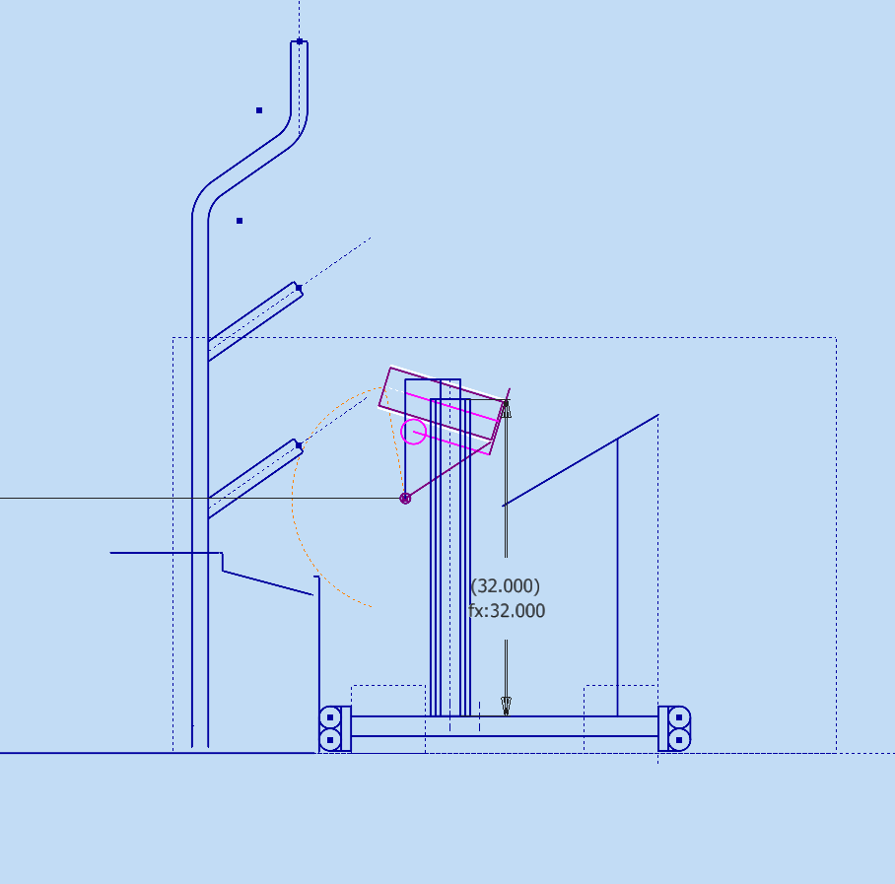
Conceptual Geometry
Field Elements
Basic robot sketches
  Drivetrain
  Important Subsystems
  Field Elements
Used to prove if a design works
  How will it intake
  How will it score
Coral & End Effector
Intake
Drivetrain

Slide 11
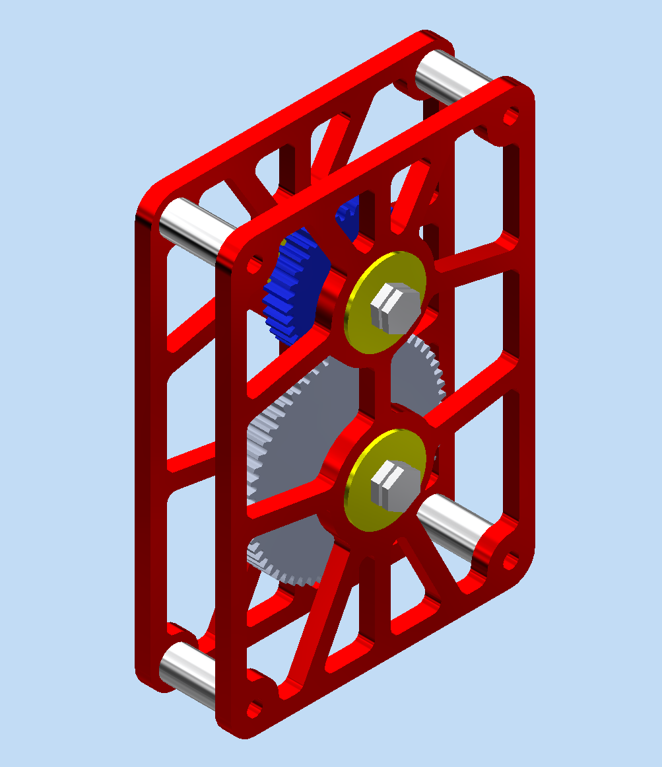
Try it out!
Notes:
Try creating a conceptual geometry for the gearbox. It should be 2D and SIMPLE.

Slide 12
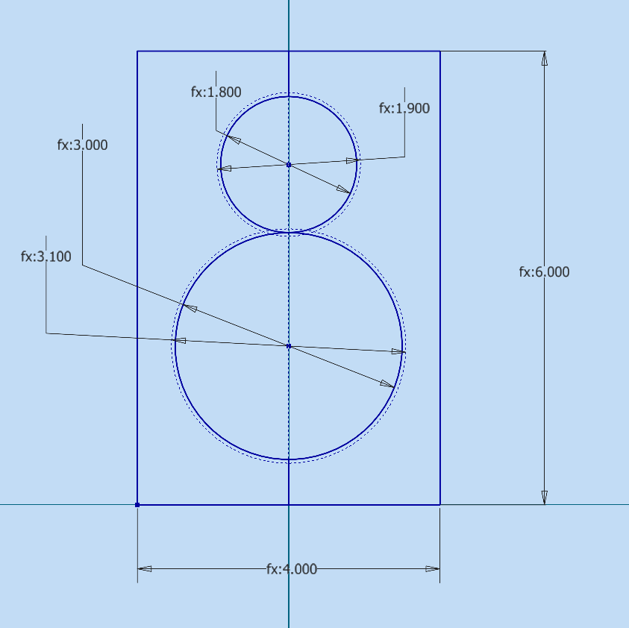
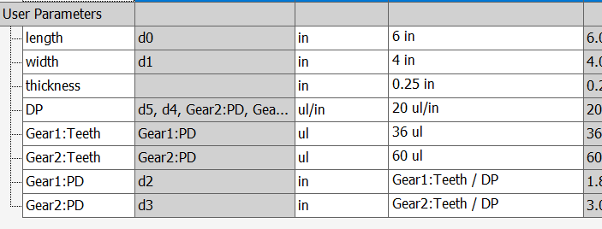
Conceptual → Detailed Geometry
Basic Shapes
Parameters
Constraints
Calculations

Slide 13

attendance:
https://tinyurl.com/846fallWorkshops26
https://forms.gle/YQXYzKseUSZpchvh7

Slide 14
Thank you for coming!
Please push in your chairs before you leave!

