Slide 1

Design Workshops:
Week 3
Welcome! Take a seat :)

Slide 2
Gears
What are they & How do they work?

Slide 3
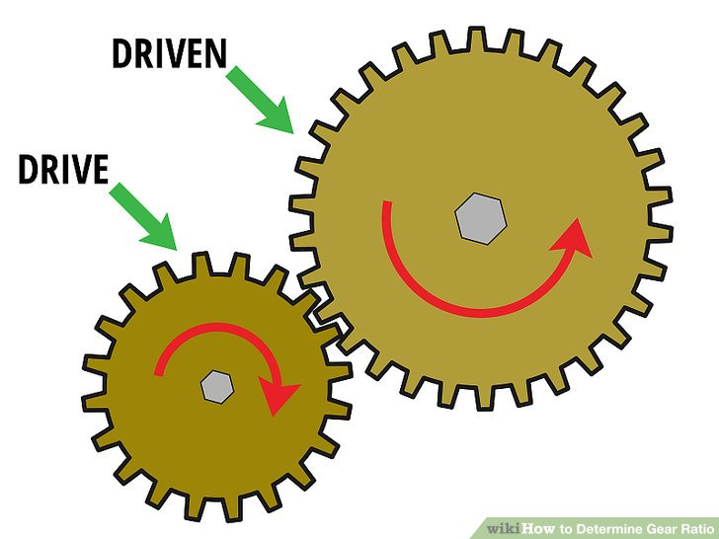

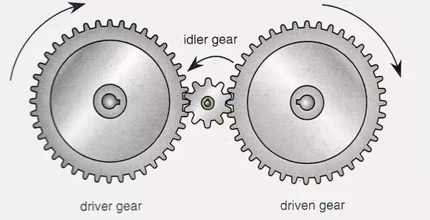
How Gears Work
Terms:
Pinion gear - small gear directly on output of motor
Idlers - gears in between input and output “a gear placed between a driving and a driven gear to transfer motion without change of direction or gear ratio”

Slide 4
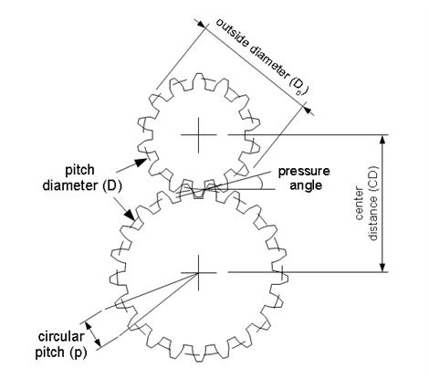
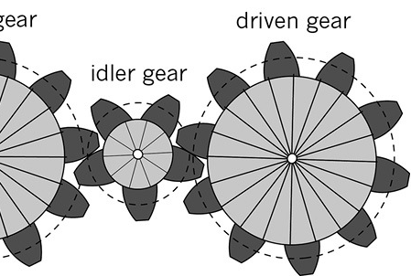
Pitch Circles are tangent
Or pitch circle,
Effective size of the gear
Diametral Pitch - the number of teeth per inch of pitch diameter (pitch circle), determines how the gears will physically mesh.
# of teeth (t) + 2 (t) divided by DP (t/in) = real diameter
# of teeth / DP (t/in) = pitch circle diameter

Slide 5
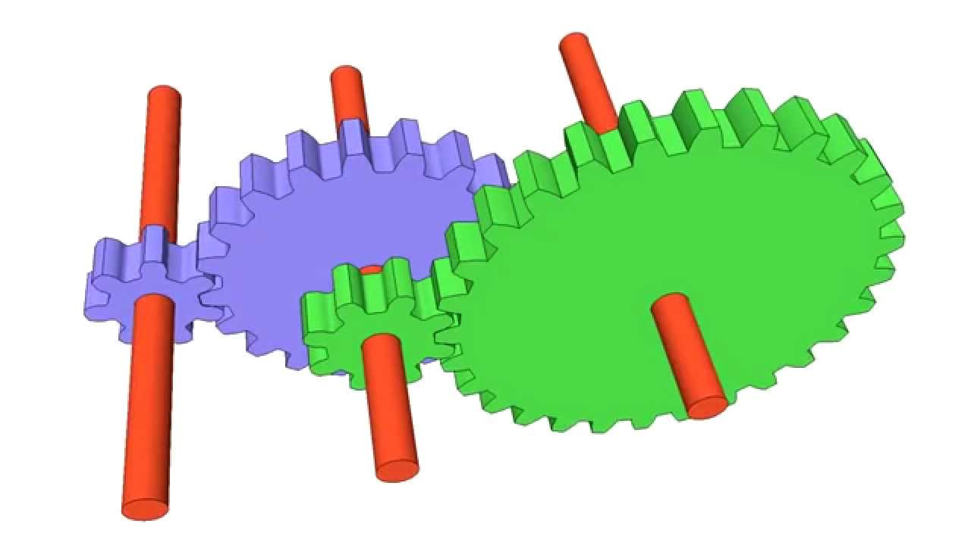
What is the gear ratio?
Driven over driver
Used to calculate speed and acceleration
20 teeth
input
7 teeth
output
8 teeth
30 teeth

Slide 6
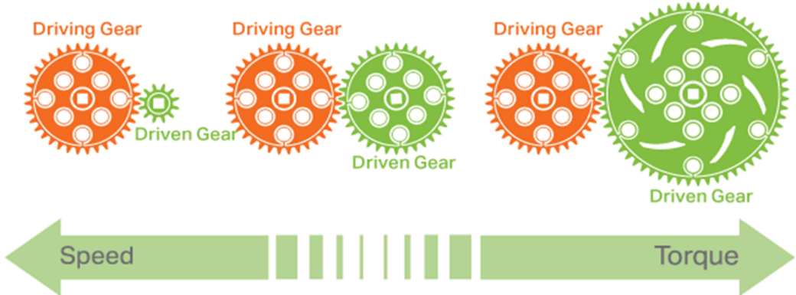
Notes:
Torque is “twisty force” (cross product of radius and Force)
Think of a door

Slide 7
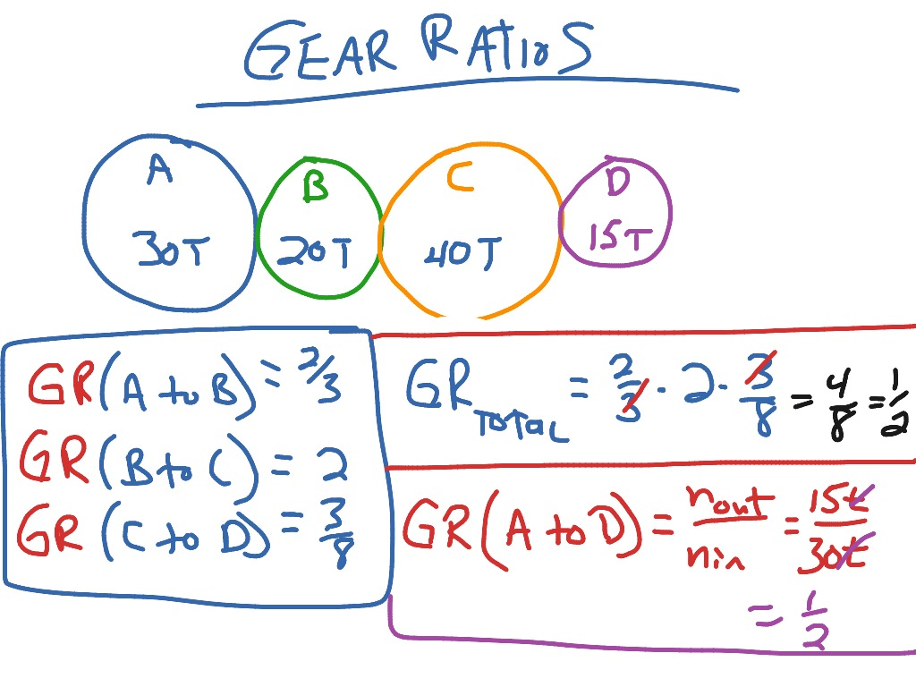
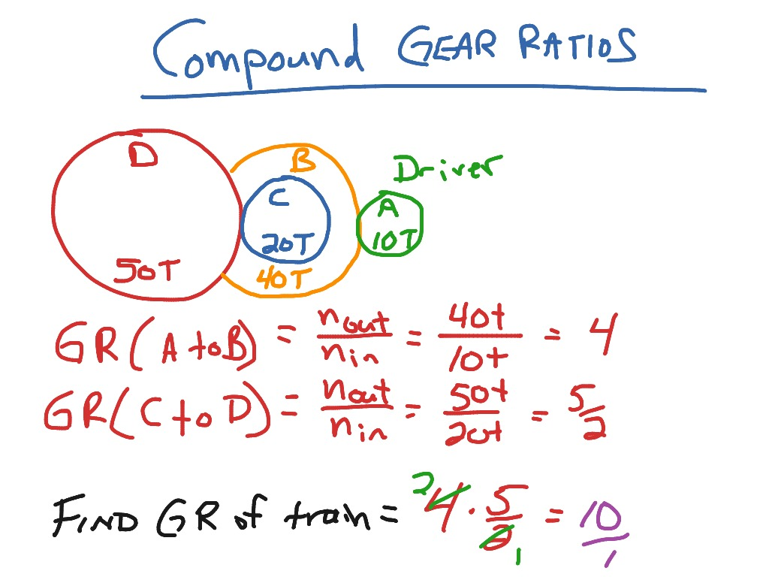
Simple Gear Ratio Math

Slide 8
Gearbox Calculations
Pitch diameter = number of teeth/Diametral pitch
Outer diameter (OD) = (number of teeth+2)/Diametral pitch
In real life you want to add a small mesh gap so that there is a little bit of clearance between the gears

Slide 9
Measurements
Given:
  Gear 1: 36 T ½-inch hex bore gear (aluminum)
  Gear Ratio: 3 to 5
  Diametral Pitch = 20 (same for both gears)
Find:
  Gear 2 Teeth
  Gear 1 & 2 Pitch Diameter
Hints:
Gear Ratio = Driven over Driver (teeth)
Diametral Pitch = # of teeth / pitch diameter

Slide 10
Measurements
Gear 1: 36 T ½-inch hex bore gear (aluminum)
    Pitch Diameter = 1.8 in
  Gear 2: 60 T ½-inch hex bore gear (aluminum)
    Pitch Diameter = 3 in
  Gear Ratio: 3 to 5
  Diametral Pitch = 20 ul/in (same for both gears)

Slide 11
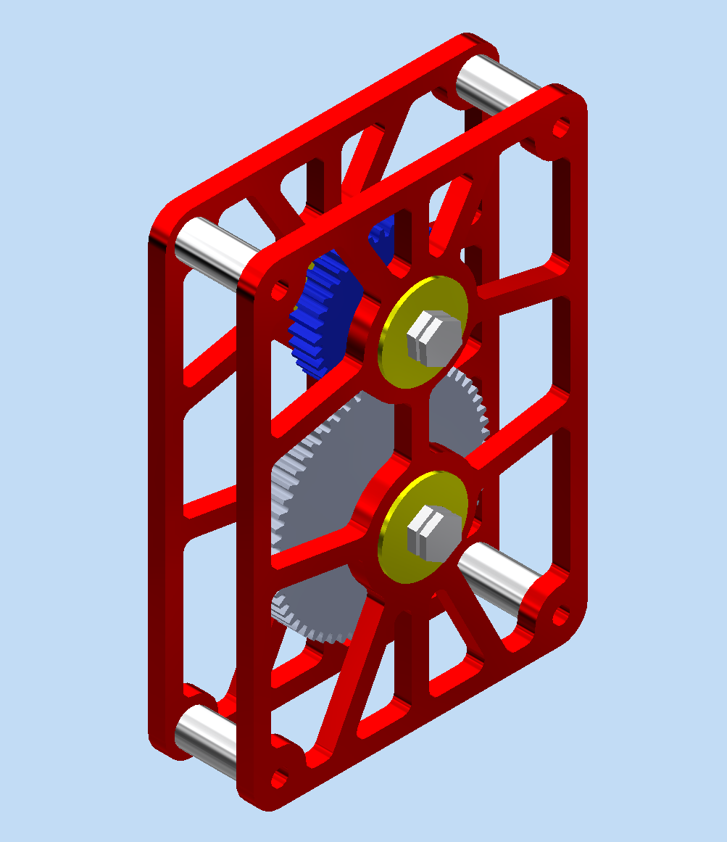
Try it out!
Notes:
Try creating a conceptual geometry for the gearbox. It should be 2D and SIMPLE.

Slide 12
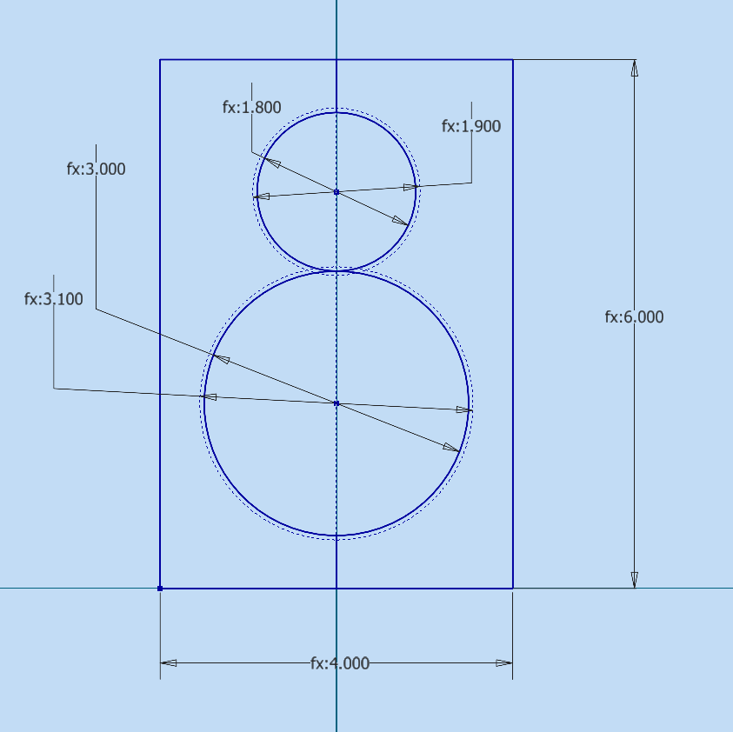
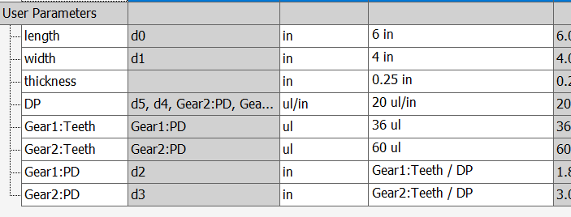
Conceptual → Detailed Geometry
Basic Shapes
Parameters
Constraints
Calculations

Slide 13
Inventor
Let’s take a look around!

Slide 14

attendance:
https://tinyurl.com/846fallWorkshops26
https://forms.gle/YQXYzKseUSZpchvh7

Slide 15
Thank you for coming!
Please push in your chairs before you leave!

