Slide 1
General Assembly Info and Best Practices

Slide 2
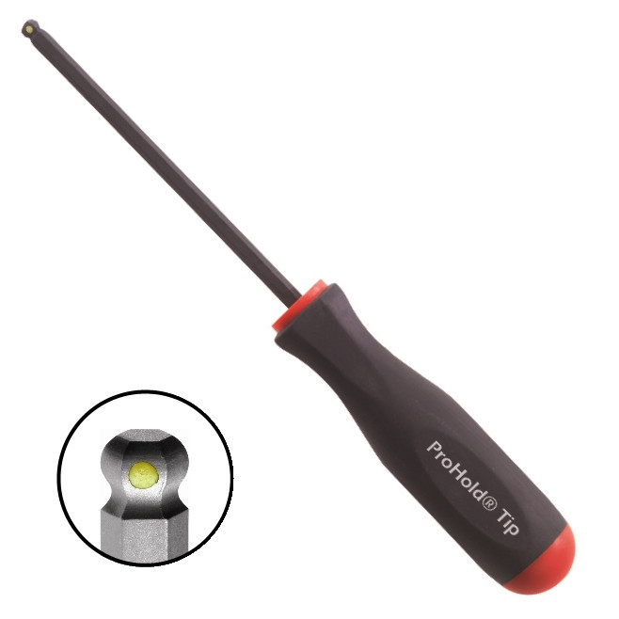
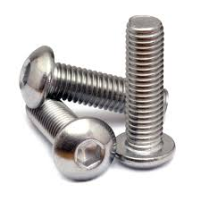
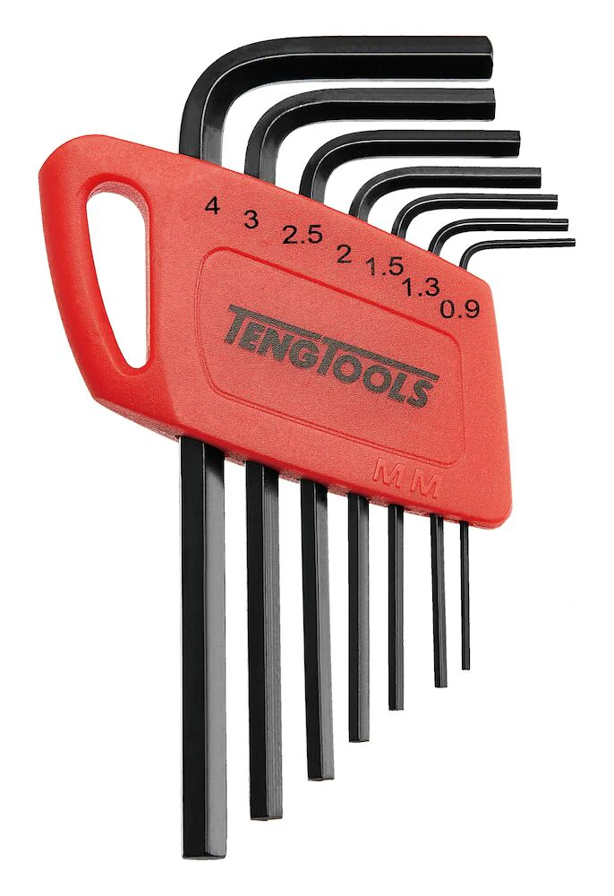
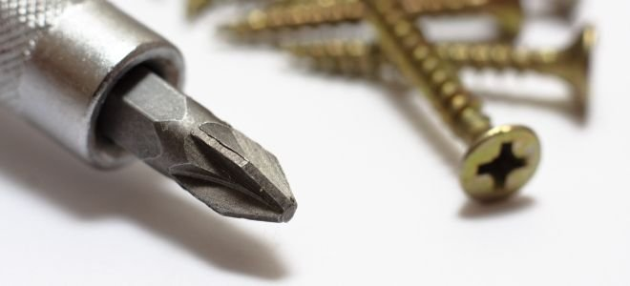
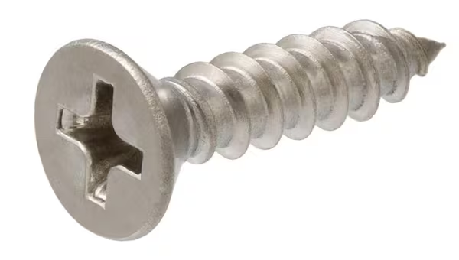
Screws!
Hex
  Screw head doesn’t strip easily
  Bonus: Can use with a ball end hex driver
Phillips
  Very common and easy to find
Notes:
Anish

Slide 3
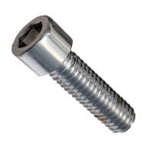
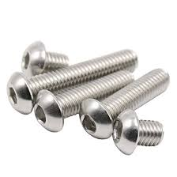
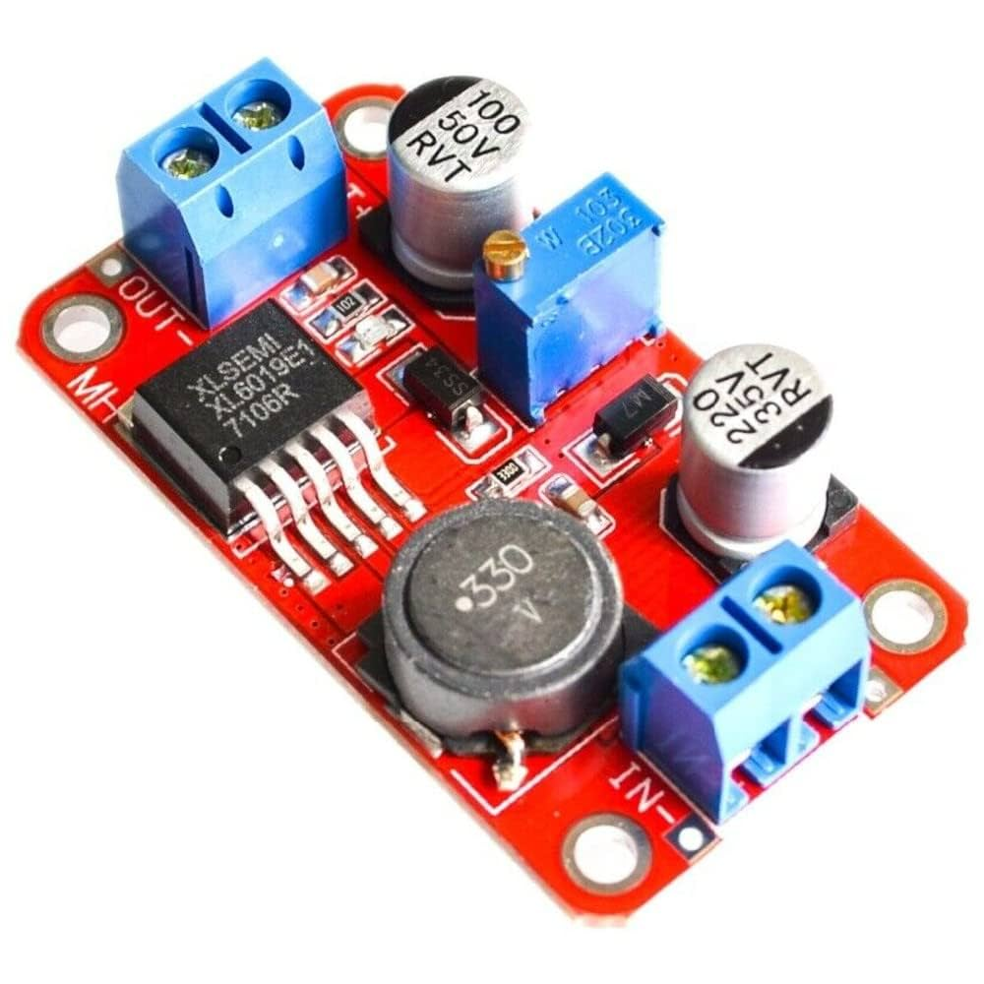
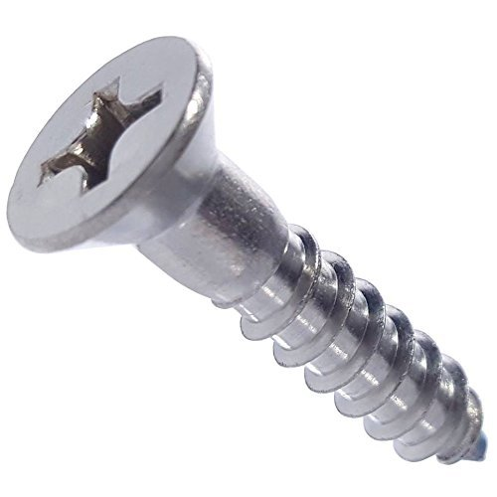
Head Types
Socket Head
  Common and inexpensive
Button Head
  Flush mounting
Flat Head
  Uncommon on FRC robots
  Used for some electronics
  Used for field elements(made of wood)
Notes:
Srini

Slide 4
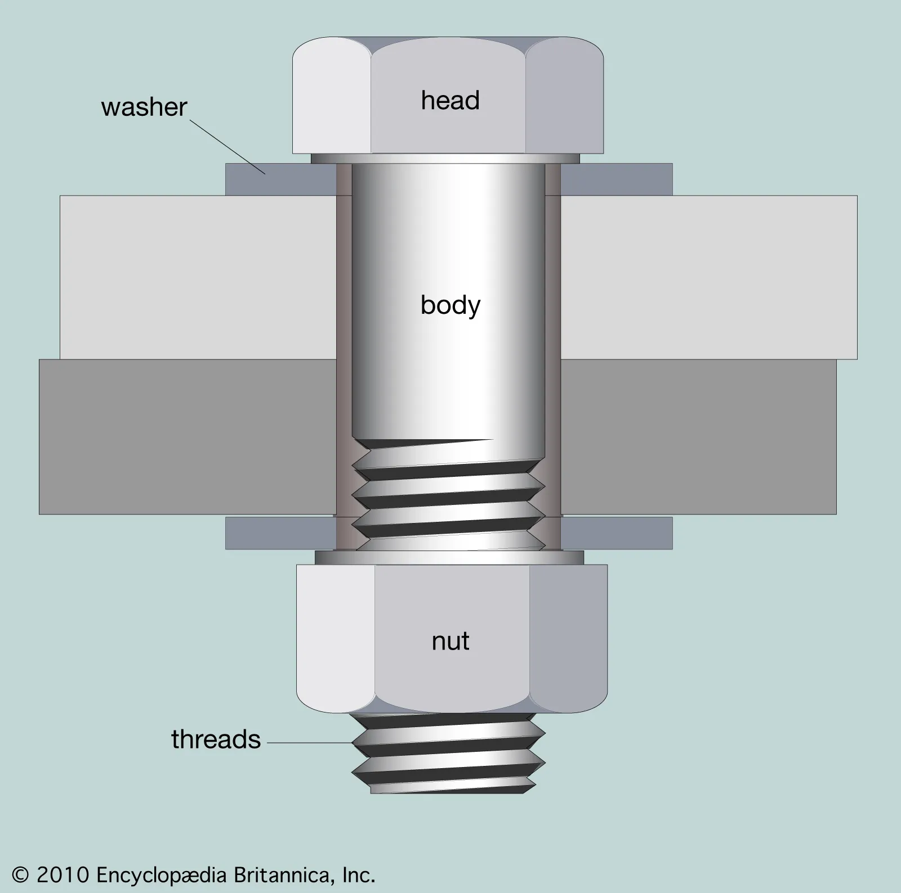
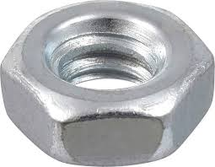
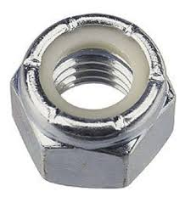
Nuts for Screws
Meant to secure material with screw
Nyloc Nut
  Screw that stays in place better
  Nylon collar
Notes:
Srini

Slide 5
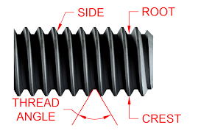
Threading
What makes a screw and nut work
  Nuts are made so they can slide into the threading
  NOT ALL SCREWS HAVE THE SAME THREADING!!!
    Different threads per inch(TPI)
    E.g. Metric screw and Imperial screw might seem similar, but they could have different TPIs
Notes:
Anish

Slide 6

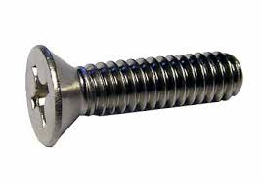
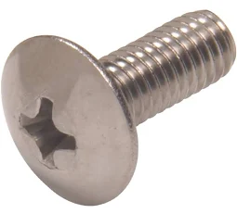
Common Screws in FRC
#10-32
  #10 stands for width
  32 is its Threads per Inch(TPI)
#8-32
¼ inch-20
  Width of screw head is ¼ inch
  20 TPI
Notes:
Srini

