Slide 1
Electrical and Assembly Workshops
Week 2

Slide 2
Today’s Agenda
Continue electronic components
Start building gearbox/frame for kitbot
Kahoot

Slide 3

Assembly

Slide 4
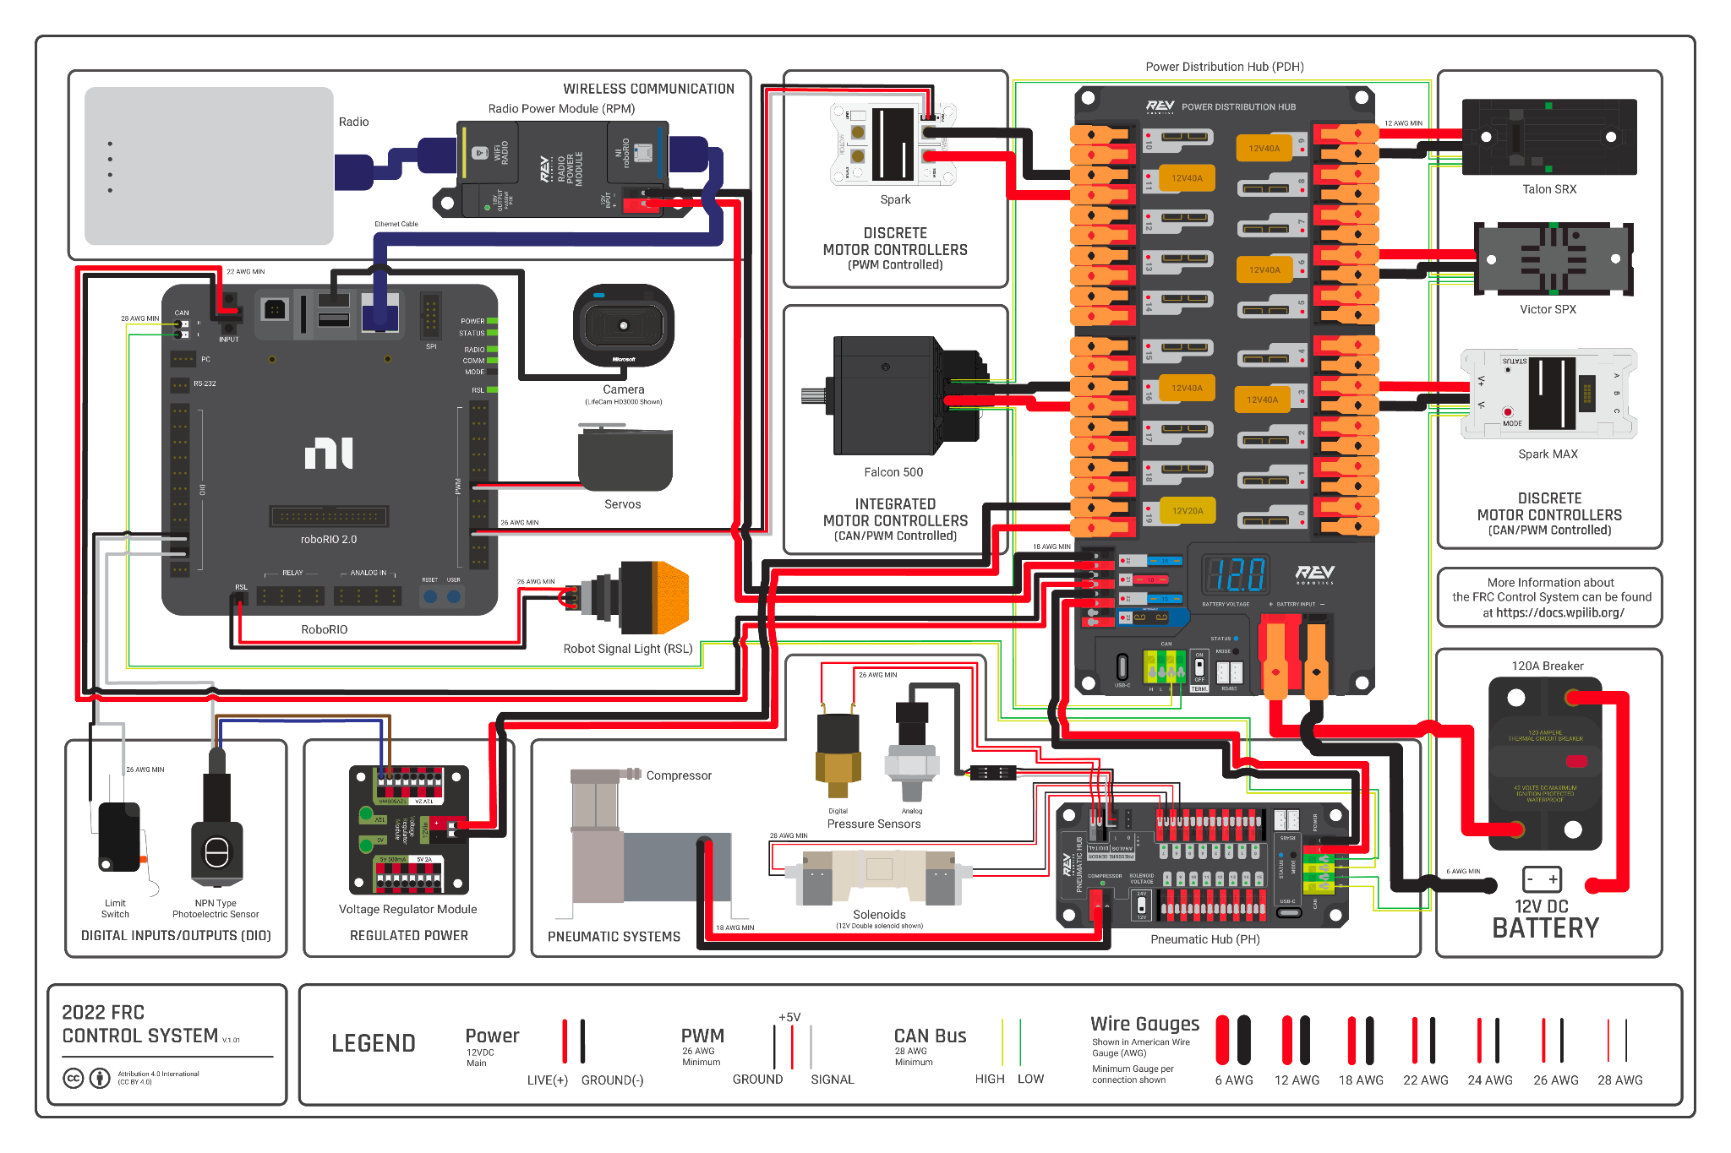

Slide 5
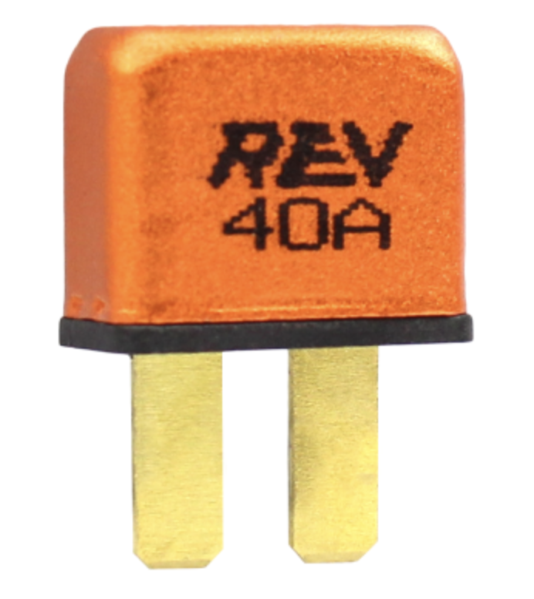
Fuses and Breakers
Required on the PDP
Limits current to branch circuits
  Prevents Fires
Fuses are one time use but breakers can be reused
Breakers use a bi-metallic sandwich!
Bi-metal sandwichmetals heat up at different rates causing it to bend and “trip

Slide 6
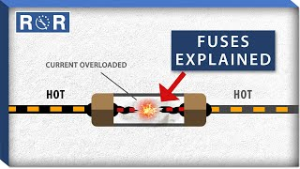
Fuses

Slide 7
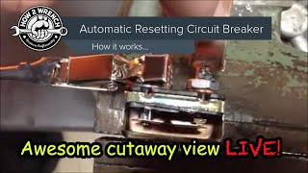
Breakers

Slide 8
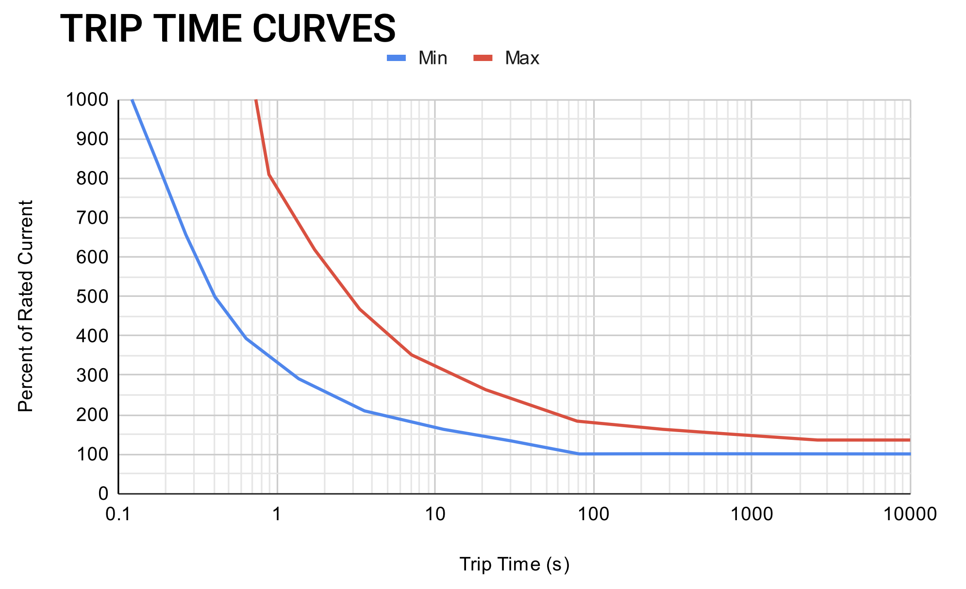
Fuses and Breakers

Slide 9
Wire Gauges

Slide 10
Wire Gauges
FRC manual requires certain gauges for certain current ratings
Higher gauge wire is more resistive

Slide 12
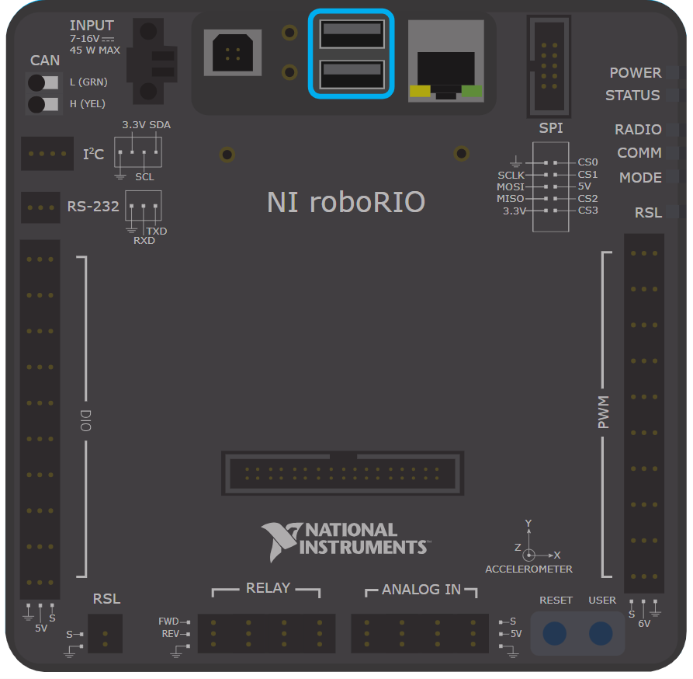
RoboRio
Main robot controller
  “Brain of the robot”
Runs code that controls electronic speed controllers
Connects sensors
Allows (FMS) to disable robot
Notes:
zachary

Slide 14
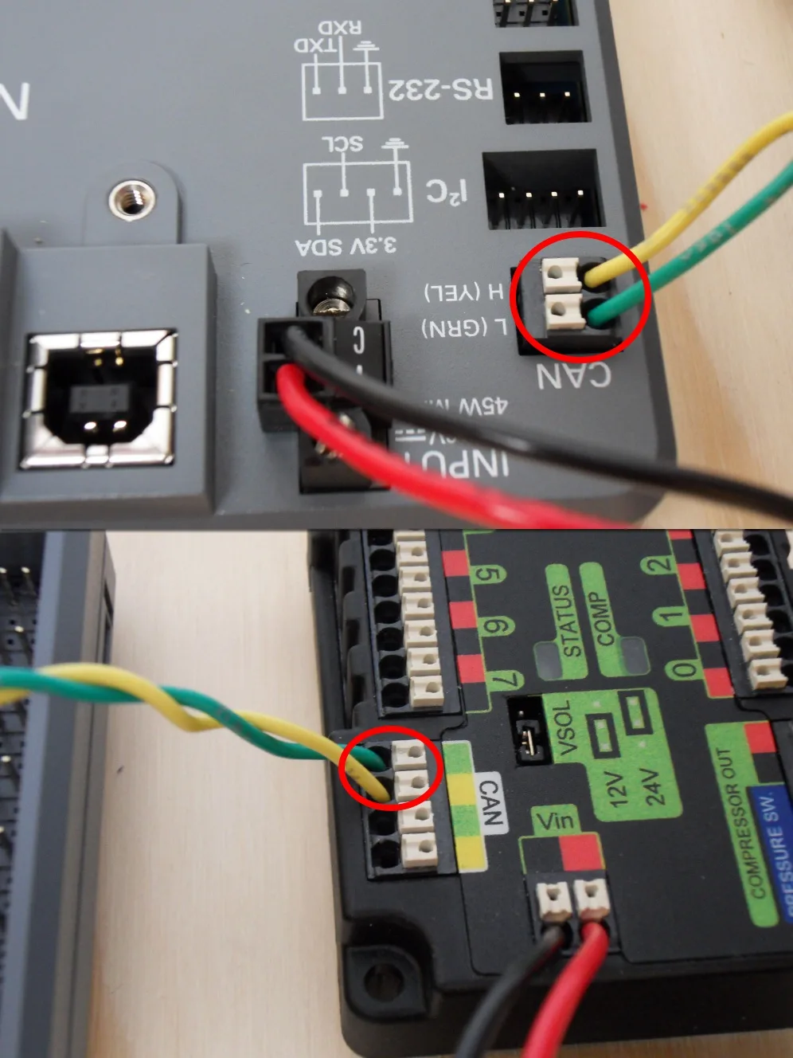
CAN Wires
Generally yellow and green
Lets components communicate with each other
“Daisy chained”
No main controller (every connected device can “talk”)

Slide 16
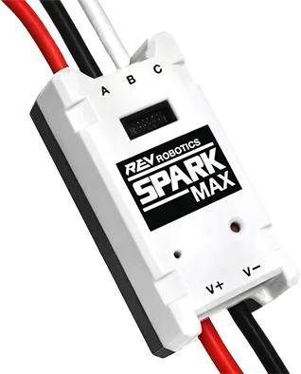
Electronic Speed Controller (ESC)
Controls power going to motors
  Roborio does not directly supply power
Notes:
zachary

Slide 17
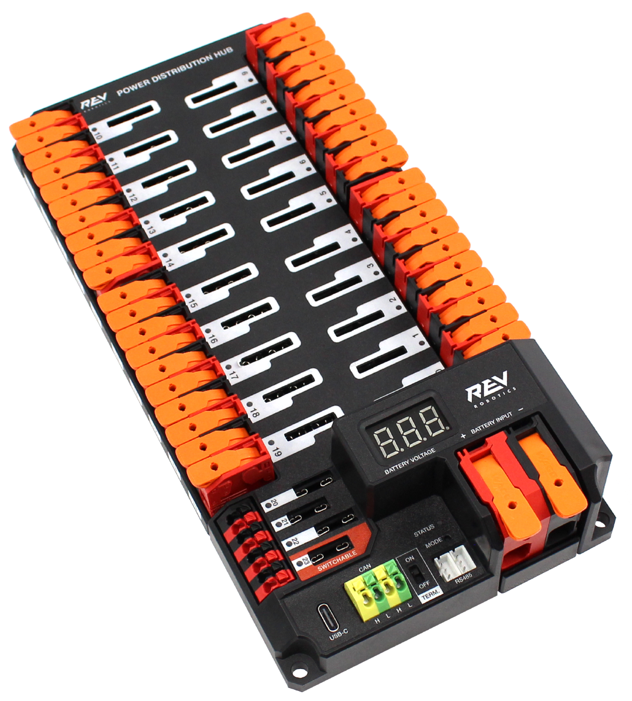
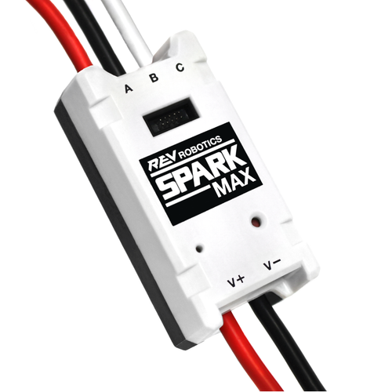
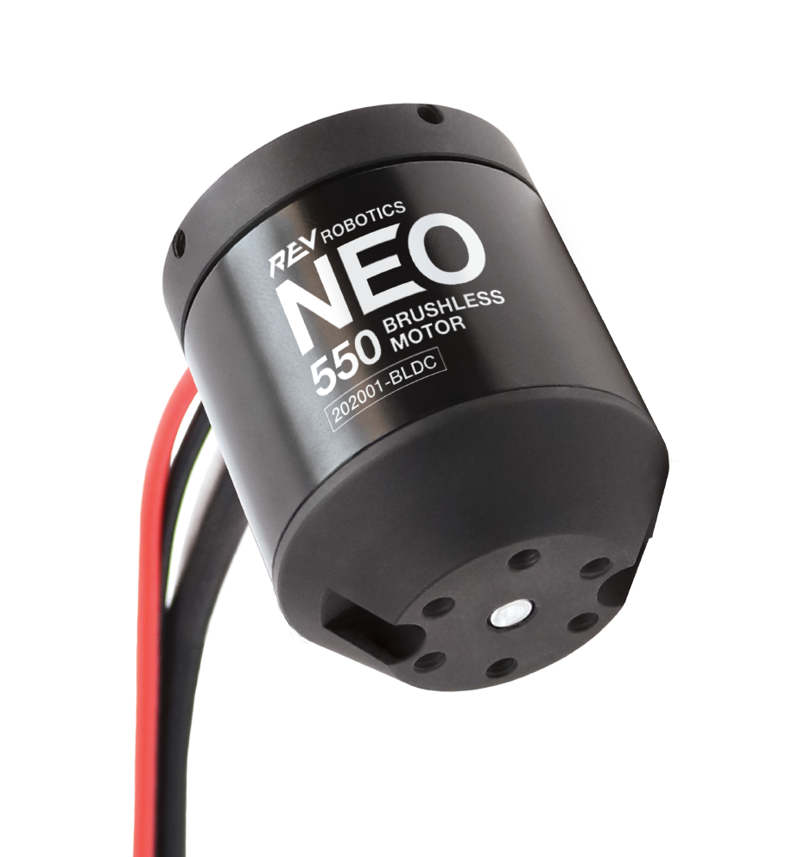
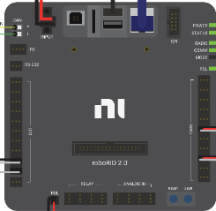
PDP
Motor Controller
Motor
Notes:
zachary

Slide 18
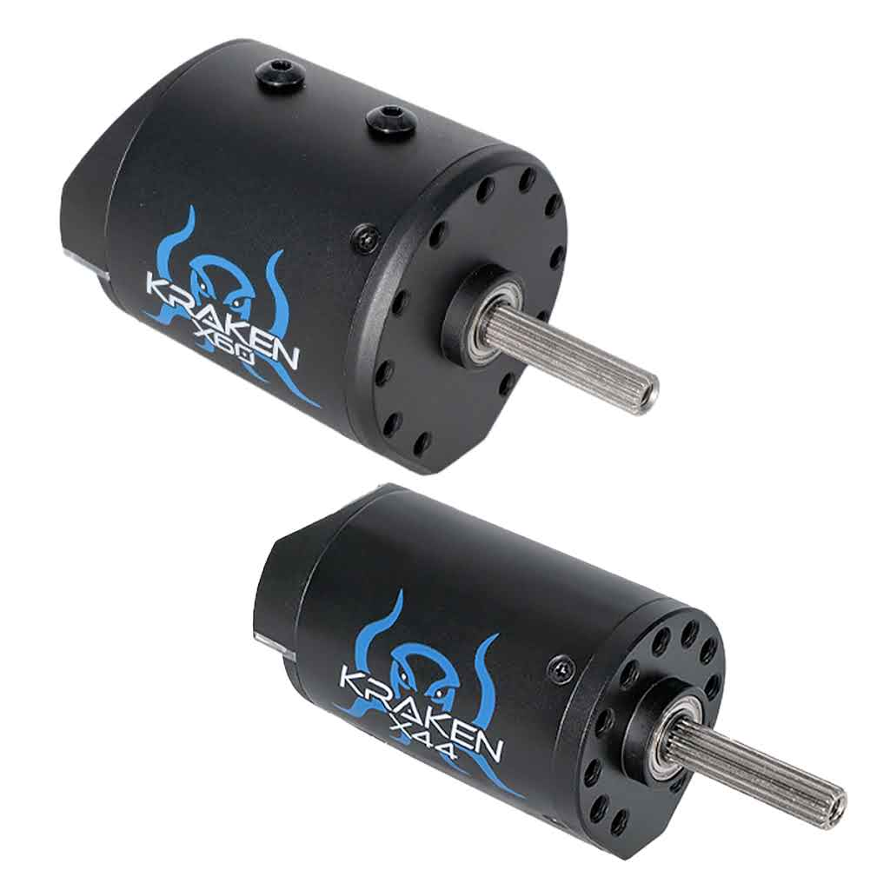
Motors
  Brushed and Brushless
  Create magnetic fields to turn
Notes:
zachary

Slide 19
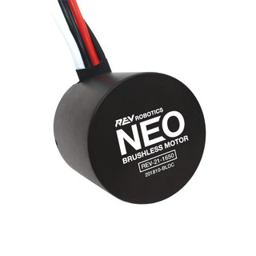
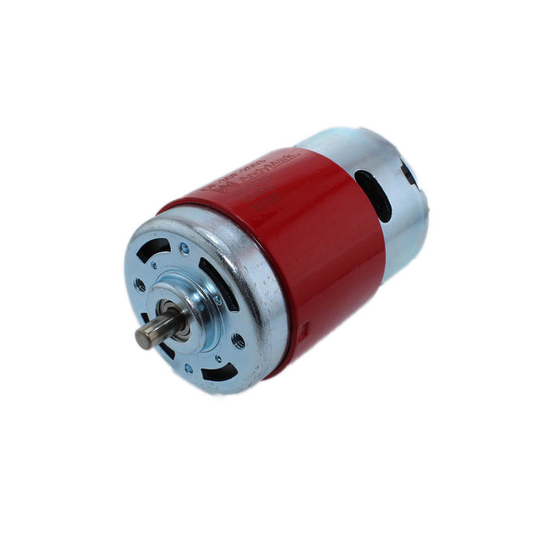
DC PM Motors
Direct Current Permanent Magnet
Brushed Motor
Brushless Motor
AndyMark 775
REV NEO Brushless Motor
Notes:
Rhea
dcpm - permanent magnets on the stationary part (stator) to create the magnetic field, rather than using wire coils to generate an electromagnet
There are two types of motors that you can use, a brushed motor like the AndyMark 775, and a brushless motor, like a REV NEO.
AndyMark 775
REV NEO Brushless Motor

Slide 20
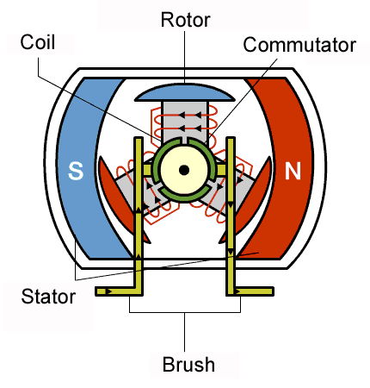
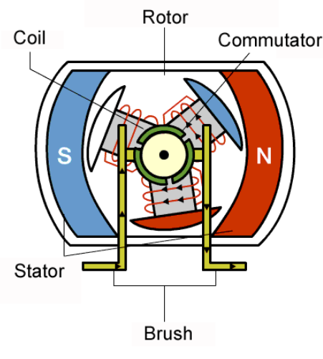
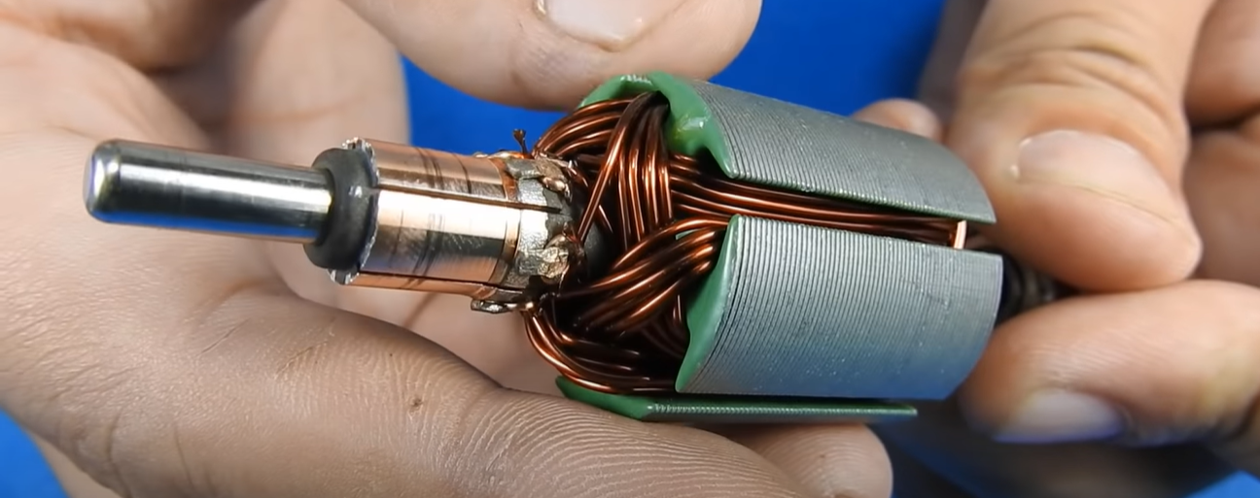
775 Brushed Motor Teardown
Notes:
Rhea
Let’s take a look at how a brushed motor works.
The outer part, or the can, has two stationary magnets on the outside to create a magnetic field.
On the inside, there is a spinning component called the rotor which rotates and converts electrical energy into mechanical energy. (due to changing magnetic fields, which induce electrical current)
The brushes, which are what makes it a brushed motor, supply current to the commutator. When putting the current through the coils, two of them become north while one becomes south, attracting each one to its counterparts on the outside.
However, once its aligned, the rotor will stop spinning. That means we have to reverse the polarity of the current using the commutator which makes the rotor continue to spin.

Slide 21
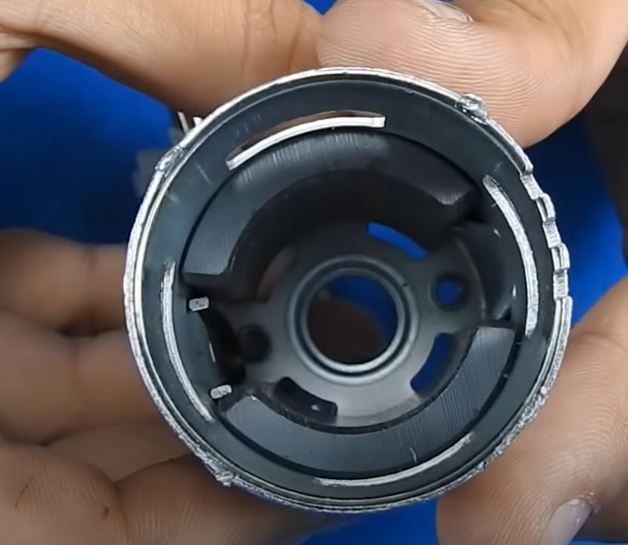
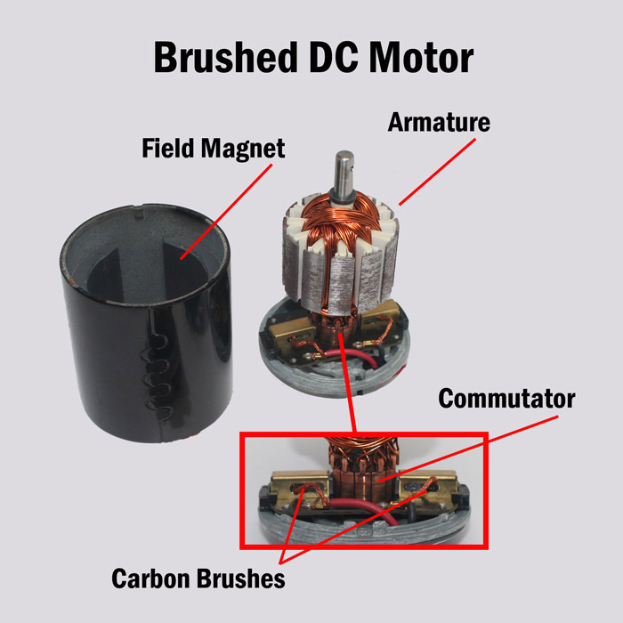
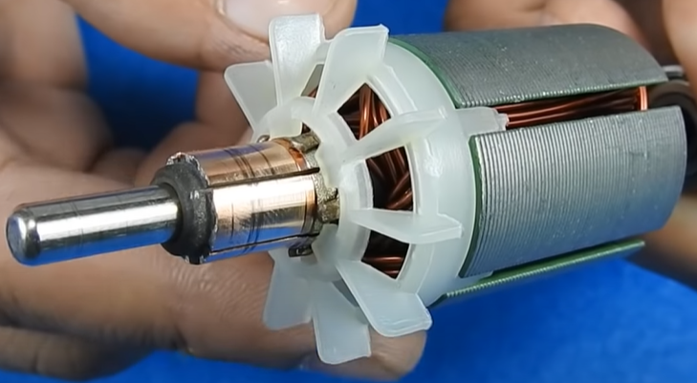
775 Brushed Motor Teardown
Notes:
Rhea
https://www.youtube.com/watch?v=peGZkxusheI
https://fuelab.com/n-56-fuel-pump-motor-technology-brushed-dc-motors-vs-brushless-dc-motors.html
Here’s a closer look at some of the parts– the can over here with the two stationary magnets which holds the rotor and wires inside.

Slide 22
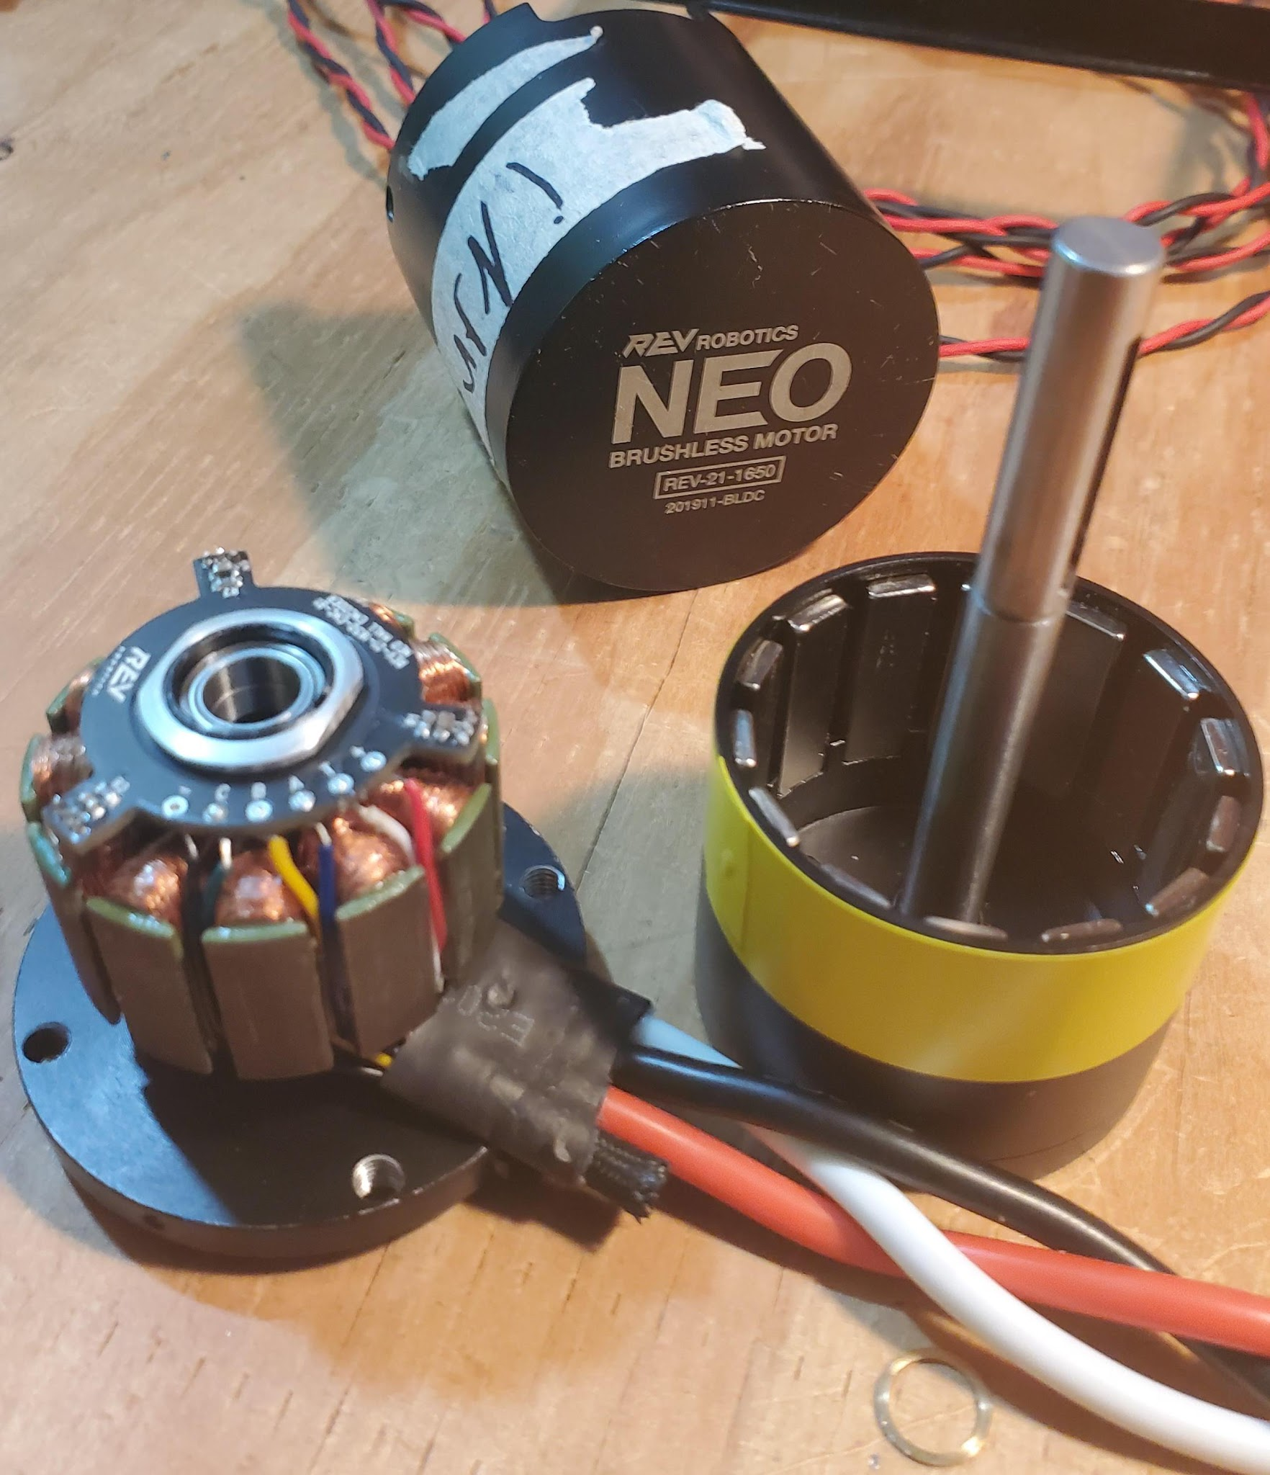
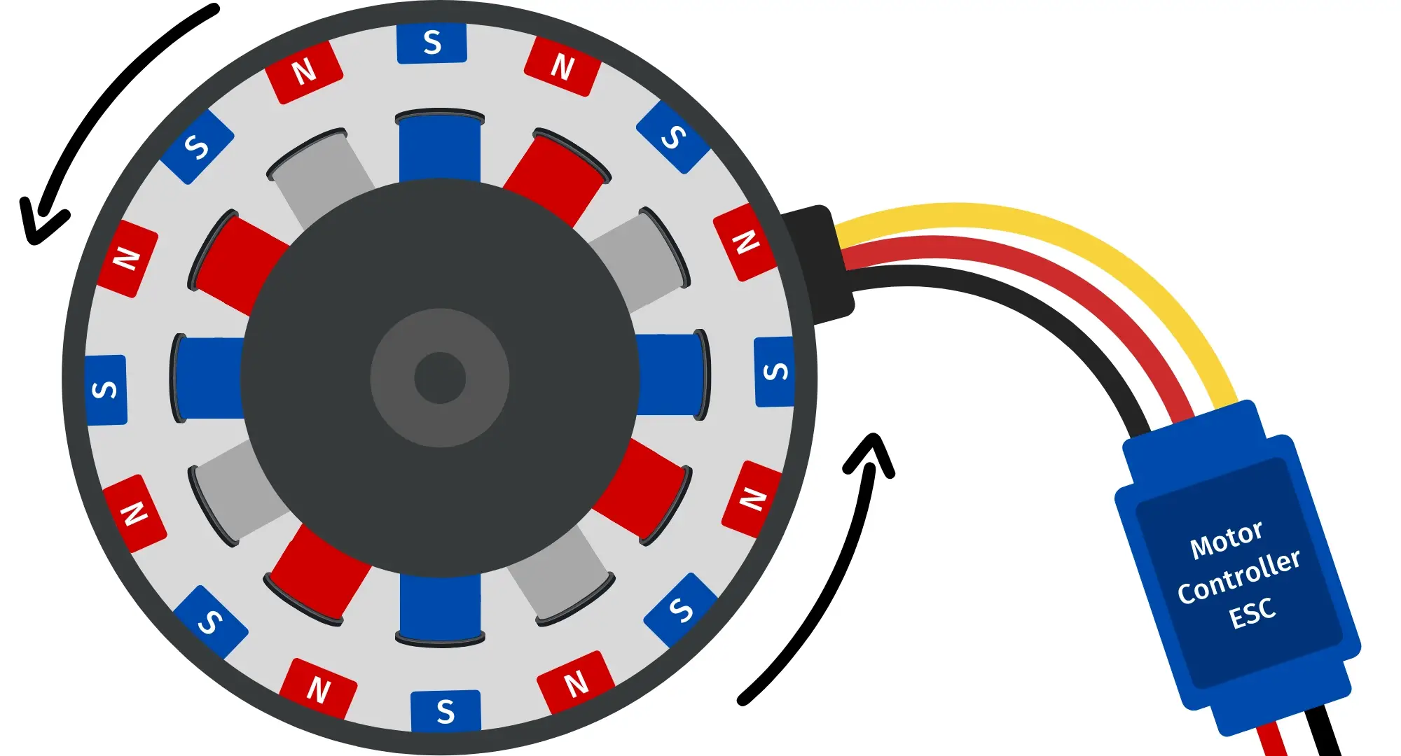
REV NEO Brushless Motor Teardown
field rotates
Credit: u/igoet999ninja24 at Reddit.com
Notes:
Rhea
Now let’s take a look at how brushLESS motors work. Instead of the rotor spinning on the inside like a brushed motor, the field, the outer part, rotates in a brushless motor.
It also has a hall effect sensor, which, as you might remember, detects the magnetic field created by the stationary magnets so that when the rotor turns, the current flowing to the coils is adjusted.
However, you will need an electronic speed controller, ESC, to switch the current from stator to stator.

Slide 24
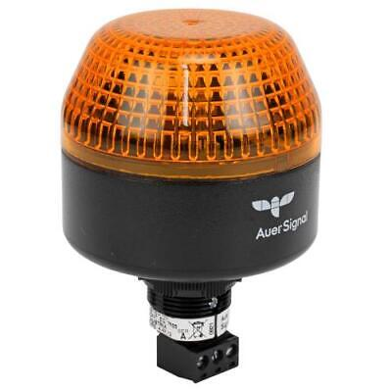
Robot Signal Light (RSL)
Signals when robot is enabled/disabled
Required by FRC
Controlled by the roboRio

Slide 26
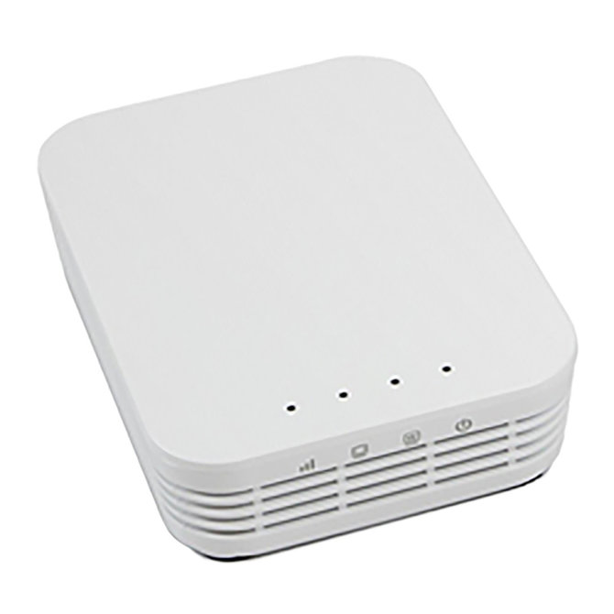
Radio
Relays information from driver station

Slide 27

Attendance
https://forms.gle/rTMyHsAMij66RHNv9

